Slide 1
Designing Global Supply Chain Networks
6

Slide 2
Learning Objectives
Identify factors that need to be included in total cost when making global sourcing decisions.
Define uncertainties that are particularly relevant when designing global supply chains.
Explain different strategies that may be used to mitigate risk in global supply chains.
Understand decision tree methodologies used to evaluate supply chain design decisions under uncertainty.

Slide 3
Impact of Globalization on Supply Chain Networks
Opportunities to simultaneously grow revenues and decrease costs
Accompanied by significant additional risk
Difference between success and failure often ability to incorporate suitable risk mitigation into supply chain design
Uncertainty of demand and price drives the value of building flexible production capacity

Slide 4
Impact of Globalization on Supply Chain Networks
Risk Factors | Percentage of Supply Chains Impacted
Natural disasters | 35
Shortage of skilled resources | 24
Geopolitical uncertainty | 20
Terrorist infiltration of cargo | 13
Volatility of fuel prices | 37
Currency fluctuation | 29
Port operations/custom delays | 23
Customer/consumer preference shifts | 23
Performance of supply chain partners | 38
Logistics capacity/complexity | 33
Forecasting/planning accuracy | 30
Supplier planning/communication issues | 27
Inflexible supply chain technology | 21
Table 6-1

Slide 5
The Offshoring Decision: Total Cost
Comparative advantage in global supply chains
Quantify the benefits of offshore production along with the reasons
Two reasons offshoring fails
  Focusing exclusively on unit cost rather than total cost
  Ignoring critical risk factors

Slide 6
The Offshoring Decision: Total Cost
Performance Dimension | Activity Impacting Performance | Impact of Offshoring
Order communication | Order placement | More difficult communication
Supply chain visibility | Scheduling and expediting | Poorer visibility
Raw material costs | Sourcing of raw material | Could go either way depending on raw material sourcing
Unit cost | Production, quality (production and transportation) | Labor/fixed costs decrease; quality may suffer
Freight costs | Transportation modes and quantity | Higher freight costs
Taxes and tariffs | Border crossing | Could go either way
Supply lead time | Order communication, supplier production scheduling, production time, customs, transportation, receiving | Lead time increase results in poorer forecasts and higher inventories
Table 6-2

Slide 7
The Offshoring Decision: Total Cost
Performance Dimension | Activity Impacting Performance | Impact of Offshoring
On-time delivery/lead time uncertainty | Production, quality, customs, transportation, receiving | Poorer on-time delivery and increased uncertainty resulting in higher inventory and lower product availability
Minimum order quantity | Production, transportation | Larger minimum quantities increase inventory
Product returns | Quality | Increased returns likely
Inventories | Lead times, inventory in transit and production | Increase
Working capital | Inventories and financial reconciliation | Increase
Hidden costs | Order communication, invoicing errors, managing exchange rate risk | Higher hidden costs
Stock-outs | Ordering, production, transportation with poorer visibility | Increase
Table 6-2

Slide 8
The Offshoring Decision: Total Cost
A global supply chain with offshoring increases the length and duration of information, product, and cash flows
The complexity and cost of managing the supply chain can be significantly higher than anticipated
Quantify factors and track them over time
Big challenges with offshoring is increased risk and its potential impact on cost

Slide 9
The Offshoring Decision: Total Cost
Key elements of total cost
  Supplier price
  Terms
  Delivery costs
  Inventory and warehousing
  Cost of quality
  Customer duties, value added-taxes, local tax incentives
  Cost of risk, procurement staff, broker fees, infrastructure, and tooling and mold costs
  Exchange rate trends and their impact on cost

Slide 10
Risk Management In
Global Supply Chains
Risks include supply disruption, supply delays, demand fluctuations, price fluctuations, and exchange-rate fluctuations
Critical for global supply chains to be aware of the relevant risk factors and build in suitable mitigation strategies

Slide 11
Risk Management In
Global Supply Chains
Category | Risk Drivers
Disruptions | Natural disaster, war, terrorism Labor disputes Supplier bankruptcy
Delays | High capacity utilization at supply source Inflexibility of supply source Poor quality or yield at supply source
Systems risk | Information infrastructure breakdown System integration or extent of systems being networked
Forecast risk | Inaccurate forecasts due to long lead times, seasonality, product variety, short life cycles, small customer base Information distortion
Table 6-3

Slide 12
Risk Management In
Global Supply Chains
Category | Risk Drivers
Intellectual property risk | Vertical integration of supply chain Global outsourcing and markets
Procurement risk | Exchange-rate risk Price of inputs Fraction purchased from a single source Industry-wide capacity utilization
Receivables risk | Number of customers Financial strength of customers
Inventory risk | Rate of product obsolescence Inventory holding cost Product value Demand and supply uncertainty
Capacity risk | Cost of capacity Capacity flexibility
Table 6-3

Slide 13
Risk Management In
Global Supply Chains
Good network design can play a significant role in mitigating supply chain risk
Every mitigation strategy comes at a price and may increase other risks
Global supply chains should generally use a combination of rigorously evaluated mitigation strategies along with financial strategies to hedge uncovered risks

Slide 14
Risk Management In
Global Supply Chains
Risk Mitigation Strategy | Tailored Strategies
Increase capacity | Focus on low-cost, decentralized capacity for predictable demand. Build centralized capacity for unpredictable demand. Increase decentralization as cost of capacity drops.
Get redundant suppliers | More redundant supply for high-volume products, less redundancy for low-volume products. Centralize redundancy for low-volume products in a few flexible suppliers.
Increase responsiveness | Favor cost over responsiveness for commodity products. Favor responsiveness over cost for short–life cycle products.
Table 6-4

Slide 15
Risk Management In
Global Supply Chains
Risk Mitigation Strategy | Tailored Strategies
Increase inventory | Decentralize inventory of predictable, lower value products. Centralize inventory of less predictable, higher value products.
Increase flexibility | Favor cost over flexibility for predictable, high-volume products. Favor flexibility for unpredictable, low-volume products. Centralize flexibility in a few locations if it is expensive.
Pool or aggregate demand | Increase aggregation as unpredictability grows.
Increase source capability | Prefer capability over cost for high-value, high-risk products. Favor cost over capability for low-value commodity products. Centralize high capability in flexible source if possible.
Table 6-4

Slide 16
Flexibility, Chaining, and Containment
Three broad categories of flexibility
  New product flexibility
    Ability to introduce new products into the market at a rapid rate
  Mix flexibility
    Ability to produce a variety of products within a short period of time
  Volume flexibility
    Ability to operate profitably at different levels of output

Slide 17
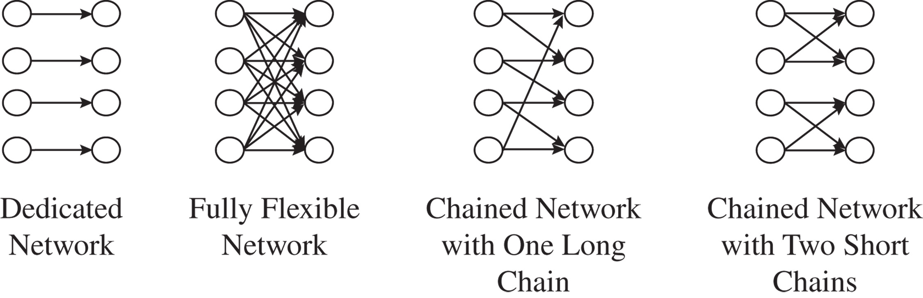
Flexibility, Chaining, and Containment
Figure 6-1

Slide 18
Flexibility, Chaining, and Containment
As flexibility is increased, the marginal benefit derived from the increased flexibility decreases
  With demand uncertainty, longer chains pool available capacity
  Long chains may have higher fixed cost than multiple smaller chains
  Coordination more difficult across with a single long chain
Flexibility and chaining are effective when dealing with demand fluctuation but less effective when dealing with supply disruption

Slide 19
Discounted Cash Flow Analysis
Supply chain decisions should be evaluated as a sequence of cash flows over time
Discounted cash flow (DCF) analysis evaluates the present value of any stream of future cash flows and allows managers to compare different cash flow streams in terms of their financial value
Based on the time value of money – a dollar today is worth more than a dollar tomorrow

Slide 20
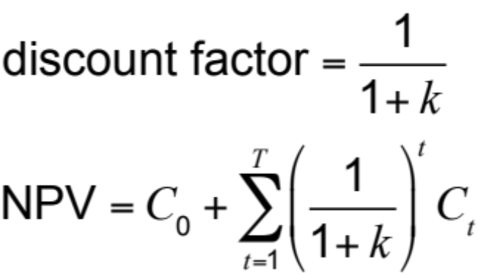
Discounted Cash Flow Analysis
where
C₀, C₁,…,C_{T} is stream of cash flows over T periods
NPV = net present value of this stream
k = rate of return
Compare NPV of different supply chain design options
The option with the highest NPV will provide the greatest financial return

Slide 21
Trips Logistics Example
Demand = 100,000 units
1,000 sq. ft. of space for every 1,000 units of demand
Revenue = $1.22 per unit of demand
Sign a three-year lease or obtain warehousing space on the spot market?
Three-year lease cost = $1 per sq. ft.
Spot market cost = $1.20 per sq. ft.
k = 0.1

Slide 22
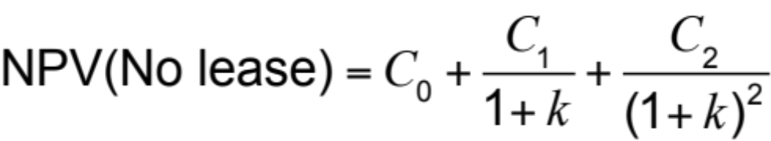
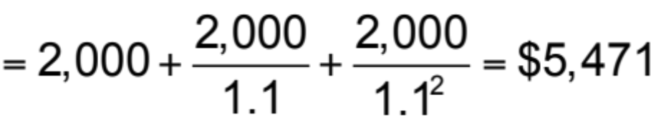
Trips Logistics Example
Expected annual profit if warehouse space is obtained from the spot market | = = | 100,000 x $1.22 – 100,000 x $1.20 $2,000

Slide 23
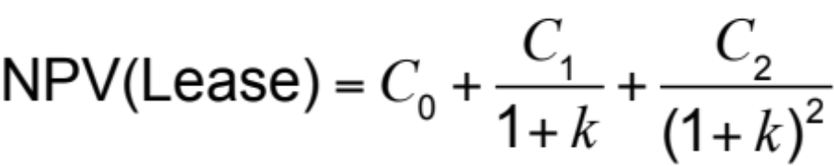
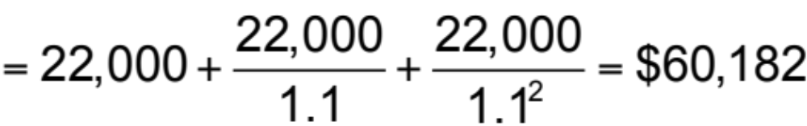
Trips Logistics Example
Expected annual profit with three year lease | = = | 100,000 x $1.22 – 100,000 x $1.00 $22,000
NPV of signing lease is $60,182 – $5,471 = $54,711 higher than spot market

Slide 24
Using Decision Trees
Many different decisions
  Should the firm sign a long-term contract for warehousing space or get space from the spot market as needed?
  What should the firm’s mix of long-term and spot market be in the portfolio of transportation capacity?
  How much capacity should various facilities have? What fraction of this capacity should be flexible?

Slide 25
Using Decision Trees
During network design, managers need a methodology that allows them to estimate the uncertainty in demand and price forecast and incorporate this in the decision-making process
Most important for network design decisions because they are hard to change in the short term

Slide 26
Basics of Decision Tree Analysis
A decision tree is a graphic device used to evaluate decisions under uncertainty
  Identify the number and duration of time periods that will be considered
  Identify factors that will affect the value of the decision and are likely to fluctuate over the time periods
  Evaluate decision using a decision tree

Slide 27
Decision Tree Methodology
Identify the duration of each period (month, quarter, etc.) and the number of periods T over which the decision is to be evaluated
Identify factors whose fluctuation will be considered
Identify representations of uncertainty for each factor
Identify the periodic discount rate k for each period
Represent the decision tree with defined states in each period as well as the transition probabilities between states in successive periods
Starting at period T, work back to Period 0, identifying the optimal decision and the expected cash flows at each step

Slide 28
Decision Tree – Trips Logistics
Three warehouse lease options
  Get all warehousing space from the spot market as needed
  Sign a three-year lease for a fixed amount of warehouse space and get additional requirements from the spot market
  Sign a flexible lease with a minimum charge that allows variable usage of warehouse space up to a limit with additional requirement from the spot market

Slide 29
Decision Tree – Trips Logistics
1000 sq. ft. of warehouse space needed for 1000 units of demand
Current demand = 100,000 units per year
Binomial uncertainty: Demand can go up by 20% with
p = 0.5 or down by 20% with 1 – p = 0.5
Lease price = $1.00 per sq. ft. per year
Spot market price = $1.20 per sq. ft. per year
Spot prices can go up by 10% with p = 0.5 or down by 10% with 1 – p = 0.5
Revenue = $1.22 per unit of demand
k = 0.1

Slide 30
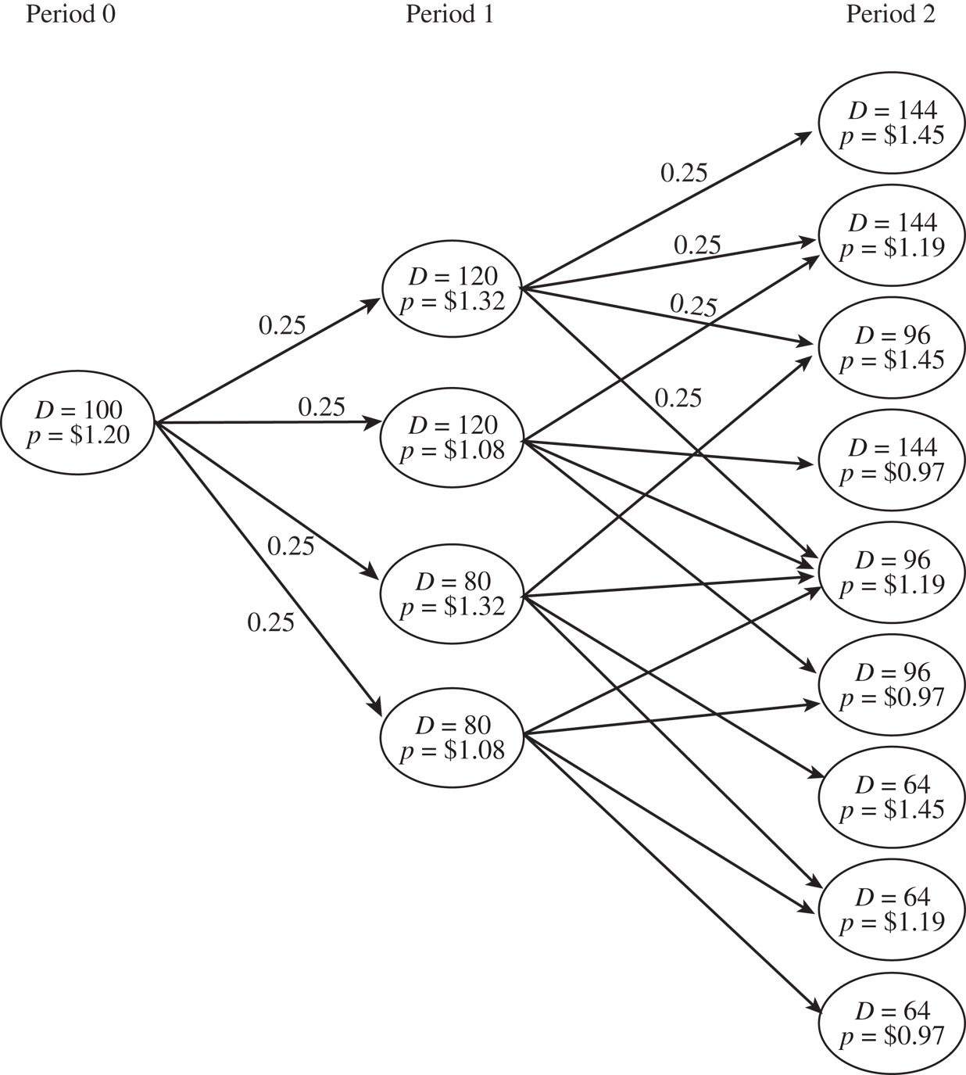
Decision Tree
Figure 6-2

Slide 31
Decision Tree – Trips Logistics
Analyze the option of not signing a lease and using the spot market
Start with Period 2 and calculate the profit at each node
For D = 144, p = $1.45, in Period 2:
C(D = 144, p = 1.45,2) = 144,000 x 1.45
= $208,800
P(D = 144, p = 1.45,2) = 144,000 x 1.22
– C(D = 144, p = 1.45, 2)
= 175,680 – 208,800
= –$33,120

Slide 32
Decision Tree – Trips Logistics
 | Revenue | Cost C(D =, p =, 2) | Profit P(D =, p =, 2)
D = 144, p = 1.45 | 144,000 × 1.22 | 144,000 × 1.45 | –$33,120
D = 144, p = 1.19 | 144,000 × 1.22 | 144,000 × 1.19 | $4,320
D = 144, p = 0.97 | 144,000 × 1.22 | 144,000 × 0.97 | $36,000
D = 96, p = 1.45 | 96,000 × 1.22 | 96,000 × 1.45 | –$22,080
D = 96, p = 1.19 | 96,000 × 1.22 | 96,000 × 1.19 | $2,880
D = 96, p = 0.97 | 96,000 × 1.22 | 96,000 × 0.97 | $24,000
D = 64, p = 1.45 | 64,000 × 1.22 | 64,000 × 1.45 | –$14,720
D = 64, p = 1.19 | 64,000 × 1.22 | 64,000 × 1.19 | $1,920
D = 64, p = 0.97 | 64,000 × 1.22 | 64,000 × 0.97 | $16,000
Table 6-5

Slide 33
Decision Tree – Trips Logistics
Expected profit at each node in Period 1 is the profit during Period 1 plus the present value of the expected profit in Period 2
Expected profit EP(D =, p =, 1) at a node is the expected profit over all four nodes in Period 2 that may result from this node
PVEP(D =, p =, 1) is the present value of this expected profit and P(D =, p =, 1), and the total expected profit, is the sum of the profit in Period 1 and the present value of the expected profit in Period 2

Slide 34
Decision Tree – Trips Logistics
From node D = 120, p = $1.32 in Period 1, there are four possible states in Period 2
Evaluate the expected profit in Period 2 over all four states possible from node D = 120, p = $1.32 in Period 1 to be
EP(D = 120, p = 1.32,1) = 0.2 x [P(D = 144, p = 1.45,2) +
P(D = 144, p = 1.19,2) +
P(D = 96, p = 1.45,2) +
P(D = 96, p = 1.19,2)
= 0.25 x [–33,120 + 4,320 –
22,080 + 2,880
= –$12,000

Slide 35
Decision Tree – Trips Logistics
The present value of this expected value in Period 1 is
PVEP(D = 120, p = 1.32,1) = EP(D = 120, p = 1.32,1) / (1 + k)
= –$12,000 / (1.1)
= –$10,909
The total expected profit P(D = 120, p = 1.32,1) at node D = 120, p = 1.32 in Period 1 is the sum of the profit in Period 1 at this node, plus the present value of future expected profits possible from this node
P(D = 120, p = 1.32,1) = 120,000 x 1.22 – 120,000 x 1.32 +
PVEP(D = 120, p = 1.32,1)
= –$12,000 – $10,909 = –$22,909

Slide 36
Decision Tree – Trips Logistics
For Period 0, the total profit P(D = 100, p = 120,0) is the sum of the profit in Period 0 and the present value of the expected profit over the four nodes in Period 1
EP(D = 100, p = 1.20,0) = 0.25 x [P(D = 120, p = 1.32,1) +
P(D = 120, p = 1.08,1) +
P(D = 96, p = 1.32,1) +
P(D = 96, p = 1.08,1)]
= 0.25 x [–22,909 + 32,073 –
15,273) + 21,382]
= $3,818

Slide 37
Decision Tree – Trips Logistics
PVEP(D = 100, p = 1.20,1) = EP(D = 100, p = 1.20,0) / (1 + k)
= $3,818 / (1.1) = $3,471
P(D = 100, p = 1.20,0) = 100,000 x 1.22 – 100,000 x 1.20 +
PVEP(D = 100, p = 1.20,0)
= $2,000 + $3,471 = $5,471
Therefore, the expected NPV of not signing the lease and obtaining all warehouse space from the spot market is given by NPV(Spot Market) = $5,471

Slide 38
Decision Tree – Trips Logistics
Fixed Lease Option
Node | EP(D =, p =, 1) | P(D =, p =, 1) = D x 1.22 – D x p + EP(D =, p =, 1) / (1 + k)
D = 120, p = 1.32 | 100,000 sq. ft. | –$22,909
D = 120, p = 1.08 | 100,000 sq. ft. | $32,073
D = 80, p = 1.32 | 100,000 sq. ft. | –$15,273
D = 80, p = 1.08 | 100,000 sq. ft. | $21,382
Table 6-6

Slide 39
Decision Tree – Trips Logistics
Node | Leased Space | Warehouse Space at Spot Price (S) | Profit P(D =, p =, 2) = D x 1.22 – (100,000 x 1 + S x p)
D = 144, p = 1.45 | 100,000 sq. ft. | 44,000 sq. ft. | $11,880
D = 144, p = 1.19 | 100,000 sq. ft. | 44,000 sq. ft. | $23,320
D = 144, p = 0.97 | 100,000 sq. ft. | 44,000 sq. ft. | $33,000
D = 96, p = 1.45 | 100,000 sq. ft. | 0 sq. ft. | $17,120
D = 96, p = 1.19 | 100,000 sq. ft. | 0 sq. ft. | $17,120
D = 96, p = 0.97 | 100,000 sq. ft. | 0 sq. ft. | $17,120
D = 64, p = 1.45 | 100,000 sq. ft. | 0 sq. ft. | –$21,920
D = 64, p = 1.19 | 100,000 sq. ft. | 0 sq. ft. | –$21,920
D = 64, p = 0.97 | 100,000 sq. ft. | 0 sq. ft. | –$21,920
Table 6-7

Slide 40
Decision Tree – Trips Logistics
Node | EP(D =, p =, 1) | Warehouse Space at Spot Price (S) | P(D =, p =, 1) = D x 1.22 – (100,000 x 1 + S x p) + EP(D =, p = ,1)(1 + k)
D = 120, p = 1.32 | 0.25 x [P(D = 144, p = 1.45,2) + P(D = 144, p = 1.19,2) + P(D = 96, p = 1.45,2) + P(D = 96, p = 1.19,2)] = 0.25 x (11,880 + 23,320 + 17,120 + 17,120) = $17,360 | 20,000 | $35,782
D = 120, p = 1.08 | 0.25 x (23,320 + 33,000 + 17,120 + 17,120) = $22,640 | 20,000 | $45,382
D = 80, p = 1.32 | 0.25 x (17,120 + 17,120 – 21,920 – 21,920) = –$2,400 | 0 | –$4,582
D = 80, p = 1.08 | 0.25 x (17,120 + 17,120 – 21,920 – 21,920) = –$2,400 | 0 | –$4,582
Table 6-8

Slide 41
Decision Tree – Trips Logistics
Using the same approach for the lease option, NPV(Lease) = $38,364
Recall that when uncertainty was ignored, the NPV for the lease option was $60,182
However, the manager would probably still prefer to sign the three-year lease for 100,000 sq. ft. because this option has the higher expected profit

Slide 42
Decision Tree – Trips Logistics
Flexible Lease Option
Node | Warehouse Space at $1 (W) | Warehouse Space at Spot Price (S) | Profit P(D =, p =, 2) = D x 1.22 – (W x 1 + S x p)
D = 144, p = 1.45 | 100,000 sq. ft. | 44,000 sq. ft. | $11,880
D = 144, p = 1.19 | 100,000 sq. ft. | 44,000 sq. ft. | $23,320
D = 144, p = 0.97 | 100,000 sq. ft. | 44,000 sq. ft. | $33,000
D = 96, p = 1.45 | 96,000 sq. ft. | 0 sq. ft. | $21,120
D = 96, p = 1.19 | 96,000 sq. ft. | 0 sq. ft. | $21,120
D = 96, p = 0.97 | 96,000 sq. ft. | 0 sq. ft. | $21,120
D = 64, p = 1.45 | 64,000 sq. ft. | 0 sq. ft. | $14,080
D = 64, p = 1.19 | 64,000 sq. ft. | 0 sq. ft. | $14,080
D = 64, p = 0.97 | 64,000 sq. ft. | 0 sq. ft. | $14,080
Table 6-9

Slide 43
Decision Tree – Trips Logistics
Node | EP(D =, p =, 1) | Warehouse Space at $1 (W) | Warehouse Space at Spot Price (S) | P(D =, p =, 1) = D x 1.22 – (W x 1 + S x p) + EP(D =, p = ,1)(1 + k)
D = 120, p = 1.32 | 0.25 x (11,880 + 23,320 + 21,120 + 21,120) = $19,360 | 100,000 | 20,000 | $37,600
D = 120, p = 1.08 | 0.25 x (23,320 + 33,000 + 21,120 + 21,120) = $24,640 | 100,000 | 20,000 | $47,200
D = 80, p = 1.32 | 0.25 x (21,120 + 21,120 + 14,080 + 14,080) = $17,600 | 80,000 | 0 | $33,600
D = 80, p = 1.08 | 0.25 x (21,920 + 21,920 + 14,080 + 14,080) = $17,600 | 80,000 | 0 | $33,600
Table 6-10

Slide 44
Decision Tree – Trips Logistics
Option | Value
All warehouse space from the spot market | $5,471
Lease 100,000 sq. ft. for three years | $38,364
Flexible lease to use between 60,000 and 100,000 sq. ft. | $46,545
Table 6-11

Slide 45
Onshore or Offshore
D-Solar demand in Europe = 100,000 panels per year
Each panel sells for €70
Annual demand may increase by 20 percent with probability 0.8 or decrease by 20 percent with probability 0.2
Build a plant in Europe or China with a rated capacity of 120,000 panels

Slide 46
D-Solar Decision
European Plant |  |  | Chinese Plant
Fixed Cost (euro) | Variable Cost (euro) |  | Fixed Cost (yuan) | Variable Cost (yuan)
1 million/year | 40/panel |  | 8 million/year | 340/panel
Table 6-12
Period 1 |  |  | Period 2
Demand | Exchange Rate |  | Demand | Exchange Rate
112,000 | 8.64 yuan/euro |  | 125,440 | 8.2944 yuan/euro
Table 6-13

Slide 47
D-Solar Decision
European plant has greater volume flexibility
Increase or decrease production between 60,000 to 150,000 panels
Chinese plant has limited volume flexibility
Can produce between 100,000 and 130,000 panels
Chinese plant will have a variable cost for 100,000 panels and will lose sales if demand increases above 130,000 panels
Yuan, currently 9 yuan/euro, expected to rise 10%, probability of 0.7 or drop 10%, probability of 0.3
Sourcing decision over the next three years
Discount rate k = 0.1

Slide 48
D-Solar Decision
Period 0 profits = 100,000 x 70 – 1,000,000 – 100,000 x 40 = €2,000,000
Period 1 profits = 112,000 x 70 – 1,000,000 – 112,000 x 40 = €2,360,000
Period 2 profits = 125,440 x 70 – 1,000,000 – 125,440 x 40 = €2,763,200
Expected profit from onshoring = 2,000,000 + 2,360,000/1.1 +
2,763,200/1.21
= €6,429,091
Period 0 profits = 100,000 x 70 – 8,000,000/9 – 100,000 x 340/9
= €2,333,333
Period 1 profits = 112,000 x 70 – 8,000,000/8.64 – 112,000 x 340/8.64
= €2,506,667
Period 2 profits = 125,440 x 70 – 8,000,000/7.9524 – 125,440 x 340/7.9524 = €2,674,319
Expected profit from off-shoring = 2,333,333 + 2,506,667/1.1 +
2,674,319/1.21
= €6,822,302

Slide 49
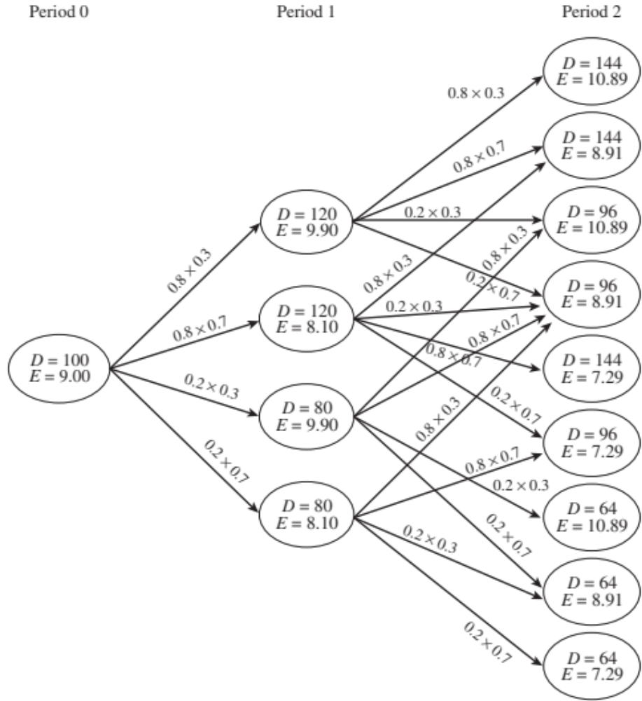
Decision Tree
Figure 6-3

Slide 50
D-Solar Decision
Period 2 evaluation – onshore
Revenue from the manufacture
and sale of 144,000 panels = 144,000 x 70
= €10,080,000
Fixed + variable cost
of onshore plant = 1,000,000 + 144,000 x 40
= €6,760,000
P(D = 144, E = 10.89,2) = 10,080,000 – 6,760,000
= €3,320,000

Slide 51
D-Solar Decision
D | E | Sales | Production Cost Quantity | Revenue (euro) | Cost (euro) | Profit (euro)
144 | 10.89 | 144,000 | 144,000 | 10,080,000 | 6,760,000 | 3,320,000
144 | 8.91 | 144,000 | 144,000 | 10,080,000 | 6,760,000 | 3,320,000
96 | 10.89 | 96,000 | 96,000 | 6,720,000 | 4,840,000 | 1,880,000
96 | 8.91 | 96,000 | 96,000 | 6,720,000 | 4,840,000 | 1,880,000
144 | 7.29 | 144,000 | 144,000 | 10,080,000 | 6,760,000 | 3,320,000
96 | 7.29 | 96,000 | 96,000 | 6,720,000 | 4,840,000 | 1,880,000
64 | 10.89 | 64,000 | 64,000 | 4,480,000 | 3,560,000 | 920,000
64 | 8.91 | 64,000 | 64,000 | 4,480,000 | 3,560,000 | 920,000
64 | 7.29 | 64,000 | 64,000 | 4,480,000 | 3,560,000 | 920,000
Table 6-14

Slide 52
D-Solar Decision
Period 1 evaluation – onshore
EP(D = 120, E = 9.90, 1) = 0.24 x P(D = 144, E = 10.89, 2) +
0.56 x P(D = 144, E = 8.91, 2) +
0.06 x P(D = 96, E = 10.89, 2) +
0.14 x P(D = 96, E = 8.91, 2)
= 0.24 x 3,320,000 + 0.56 x 3,320,000 +
0.06 x 1,880,000 + 0.14 x 1,880,000
= €3,032,000
PVEP(D = 120, E = 9.90,1) = EP(D = 120, E = 9.90,1)/(1 + k)
= 3,032,000/1.1 = €2,756,364

Slide 53
D-Solar Decision
Period 1 evaluation – onshore
Revenue from manufacture
and sale of 120,000 panels = 120,000 x 70 = €8,400,000
Fixed + variable cost of onshore plant = 1,000,000 + 120,000 x 40
= €5,800,000
P(D = 120, E = 9.90, 1) = 8,400,000 – 5,800,000 +
PVEP(D = 120, E = 9.90, 1)
= 2,600,000 + 2,756,364
= €5,356,364

Slide 54
D-Solar Decision
D | E | Sales | Production Cost Quantity | Revenue (euro) | Cost (euro) | Profit (euro)
120 | 9.90 | 120,000 | 120,000 | 8,400,000 | 5,800,000 | 5,356,364
120 | 8.10 | 120,000 | 120,000 | 8,400,000 | 5,800,000 | 5,356,364
80 | 9.90 | 80,000 | 80,000 | 5,600,000 | 4,200,000 | 2,934,545
80 | 8.10 | 80,000 | 80,000 | 5,600,000 | 4,200,000 | 2,934,545
Table 6-15

Slide 55
D-Solar Decision
Period 0 evaluation – onshore
EP(D = 100, E = 9.00, 1) = 0.24 x P(D = 120, E = 9.90, 1) +
0.56 x P(D = 120, E = 8.10, 1) +
0.06 x P(D = 80, E = 9.90, 1) +
0.14 x P(D = 80, E = 8.10, 1)
= 0.24 x 5,356,364 + 0.56 x 5,5356,364 +
0.06 x 2,934,545 + 0.14 x 2,934,545
= € 4,872,000
PVEP(D = 100, E = 9.00,1) = EP(D = 100, E = 9.00,1)/(1 + k)
= 4,872,000/1.1 = €4,429,091

Slide 56
D-Solar Decision
Period 0 evaluation – onshore
Revenue from manufacture
and sale of 100,000 panels = 100,000 x 70 = €7,000,000
Fixed + variable cost of onshore plant = 1,000,000 + 100,000 x 40
= €5,000,000
P(D = 100, E = 9.00, 1) = 8,400,000 – 5,800,000 +
PVEP(D = 100, E = 9.00, 1)
= 2,000,000 + 4,429,091
= €6,429,091

Slide 57
D-Solar Decision
Period 2 evaluation – offshore
Revenue from the manufacture
and sale of 130,000 panels = 130,000 x 70
= €9,100,000
Fixed + variable cost
of offshore plant = 8,000,000 + 130,000 x 340
= 52,200,000 yuan
P(D = 144, E = 10.89,2) = 9,100,000 – 52,200,000/10.89
= €4,306,612

Slide 58
D-Solar Decision
D | E | Sales | Production Cost Quantity | Revenue (euro) | Cost (yuan) | Profit (euro)
144 | 10.89 | 130,000 | 130,000 | 9,100,000 | 52,200,000 | 4,306,612
144 | 8.91 | 130,000 | 130,000 | 9,100,000 | 52,200,000 | 3,241,414
96 | 10.89 | 96,000 | 100,000 | 6,720,000 | 42,000,000 | 2,863,251
96 | 8.91 | 96,000 | 100,000 | 6,720,000 | 42,000,000 | 2,006,195
144 | 7.29 | 130,000 | 130,000 | 9,100,000 | 52,200,000 | 1,939,506
96 | 7.29 | 96,000 | 100,000 | 6,720,000 | 42,000,000 | 958,683
64 | 10.89 | 64,000 | 100,000 | 4,480,000 | 42,000,000 | 623,251
64 | 8.91 | 64,000 | 100,000 | 4,480,000 | 42,000,000 | –233,805
64 | 7.29 | 64,000 | 10,000 | 4,480,000 | 3,560,000 | –1,281,317
Table 6-16

Slide 59
D-Solar Decision
Period 1 evaluation – offshore
EP(D = 120, E = 9.90, 1) = 0.24 x P(D = 144, E = 10.89, 2) +
0.56 x P(D = 144, E = 8.91, 2) +
0.06 x P(D = 96, E = 10.89, 2) +
0.14 x P(D = 96, E = 8.91, 2)
= 0.24 x 4,306,612 + 0.56 x 3,241,414 +
0.06 x 2,863,251 + 0.14 x 2,006,195
= € 3,301,441
PVEP(D = 120, E = 9.90,1) = EP(D = 120, E = 9.90,1)/(1 + k)
= 3,301,441/1.1 = €3,001,310

Slide 60
D-Solar Decision
Period 1 evaluation – offshore
Revenue from manufacture
and sale of 120,000 panels = 120,000 x 70 = €8,400,000
Fixed + variable cost of offshore plant = 8,000,000 + 120,000 x 340
= 48,800,000 yuan
P(D = 120, E = 9.90, 1) = 8,400,000 – 48,800,000/9.90 +
PVEP(D = 120, E = 9.90, 1)
= 3,470,707 + 3,001,310
= €6,472,017

Slide 61
D-Solar Decision
D | E | Sales | Production Cost Quantity | Revenue (euro) | Cost (yuan) | Expected Profit (euro)
120 | 9.90 | 120,000 | 120,000 | 8,400,000 | 48,800,000 | 6,472,017
120 | 8.10 | 120,000 | 120,000 | 8,400,000 | 48,800,000 | 4,301,354
80 | 9.90 | 80,000 | 100,000 | 5,600,000 | 42,000,000 | 3,007,859
80 | 8.10 | 80,000 | 100,000 | 5,600,000 | 42,000,000 | 1,164,757
Table 6-17

Slide 62
D-Solar Decision
Period 0 evaluation – offshore
EP(D = 100, E = 9.00, 1) = 0.24 x P(D = 120, E = 9.90, 1) +
0.56 x P(D = 120, E = 8.10, 1) +
0.06 x P(D = 80, E = 9.90, 1) +
0.14 x P(D = 80, E = 8.10, 1)
= 0.24 x 6,472,017 + 0.56 x 4,301,354
+ 0.06 x 3,007,859 + 0.14 x 1,164,757
= € 4,305,580
PVEP(D = 100, E = 9.00,1) = EP(D = 100, E = 9.00,1)/(1 + k)
= 4,305,580/1.1 = €3,914,164

Slide 63
D-Solar Decision
Period 0 evaluation – offshore
Revenue from manufacture
and sale of 100,000 panels = 100,000 x 70 = €7,000,000
Fixed + variable cost of onshore plant = 8,000,000 + 100,000 x 340
= €42,000,000 yuan
P(D = 100, E = 9.00, 1) = 7,000,000 – 42,000,000/9.00 +
PVEP(D = 100, E = 9.00, 1)
= 2,333,333 + 3,914,164
= €6,247,497

Slide 64
Decisions Under Uncertainty
Combine strategic planning and financial planning during global network design
Use multiple metrics to evaluate global supply chain networks
Use financial analysis as an input to decision making, not as the decision-making process
Use estimates along with sensitivity analysis

Slide 65
Summary of Learning Objectives
Identify factors that need to be included in total cost when making global sourcing decisions
Define uncertainties that are particularly relevant when designing global supply chains
Explain different strategies that may be used to mitigate risk in global supply chains
Understand decision tree methodologies used to evaluate supply chain design decisions under uncertainty

Slide 66

All rights reserved. No part of this publication may be reproduced, stored in a retrieval system, or transmitted, in any form or by any means, electronic, mechanical, photocopying, recording, or otherwise, without the prior written permission of the publisher.
Printed in the United States of America.

