Slide 1
Demand Forecasting in a Supply Chain
7

Slide 2
Learning Objectives
Understand the role of forecasting for both an enterprise and a supply chain.
Identify the components of a demand forecast.
Forecast demand in a supply chain given historical demand data using time-series methodologies.
Analyze demand forecasts to estimate forecast error.

Slide 3
Role of Forecasting in a Supply Chain
The basis for all planning decisions in a supply chain
Used for both push and pull processes
  Production scheduling, inventory, aggregate planning
  Sales force allocation, promotions, new production introduction
  Plant/equipment investment, budgetary planning
  Workforce planning, hiring, layoffs
All of these decisions are interrelated

Slide 4
Characteristics of Forecasts
Forecasts are always inaccurate and should thus include both the expected value of the forecast and a measure of forecast error
Long-term forecasts are usually less accurate than short-term forecasts
Aggregate forecasts are usually more accurate than disaggregate forecasts
In general, the farther up the supply chain a company is, the greater is the distortion of information it receives

Slide 5
Components and Methods
Companies must identify the factors that influence future demand and then ascertain the relationship between these factors and future demand
  Past demand
  Lead time of product replenishment
  Planned advertising or marketing efforts
  Planned price discounts
  State of the economy
  Actions that competitors have taken
Notes:
Notes:

Slide 6
Components and Methods
Qualitative
  Primarily subjective
  Rely on judgment
Time Series
  Use historical demand only
  Best with stable demand
Causal
  Relationship between demand and some other factor
Simulation
  Imitate consumer choices that give rise to demand
Notes:
Notes:

Slide 7
Components of an Observation
Observed demand (O) = systematic component (S)
+ random component (R)
Systematic component – expected value of demand
  Level (current deseasonalized demand)
  Trend (growth or decline in demand)
  Seasonality (predictable seasonal fluctuation)
Random component – part of forecast that deviates from systematic component
Forecast error – difference between forecast and actual demand

Slide 8
Basic Approach
Understand the objective of forecasting.
Integrate demand planning and forecasting throughout the supply chain.
Identify the major factors that influence the demand forecast.
Forecast at the appropriate level of aggregation.
Establish performance and error measures for the forecast.
Notes:
Notes:

Slide 9
Time-Series Forecasting Methods
Three ways to calculate the systematic component
  Multiplicative
  S = level x trend x seasonal factor
  Additive
  S = level + trend + seasonal factor
  Mixed
  S = (level + trend) x seasonal factor

Slide 10
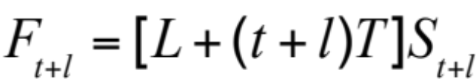
Static Methods
where
L = estimate of level at t = 0
T = estimate of trend
S_{t} = estimate of seasonal factor for Period t
D_{t} = actual demand observed in Period t
F_{t} = forecast of demand for Period t

Slide 11
Tahoe Salt
Year | Quarter | Period, t | Demand, D_{t}
1 | 2 | 1 | 8,000
1 | 3 | 2 | 13,000
1 | 4 | 3 | 23,000
2 | 1 | 4 | 34,000
2 | 2 | 5 | 10,000
2 | 3 | 6 | 18,000
2 | 4 | 7 | 23,000
3 | 1 | 8 | 38,000
3 | 2 | 9 | 12,000
3 | 3 | 10 | 13,000
3 | 4 | 11 | 32,000
4 | 1 | 12 | 41,000
Table 7-1

Slide 12
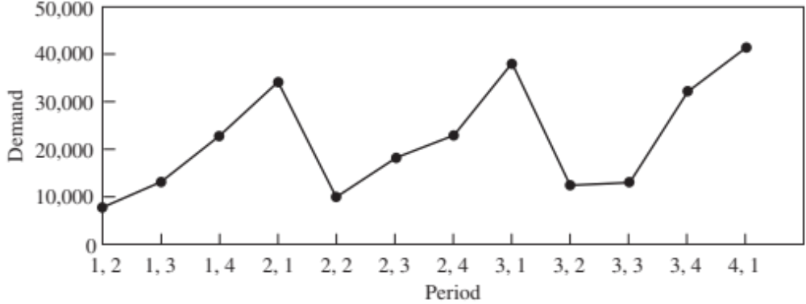
Tahoe Salt
Figure 7-1

Slide 13
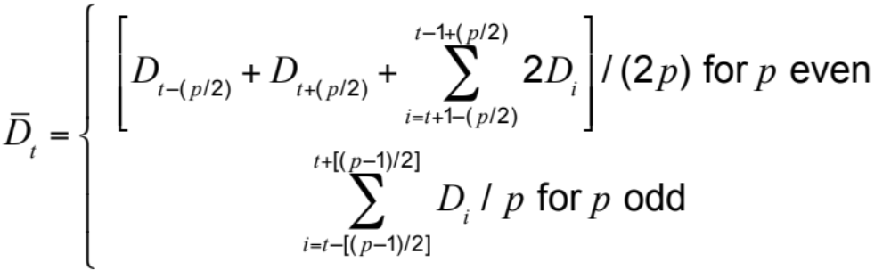
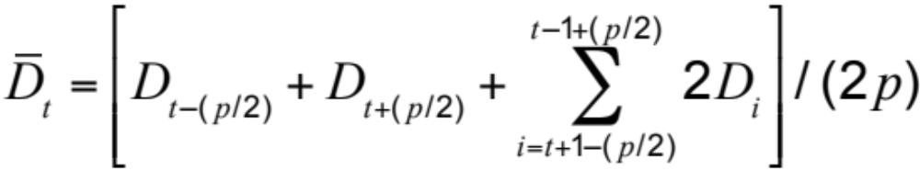
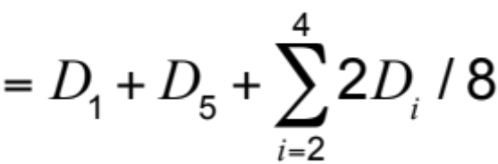
Estimate Level and Trend
Periodicity p = 4, t = 3
Notes:
Notes:

Slide 14
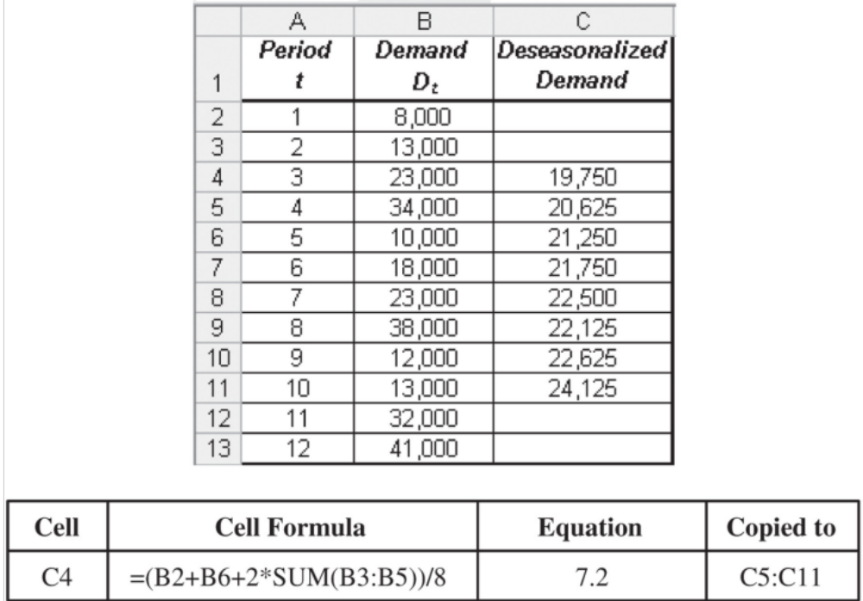
Tahoe Salt
Figure 7-2

Slide 15
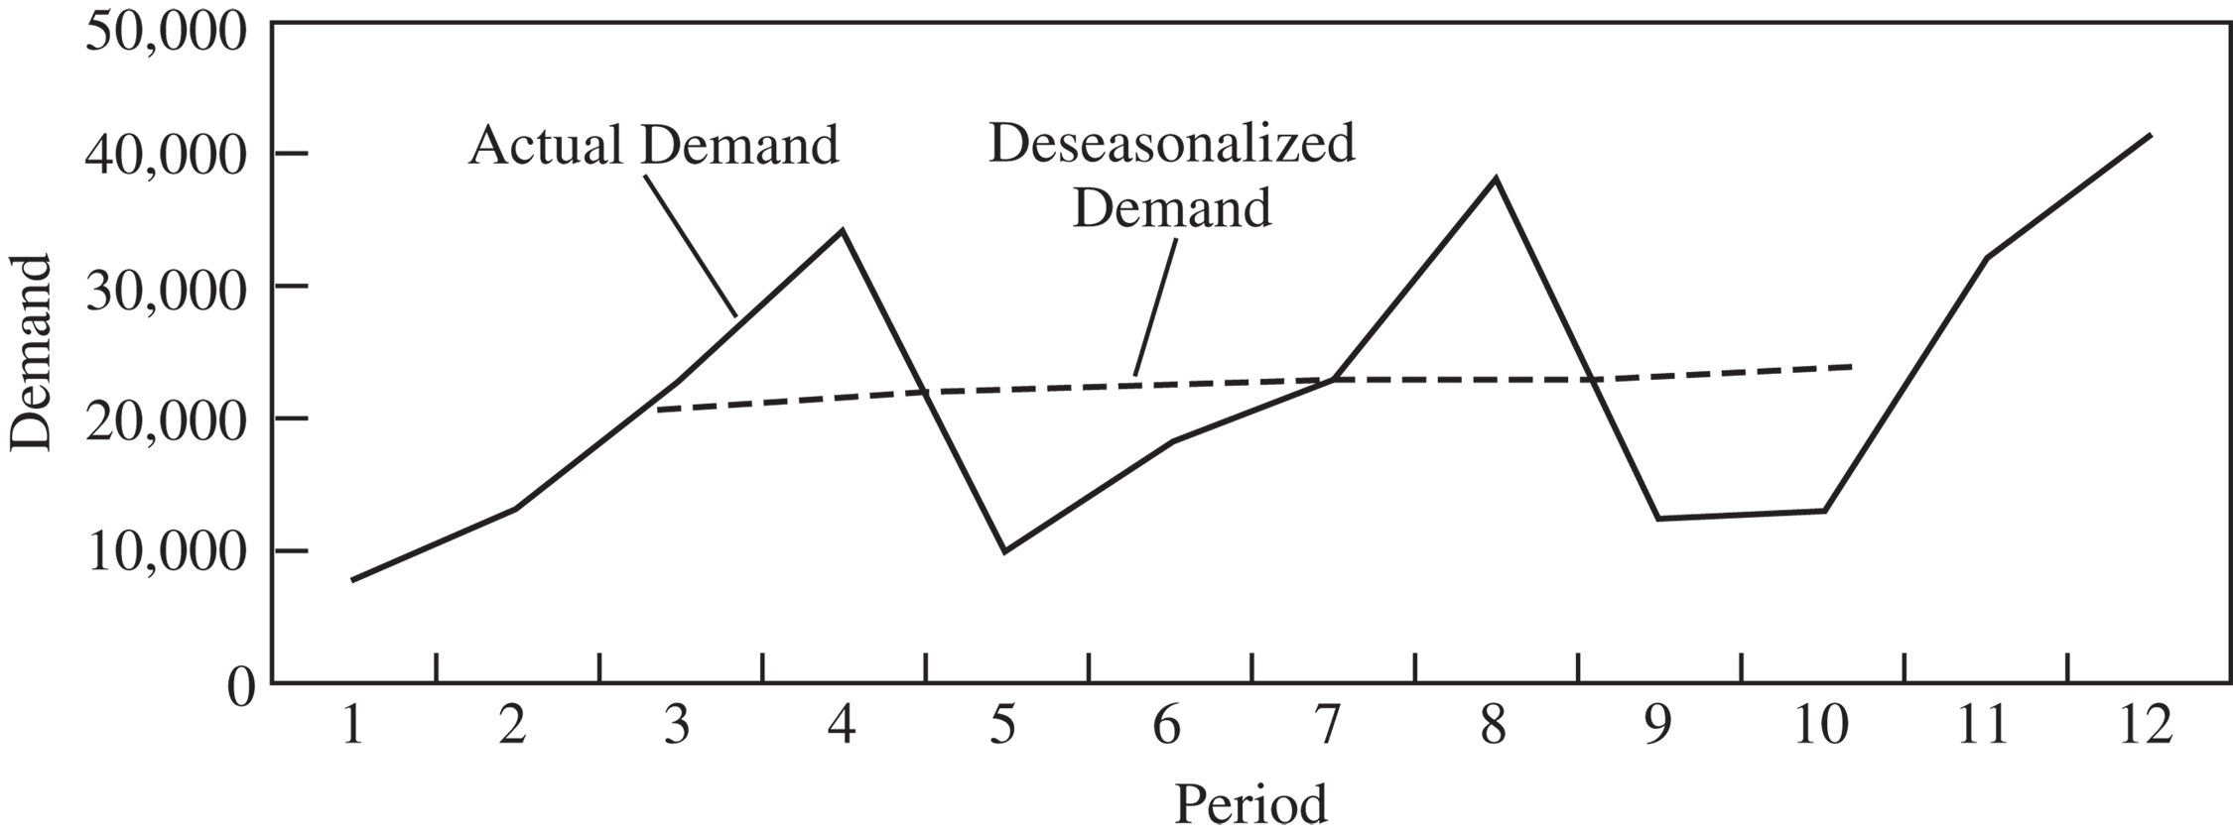

Tahoe Salt
Figure 7-3
A linear relationship exists between the deseasonalized demand and time based on the change in demand over time

Slide 16
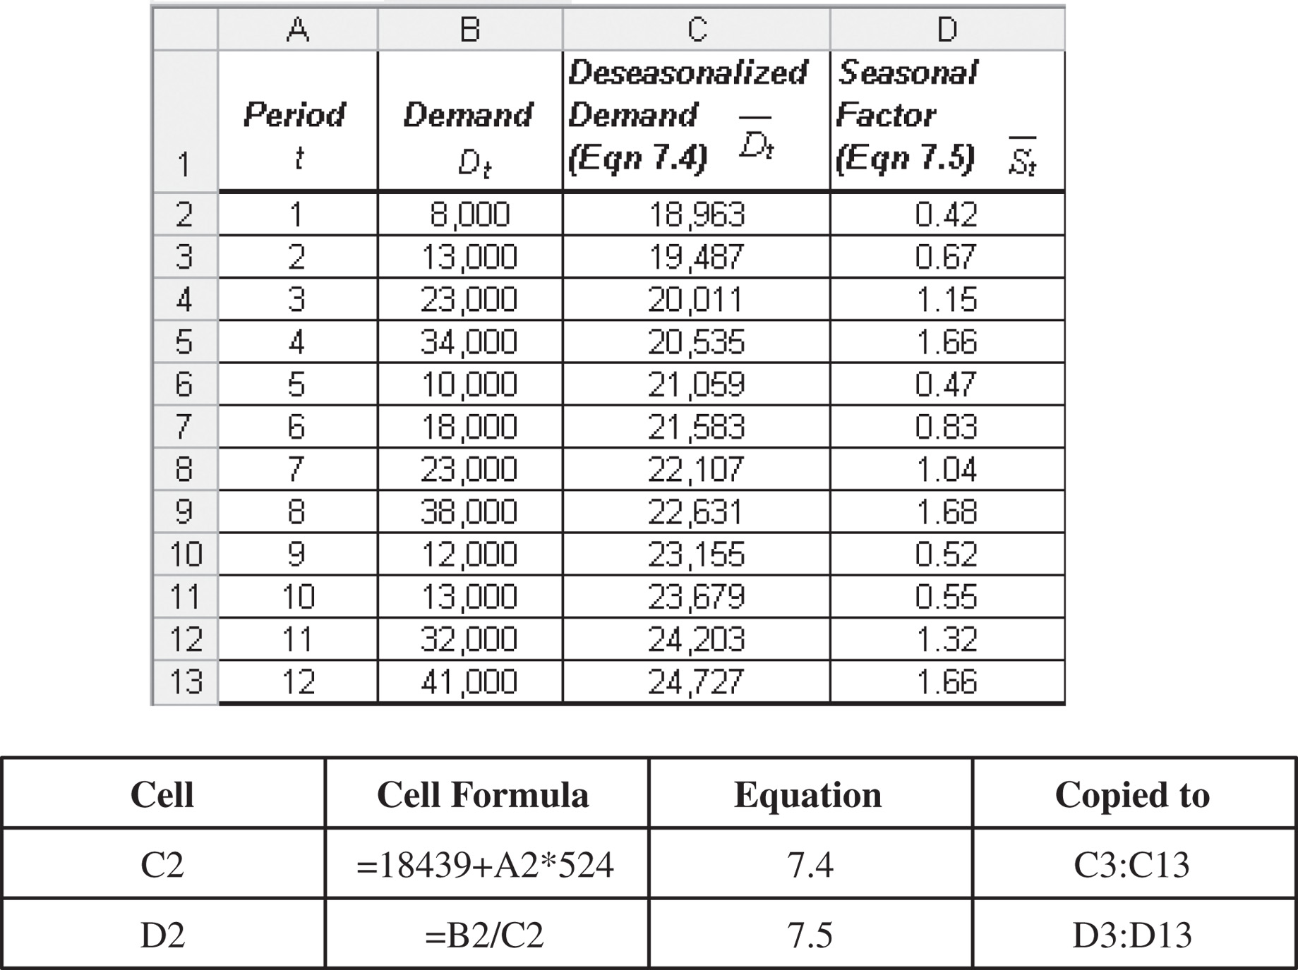
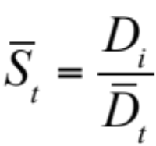
Estimating Seasonal Factors
Figure 7-4

Slide 17
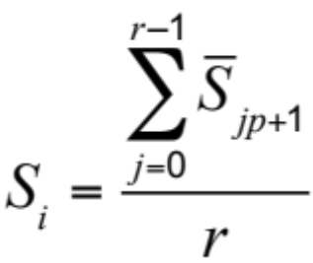
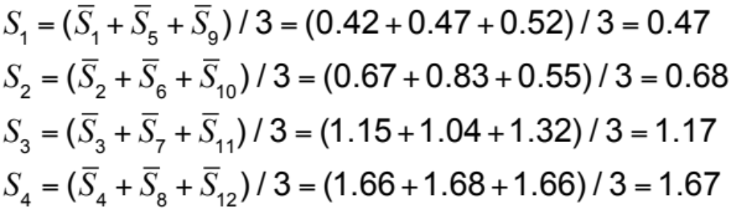
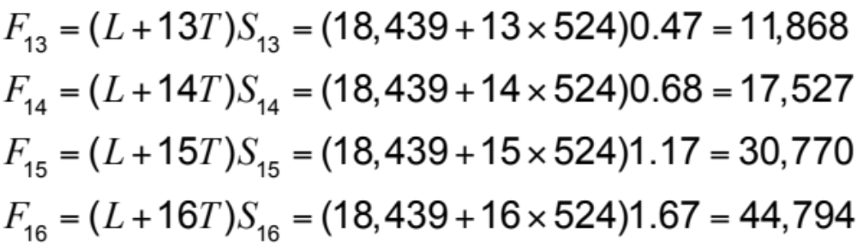
Estimating Seasonal Factors

Slide 18
Adaptive Forecasting
The estimates of level, trend, and seasonality are adjusted after each demand observation
Estimates incorporate all new data that are observed

Slide 19

Adaptive Forecasting
where
L_{t} = estimate of level at the end of Period t
T_{t} = estimate of trend at the end of Period t
S_{t} = estimate of seasonal factor for Period t
F_{t} = forecast of demand for Period t (made Period t – 1 or earlier)
D_{t} = actual demand observed in Period t
E_{t} = F_{t} – D_{t} = forecast error in Period t

Slide 20
Steps in Adaptive Forecasting
Initialize
  Compute initial estimates of level (L₀), trend (T₀), and seasonal factors (S₁,…,S_{p})
Forecast
  Forecast demand for period t + 1
Estimate error
  Compute error E_{t+1} = F_{t+1} – D_{t+1}
Modify estimates
  Modify the estimates of level (L_{t+1}), trend (T_{t+1}), and seasonal factor (S_{t+p+1}), given the error E_{t+1}

Slide 21
Moving Average
Used when demand has no observable trend or seasonality
Systematic component of demand = level
The level in period t is the average demand over the last N periods
L_{t} = (D_{t} + D_{t-1} + … + D_{t–N+1}) / N
F_{t+1} = L_{t} and F_{t+n} = L_{t}
After observing the demand for period t + 1, revise the estimates
L_{t+1} = (D_{t+1} + D_{t} + … + D_{t-N+2}) / N, F_{t+2} = L_{t+1}

Slide 22
Moving Average Example
A supermarket has experienced weekly demand of milk of D₁ = 120, D₂ = 127, D₃ = 114, and D₄ = 122 gallons over the past four weeks
  Forecast demand for Period 5 using a four-period moving average
  What is the forecast error if demand in Period 5 turns out to be 125 gallons?

Slide 23
Moving Average Example
L₄ = (D₄ + D₃ + D₂ + D₁)/4
= (122 + 114 + 127 + 120)/4 = 120.75
Forecast demand for Period 5
  F₅ = L₄ = 120.75 gallons
Error if demand in Period 5 = 125 gallons
  E₅ = F₅ – D₅ = 125 – 120.75 = 4.25
  Revised demand
  L₅ = (D₅ + D₄ + D₃ + D₂)/4
  = (125 + 122 + 114 + 127)/4 = 122

Slide 24
Simple Exponential Smoothing
Used when demand has no observable trend or seasonality
Systematic component of demand = level
Initial estimate of level, L₀, assumed to be the average of all historical data

Slide 25
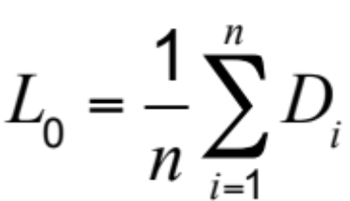
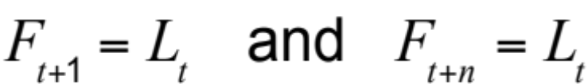
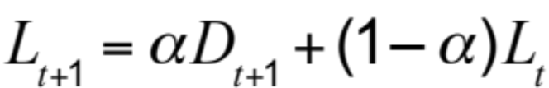
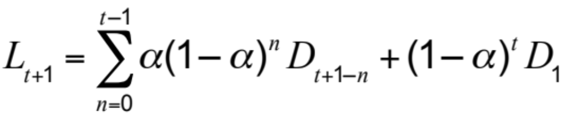
Simple Exponential Smoothing
Given data for Periods 1 to n
Current forecast
Revised forecast using smoothing constant 0 < α < 1
Thus

Slide 26
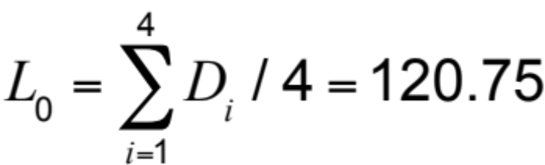
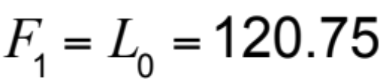
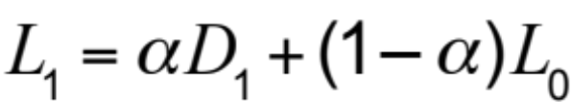
Simple Exponential Smoothing
Supermarket data
E₁ = F₁ – D₁ = 120.75 –120 = 0.75

Slide 27
Trend-Corrected Exponential Smoothing (Holt’s Model)
Appropriate when the demand is assumed to have a level and trend in the systematic component of demand but no seasonality
Systematic component of demand = level + trend

Slide 28
Trend-Corrected Exponential Smoothing (Holt’s Model)
Obtain initial estimate of level and trend by running a linear regression
D_{t} = at + b
T₀ = a, L₀ = b
In Period t, the forecast for future periods is
F_{t+1} = L_{t} + T_{t} and F_{t+n} = L_{t} + nT_{t}
Revised estimates for Period t
L_{t+1} = αD_{t+1} + (1 – α)(L_{t} + T_{t})
T_{t+1} = β(L_{t+1} – L_{t}) + (1 – β)T_{t}

Slide 29
Trend-Corrected Exponential Smoothing (Holt’s Model)
MP3 player demand
D₁ = 8,415, D₂ = 8,732, D₃ = 9,014,
D₄ = 9,808, D₅ = 10,413, D₆ = 11,961
α = 0.1, β = 0.2
Using regression analysis
L₀ = 7,367 and T₀ = 673
Forecast for Period 1
F₁ = L₀ + T₀ = 7,367 + 673 = 8,040

Slide 30
Trend-Corrected Exponential Smoothing (Holt’s Model)
Revised estimate
L₁ = αD₁ + (1 – α)(L₀ + T₀)
= 0.1 x 8,415 + 0.9 x 8,040 = 8,078
T₁ = β(L₁ – L₀) + (1 – β)T₀
= 0.2 x (8,078 – 7,367) + 0.8 x 673 = 681
With new L₁
F₂ = L₁ + T₁ = 8,078 + 681 = 8,759
Continuing
F₇ = L₆ + T₆ = 11,399 + 673 = 12,072

Slide 31
Trend- and Seasonality-Corrected Exponential Smoothing
Appropriate when the systematic component of demand is assumed to have a level, trend, and seasonal factor
Systematic component = (level + trend) x seasonal factor
F_{t+1} = (L_{t} + T_{t})S_{t+1} and F_{t+l} = (L_{t} + lT_{t})S_{t+l}

Slide 32
Trend- and Seasonality-Corrected Exponential Smoothing
After observing demand for period t + 1, revise estimates for level, trend, and seasonal factors
L_{t+1} = α(D_{t+1}/S_{t+1}) + (1 – α)(L_{t} + T_{t})
T_{t+1} = β(L_{t+1} – L_{t}) + (1 – β)T_{t}
S_{t+p+1} = γ(D_{t+1}/L_{t+1}) + (1 – γ)S_{t+1}
α = smoothing constant for level
β = smoothing constant for trend
γ = smoothing constant for seasonal factor

Slide 33
Winter’s Model
L₀ = 18,439 T₀ = 524
S₁= 0.47, S₂ = 0.68, S₃ = 1.17, S₄ = 1.67
F₁ = (L₀ + T₀)S₁ = (18,439 + 524)(0.47) = 8,913
The observed demand for Period 1 = D₁ = 8,000
Forecast error for Period 1
= E₁ = F₁ – D₁
= 8,913 – 8,000 = 913

Slide 34
Winter’s Model
Assume α = 0.1, β = 0.2, γ = 0.1; revise estimates for level and trend for period 1 and for seasonal factor for Period 5
L₁ = α(D₁/S₁) + (1 – α)(L₀ + T₀)
= 0.1 x (8,000/0.47) + 0.9 x (18,439 + 524) = 18,769
T₁ = β(L₁ – L₀) + (1 – β)T₀
= 0.2 x (18,769 – 18,439) + 0.8 x 524 = 485
S₅ = γ(D₁/L₁) + (1 – γ)S₁
= 0.1 x (8,000/18,769) + 0.9 x 0.47 = 0.47
F₂ = (L₁ + T₁)S₂ = (18,769 + 485)0.68 = 13,093

Slide 35
Time Series Models
Forecasting Method | Applicability
Moving average | No trend or seasonality
Simple exponential smoothing | No trend or seasonality
Holt’s model | Trend but no seasonality
Winter’s model | Trend and seasonality

Slide 36

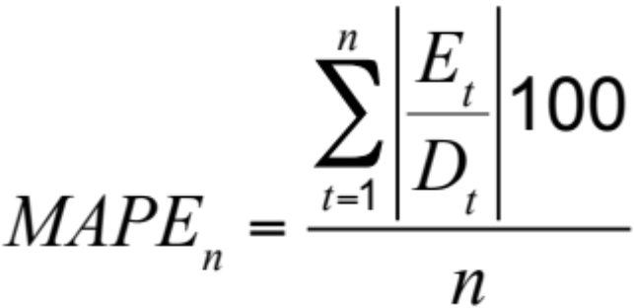
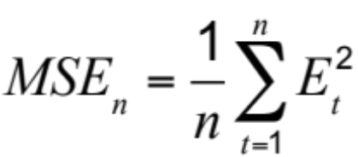
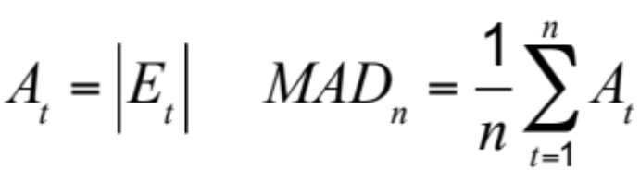
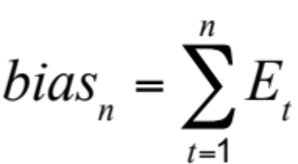
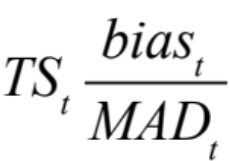

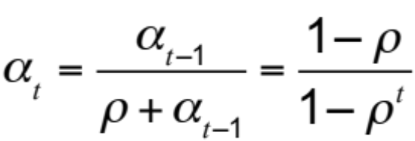
Measures of Forecast Error
Declining alpha

Slide 37
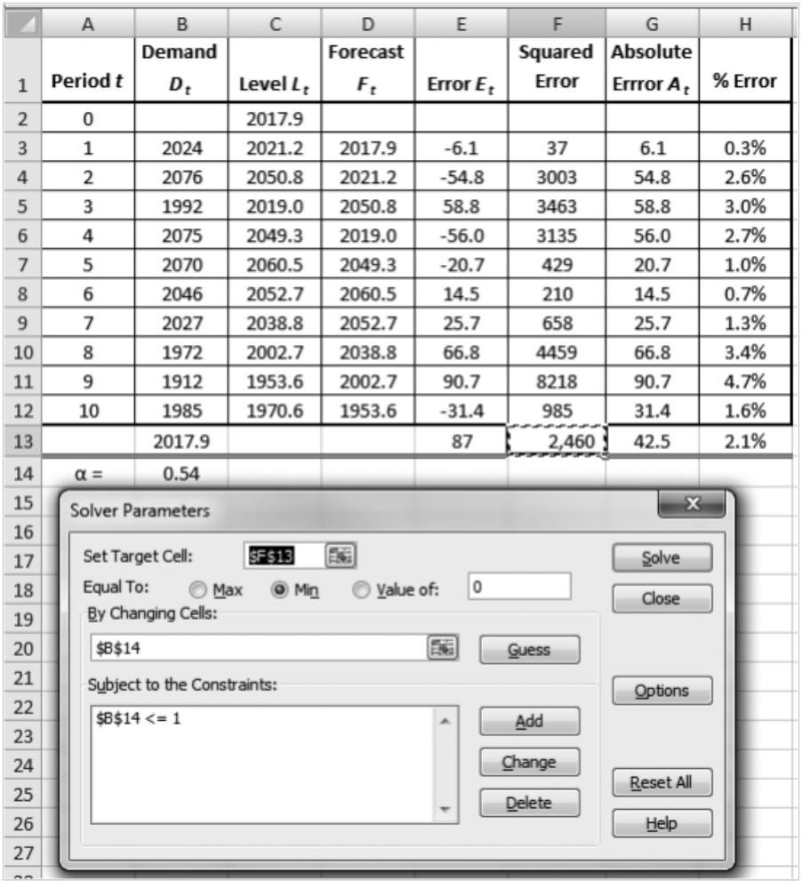
Selecting the Best Smoothing Constant
Figure 7-5

Slide 38
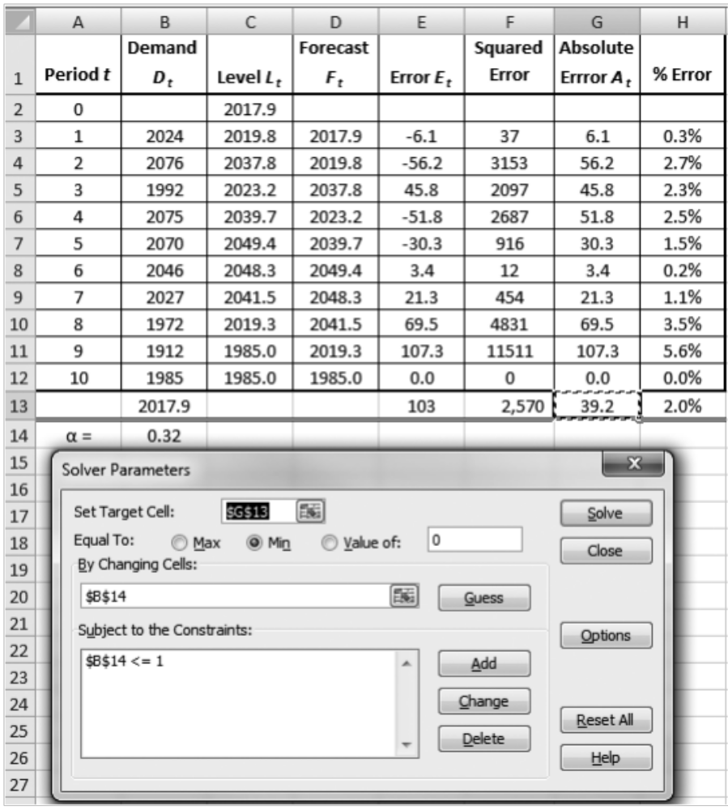
Selecting the Best Smoothing Constant
Figure 7-6

Slide 39
Forecasting Demand at Tahoe Salt
Moving average
Simple exponential smoothing
Trend-corrected exponential smoothing
Trend- and seasonality-corrected exponential smoothing

Slide 40
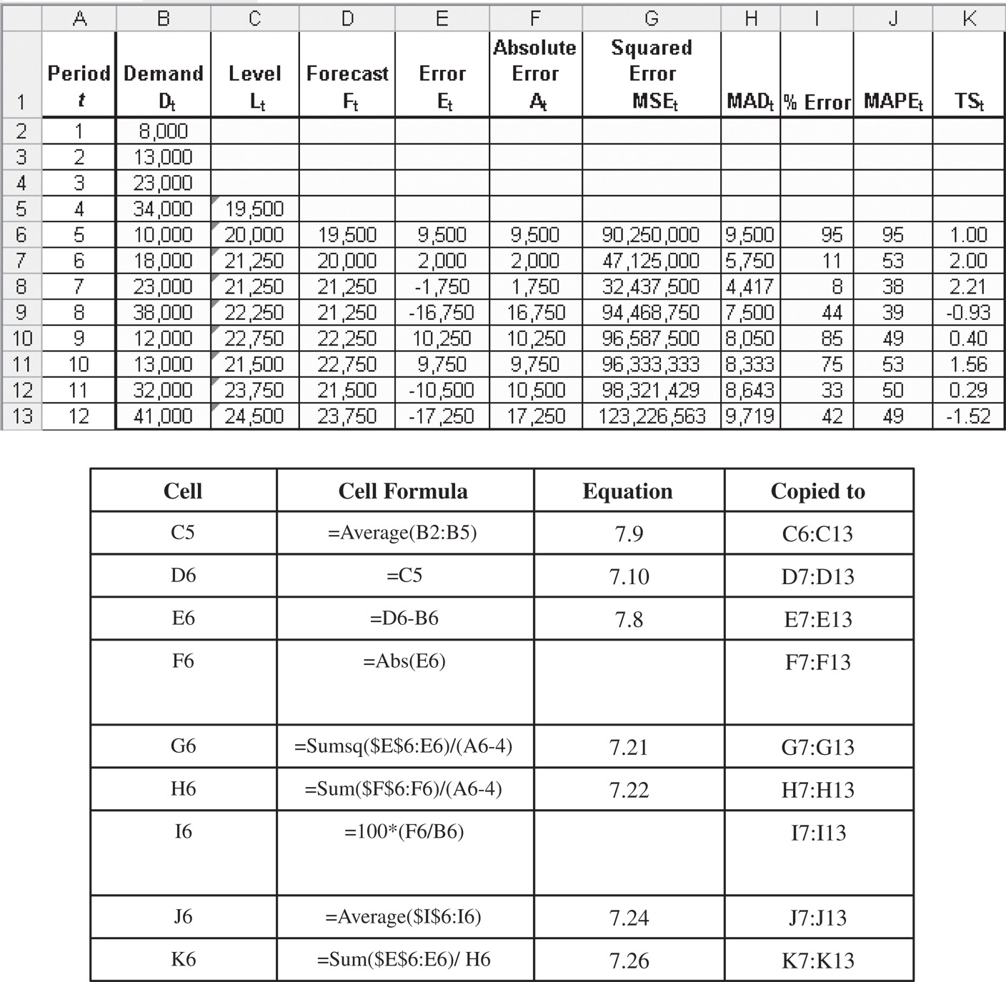
Forecasting Demand at Tahoe Salt
Figure 7-7

Slide 41
Forecasting Demand at Tahoe Salt
Moving average
L₁₂ = 24,500
F₁₃ = F₁₄ = F₁₅ = F₁₆ = L₁₂ = 24,500
σ = 1.25 x 9,719 = 12,148

Slide 42
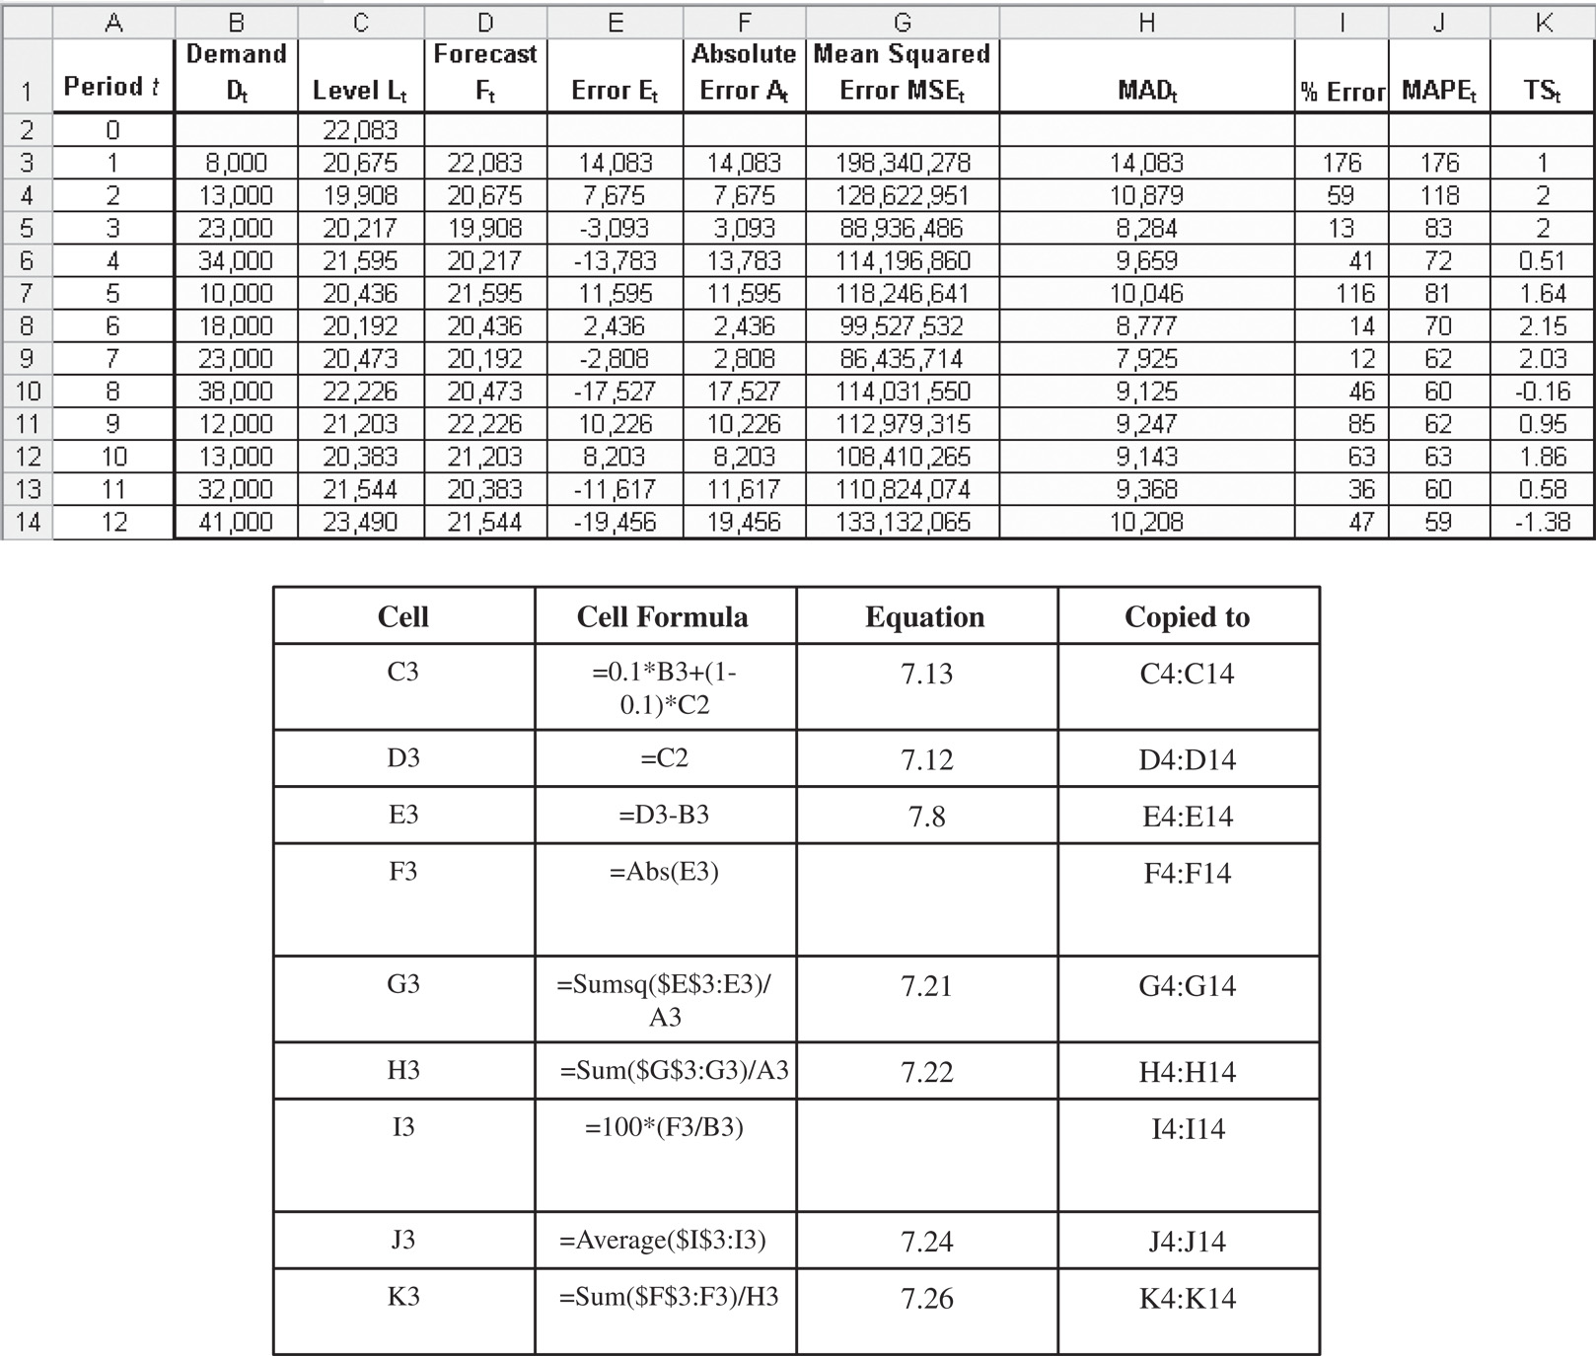
Forecasting Demand at Tahoe Salt
Figure 7-8

Slide 43
Forecasting Demand at Tahoe Salt
Single exponential smoothing
L₀ = 22,083
L₁₂ = 23,490
F₁₃ = F₁₄ = F₁₅ = F₁₆ = L₁₂ = 23,490
σ = 1.25 x 10,208 = 12,761

Slide 44
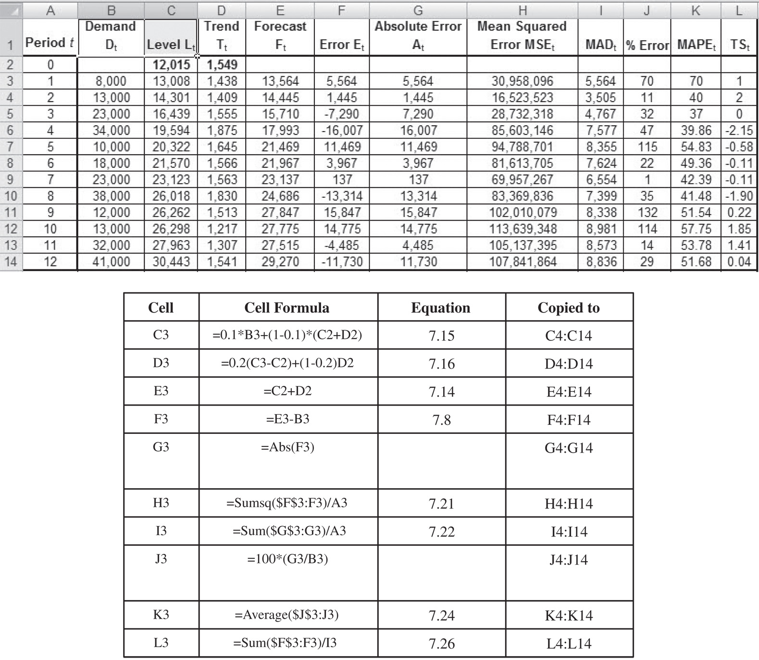
Forecasting Demand at Tahoe Salt
Figure 7-9

Slide 45
Forecasting Demand at Tahoe Salt
Trend-Corrected Exponential Smoothing
L₀ = 12,015 and T₀ = 1,549
L₁₂ = 30,443 and T₁₂ = 1,541
F₁₃ = L₁₂ + T₁₂ = 30,443 + 1,541 = 31,984
F₁₄ = L₁₂ + 2T₁₂ = 30,443 + 2 x 1,541 = 33,525
F₁₅ = L₁₂ + 3T₁₂ = 30,443 + 3 x 1,541 = 35,066
F₁₆ = L₁₂ + 4T₁₂ = 30,443 + 4 x 1,541 = 36,607
σ = 1.25 x 8,836 = 11,045

Slide 46
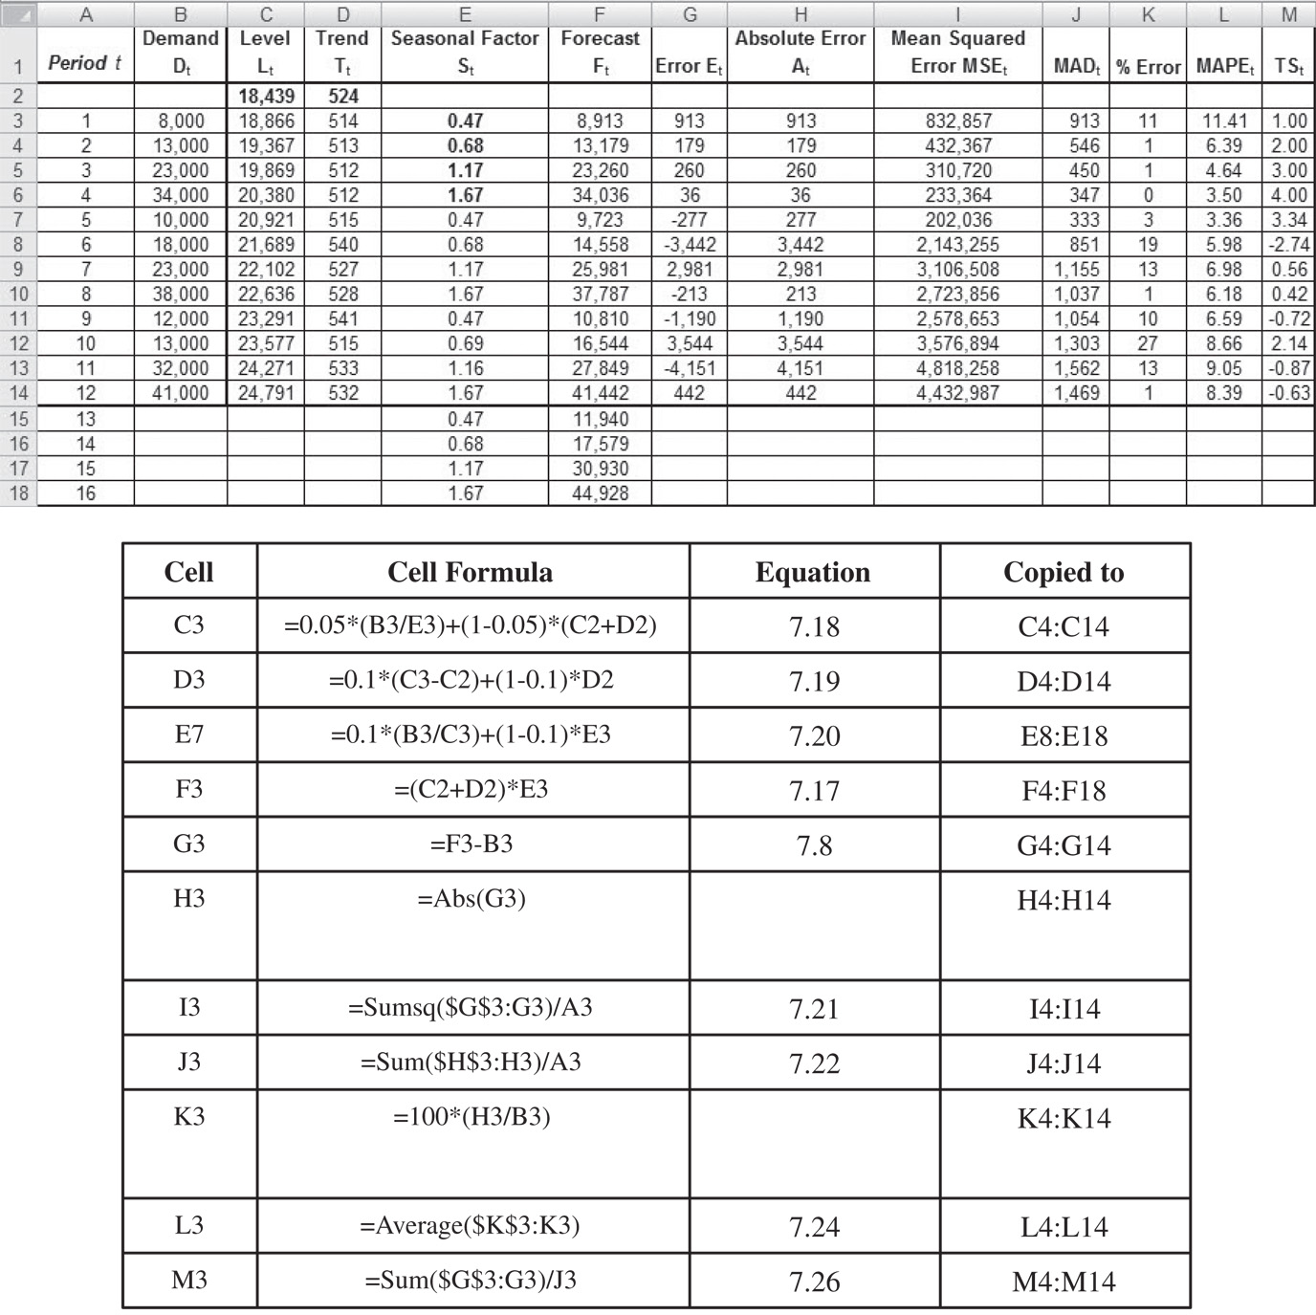
Forecasting Demand at Tahoe Salt
Figure 7-10

Slide 47
Forecasting Demand at Tahoe Salt
Trend- and Seasonality-Corrected
L₀ = 18,439 T₀ =524
S₁ = 0.47 S₂ = 0.68 S₃ = 1.17 S₄ = 1.67
L₁₂ = 24,791 T₁₂ = 532
F₁₃ = (L₁₂ + T₁₂)S₁₃ = (24,791 + 532)0.47 = 11,940
F₁₄ = (L₁₂ + 2T₁₂)S₁₃ = (24,791 + 2 x 532)0.68 = 17,579
F₁₅ = (L₁₂ + 3T₁₂)S₁₃ = (24,791 + 3 x 532)1.17 = 30,930
F₁₆ = (L₁₂ + 4T₁₂)S₁₃ = (24,791 + 4 x 532)1.67 = 44,928
σ = 1.25 x 1,469 = 1,836

Slide 48
Forecasting Demand at Tahoe Salt
Forecasting Method | MAD | MAPE (%) | TS Range
Four-period moving average | 9,719 | 49 | –1.52 to 2.21
Simple exponential smoothing | 10,208 | 59 | –1.38 to 2.15
Holt’s model | 8,836 | 52 | –2.15 to 2.00
Winter’s model | 1,469 | 8 | –2.74 to 4.00
Table 7-2

Slide 49
The Role of IT in Forecasting
Forecasting module is core supply chain software
Can be used to best determine forecasting methods for the firm and by product categories and markets
Real time updates help firms respond quickly to changes in marketplace
Facilitate demand planning

Slide 50
Risk Management
Errors in forecasting can cause significant misallocation of resources in inventory, facilities, transportation, sourcing, pricing, and information management
Common factors are long lead times, seasonality, short product life cycles, few customers and lumpy demand, and when orders placed by intermediaries in a supply chain
Mitigation strategies – increasing the responsiveness of the supply chain and utilizing opportunities for pooling of demand

Slide 51
Forecasting In Practice
Collaborate in building forecasts
Share only the data that truly provide value
Be sure to distinguish between demand and sales

Slide 52
Summary of Learning Objectives
Understand the role of forecasting for both an enterprise and a supply chain
Identify the components of a demand forecast
Forecast demand in a supply chain given historical demand data using time-series methodologies
Analyze demand forecasts to estimate forecast error

Slide 53

All rights reserved. No part of this publication may be reproduced, stored in a retrieval system, or transmitted, in any form or by any means, electronic, mechanical, photocopying, recording, or otherwise, without the prior written permission of the publisher.
Printed in the United States of America.

