Slide 1
Aggregate Planning in a Supply Chain
8

Slide 2
Learning Objectives
Identify the decisions that are best solved by aggregate planning.
Understand the importance of aggregate planning as a supply chain activity.
Describe the information needed to produce an aggregate plan.
Explain the basic trade-offs to consider when creating an aggregate plan.
Formulate and solve basic aggregate planning problems using Microsoft Excel.

Slide 3
Role of Aggregate Planning in a Supply Chain
Capacity has a cost and lead times are often long
Aggregate planning:
  process by which a company determines levels of capacity, production, subcontracting, inventory, stockouts, and pricing over a specified time horizon
  goal is to maximize profit
  decisions made at a product family (not SKU) level
  time frame of 3 to 18 months
  how can a firm best use the facilities it has?

Slide 4
Role of Aggregate Planning in a Supply Chain
Specify operational parameters over the time horizon
  Production rate – Subcontracting
  Workforce – Backlog
  Overtime – Inventory on hand
  Machine capacity level
All supply chain stages should work together on an aggregate plan that will optimize supply chain performance

Slide 5
The Aggregate Planning Problem
Given the demand forecast for each period in the planning horizon, determine the production level, inventory level, and the capacity level for each period that maximizes the firm’s (supply chain’s) profit over the planning horizon
Specify the planning horizon (typically 3-18 months)
Specify the duration of each period
Specify key information required to develop an aggregate plan

Slide 6
Information Needed for an Aggregate Plan
Aggregate demand forecast F_{t} for each Period t over T periods
Production costs
  Labor costs, regular time ($/hr) and overtime ($/hr)
  Subcontracting costs ($/hr or $/unit)
  Cost of changing capacity – hiring or layoff ($/worker), adding or reducing machine capacity ($/machine)
Labor/machine hours required per unit
Inventory holding cost ($/unit/period)
Stockout or backlog cost ($/unit/period)
Constraints – overtime, layoffs, capital available, stockouts, backlogs, from suppliers

Slide 7
Outputs of Aggregate Plan
Production quantity from regular time, overtime, and subcontracted time
Inventory held
Backlog/stockout quantity
Machine capacity increase/decrease
A poor aggregate plan can result in lost sales, lost profits, excess inventory, or excess capacity

Slide 8
Identifying Aggregate Units of Production
Aggregate unit should be identified in a way that the resulting production schedule can be accomplished in practice
Focus on the bottlenecks when selecting the aggregate unit and identifying capacity and production times
Account for activities such as setups and maintenance

Slide 9
Red Tomato Tools
Family | Material Cost/ Unit ($) | Revenue/ Unit ($) | Setup Time/Batch (hour) | Average Batch Size | Production Time/ Unit (hour) | Net Production Time/Unit (hour) | Percentage Share of Units Sold
A | 15 | 54 | 8 | 50 | 5.60 | 5.76 | 10
B | 7 | 30 | 6 | 150 | 3.00 | 3.04 | 25
C | 9 | 39 | 8 | 100 | 3.80 | 3.88 | 20
D | 12 | 49 | 10 | 50 | 4.80 | 5.00 | 10
E | 9 | 36 | 6 | 100 | 3.60 | 3.66 | 20
F | 13 | 48 | 5 | 75 | 4.30 | 4.37 | 15
Table 8-1

Slide 10
Red Tomato Tools
Weighted average approach
Material cost per aggregate unit
= 15 x 0.10 + 7 x 0.25 + 9 x 0.20
+ 12 x 0.10 + 9 x 0.20 + 13 x 0.15
= $10
Similarly
Revenue per aggregate unit = $40
Net production time per aggregate unit = 4.00 hours

Slide 11
Aggregate Planning Strategies
Trade-off between capacity, inventory, backlog/lost sales
Chase strategy – using capacity as the lever
Time flexibility from workforce or capacity strategy – using utilization as the lever
Level strategy – using inventory as the lever
Tailored or hybrid strategy – a combination of strategies

Slide 12
Chase Strategy
Vary machine capacity or hire and lay off workers as demand varies
Often difficult to vary capacity and workforce on short notice
Expensive if cost of varying capacity is high
Negative effect on workforce morale
Results in low levels of inventory
Used when inventory holding costs are high and costs of changing capacity are low

Slide 13
Time Flexibility Strategy
Use excess machine capacity
Workforce stable, number of hours worked varies
Use overtime or a flexible work schedule
Flexible workforce, avoids morale problems
Low levels of inventory, lower utilization
Used when inventory holding costs are high and capacity is relatively inexpensive

Slide 14
Level Strategy
Stable machine capacity and workforce levels, constant output rate
Inventory levels fluctuate over time
Inventories carried over from high to low demand periods
Better for worker morale
Large inventories and backlogs may accumulate
Used when inventory holding and backlog costs are relatively low

Slide 15
Aggregate Planning Using
Linear Programming
Red Tomato Tools
  Highly seasonal demand
  Develop a forecast
Month | Demand Forecast
January | 1,600
February | 3,000
March | 3,200
April | 3,800
May | 2,200
June | 2,200
Table 8-2

Slide 16
Red Tomato Tools
Item | Cost
Material cost | $10/unit
Inventory holding cost | $2/unit/month
Marginal cost of stockout/backlog | $5/unit/month
Hiring and training costs | $300/worker
Layoff cost | $500/worker
Labor hours required | 4/unit
Regular time cost | $4/hour
Overtime cost | $6/hour
Cost of subcontracting | $30/unit
Table 8-3

Slide 17
Red Tomato Tools
Decision Variables
For t = 1, ..., 6
W_{t} = Workforce size for month t
H_{t} = Number of employees hired at the beginning of month t
L_{t} = Number of employees laid off at the beginning of month t
P_{t} = Production in month t
I_{t} = Inventory at the end of month t
S_{t} = Number of units stocked out at the end of month t
C_{t} = Number of units subcontracted for month t
O_{t} = Number of overtime hours worked in month t

Slide 18
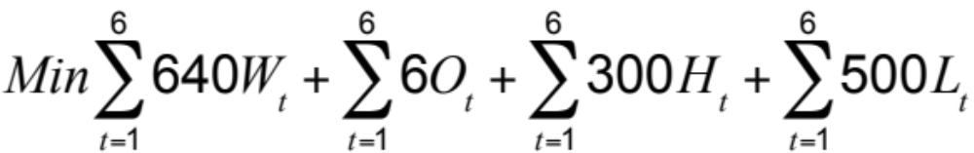
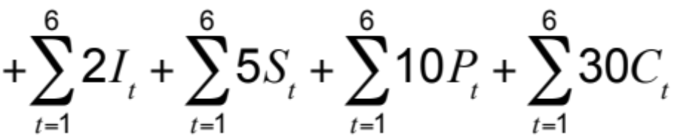
Red Tomato Tools
Objective Function
Minimize
(Regular-time labor cost + Overtime labor cost + Cost of hiring and layoffs + Cost of holding inventory + Cost of stocking out + Cost of subcontracting + Material cost)

Slide 19

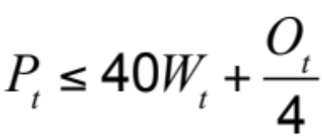


Red Tomato Tools
Constraints
All for t = 1,..., 6
Workforce, hiring, and layoff constraints
Capacity constraints
Inventory balance constraints
Overtime limit constraints

Slide 20
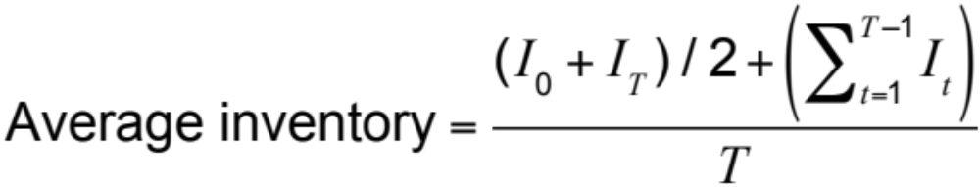
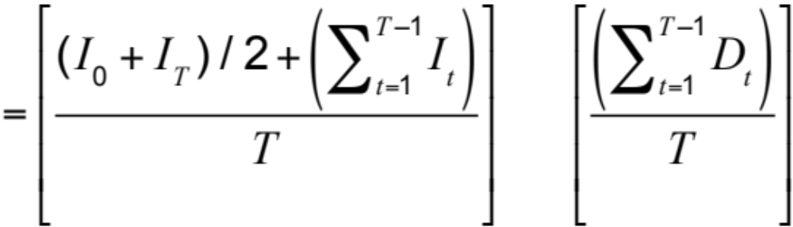
Red Tomato Tools
Average time
in inventory

Slide 21
Red Tomato Tools
Total cost over planning horizon = $422,275
Revenue over planning horizon = 40 x 16,000 = $640,000
Period, t | No. Hired, H_{t} | No. Laid Off, L_{t} | Workforce Size, W_{t} | Overtime, O_{t} | Inventory, I_{t} | Stockout, S_{t} | Subcontract, C_{t} | Total Production, P_{t}
0 | 0 | 0 | 80 | 0 | 1,000 | 0 | 0
1 | 0 | 15 | 65 | 0 | 1,983 | 0 | 0 | 2,583
2 | 0 | 0 | 65 | 0 | 1,567 | 0 | 0 | 2,583
3 | 0 | 0 | 65 | 0 | 950 | 0 | 0 | 2,583
4 | 0 | 0 | 65 | 0 | 0 | 267 | 0 | 2,583
5 | 0 | 0 | 65 | 0 | 117 | 0 | 0 | 2,583
6 | 0 | 0 | 65 | 0 | 500 | 0 | 0 | 2,583
Table 8-4

Slide 22
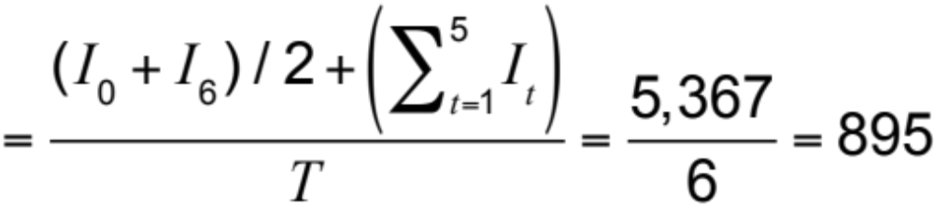
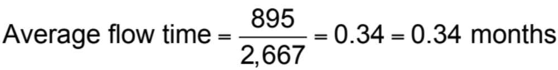
Red Tomato Tools
Average seasonal inventory

Slide 23
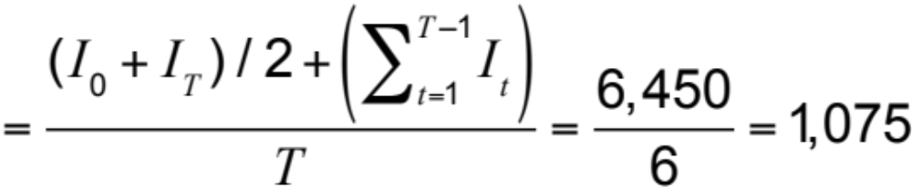
Red Tomato Tools
Higher demand variability
Month | Demand Forecast
January | 1,000
February | 3,000
March | 3,800
April | 4,800
May | 2,000
June | 1,400
Table 8-5
Average seasonal inventory

Slide 24
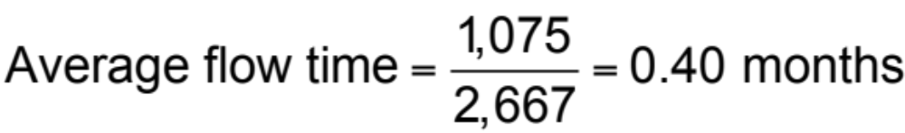
Red Tomato Tools
Total cost over planning horizon = $432,858
Period, t | No. Hired, H_{t} | No. Laid Off, L_{t} | Workforce Size, W_{t} | Overtime, O_{t} | Inventory, I_{t} | Stockout, S_{t} | Subcontract, C_{t} | Total Production, P_{t}
0 | 0 | 0 | 80 | 0 | 1,000 | 0 | 0
1 | 0 | 15 | 65 | 0 | 2,583 | 0 | 0 | 2,583
2 | 0 | 0 | 65 | 0 | 2,167 | 0 | 0 | 2,583
3 | 0 | 0 | 65 | 0 | 950 | 0 | 0 | 2,583
4 | 0 | 0 | 65 | 0 | 0 | 1,267 | 0 | 2,583
5 | 0 | 0 | 65 | 0 | 0 | 683 | 0 | 2,583
6 | 0 | 0 | 65 | 0 | 500 | 0 | 0 | 2,583
Table 8-6

Slide 25
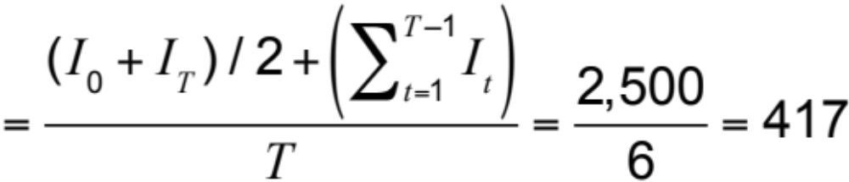
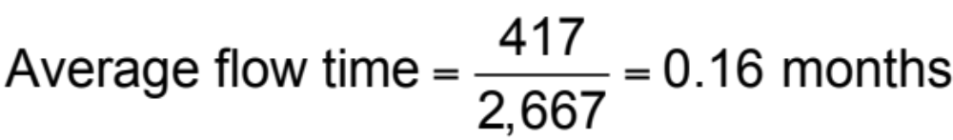
Red Tomato Tools
Lower hiring and layoff costs
Total cost over planning horizon = $412,688
Average seasonal inventory

Slide 26
Red Tomato Tools
Period, t | No. Hired, H_{t} | No. Laid Off, L_{t} | Workforce Size, W_{t} | Overtime, O_{t} | Inventory, I_{t} | Stockout, S_{t} | Subcontract, C_{t} | Total Production, P_{t}
0 | 0 | 0 | 80 | 0 | 1,000 | 0 | 0
1 | 0 | 35 | 45 | 0 | 1,200 | 0 | 0 | 2,267
2 | 0 | 0 | 45 | 0 | 0 | 0 | 0 | 2,267
3 | 42 | 0 | 87 | 0 | 300 | 0 | 0 | 2,267
4 | 0 | 0 | 87 | 0 | 0 | 1,267 | 0 | 2,267
5 | 0 | 26 | 61 | 0 | 250 | 683 | 0 | 2,267
6 | 0 | 0 | 61 | 0 | 500 | 0 | 0 | 2,267
Table 8-7

Slide 27
Forecast Error in Aggregate Plans
Forecast errors must be considered
Safety inventory
Safety capacity
  Use overtime as a form of safety capacity
  Carry extra workforce permanently as a form of safety capacity
  Use subcontractors as a form of safety capacity
  Build and carry extra inventories as a form of safety inventory
  Purchase capacity or product from an open or spot market as a form of safety capacity

Slide 28
Aggregate Planning In Excel
For t = 1, ..., 6
W_{t} = Workforce size for Month t
H_{t} = Number of employees hired at the beginning of Month t
L_{t} = Number of employees laid off at the beginning of Month t
P_{t} = Production in Month t
I_{t} = Inventory at the end of Month t
S_{t} = Number of units stocked out at the end of Month t
C_{t} = Number of units subcontracted for Month t
O_{t} = Number of overtime hours worked in Month t

Slide 29
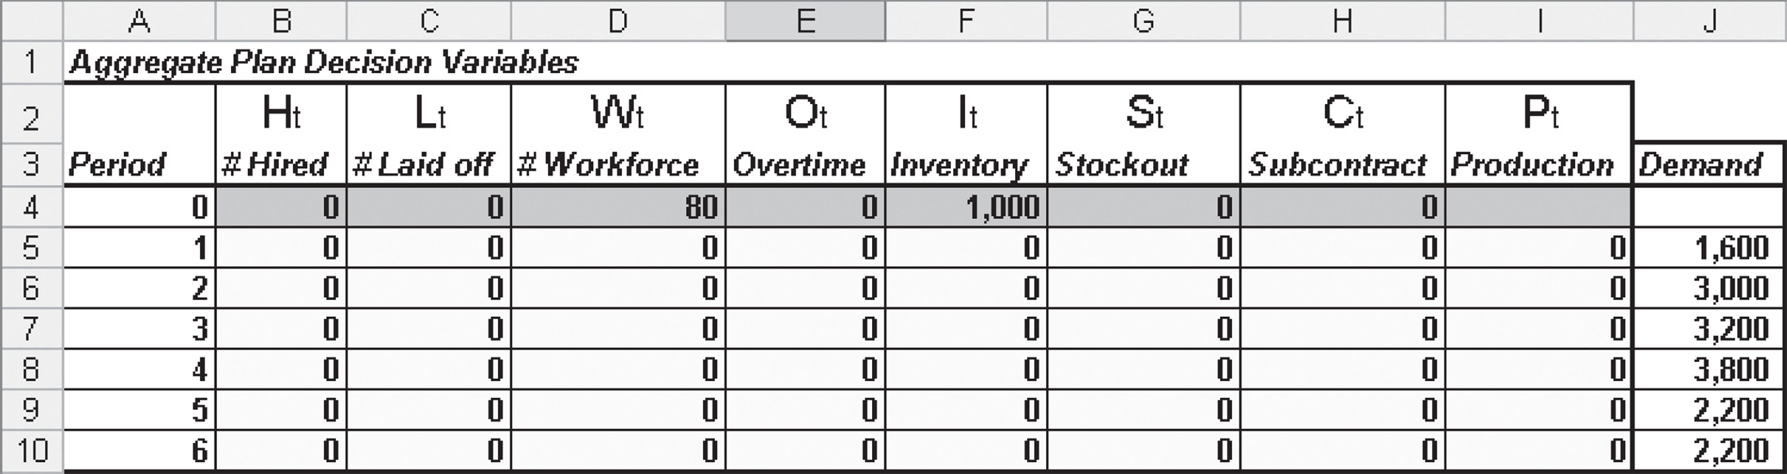
Aggregate Planning In Excel
Figure 8-1

Slide 30
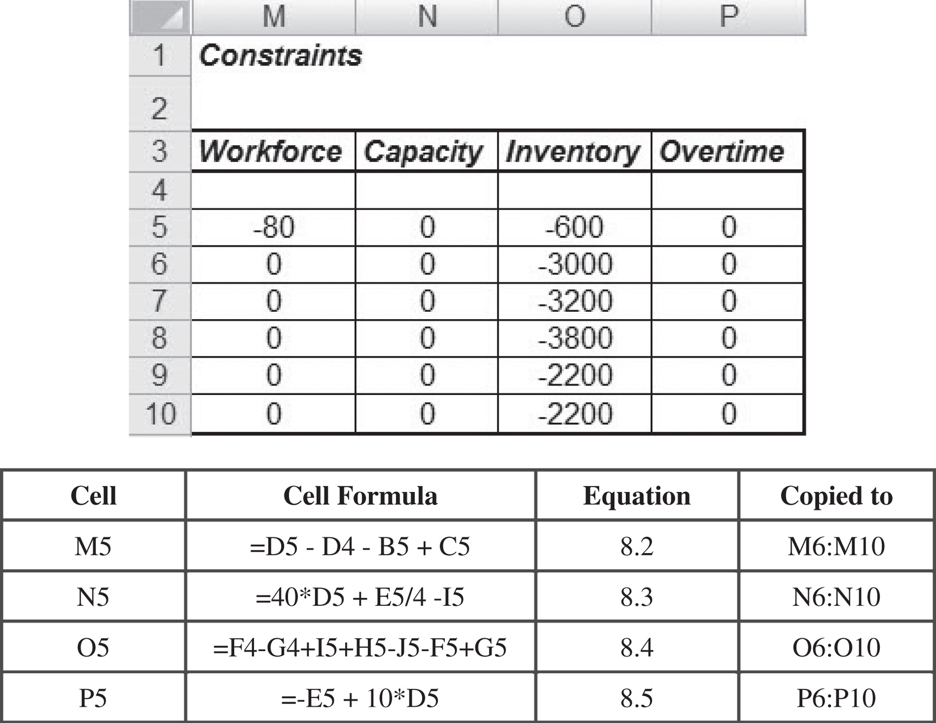
Aggregate Planning In Excel
Figure 8-2

Slide 31
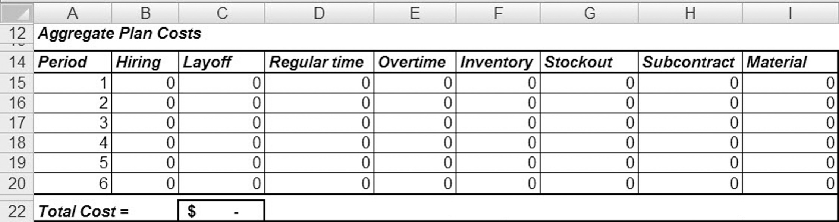
Aggregate Planning In Excel
Figure 8-3

Slide 32
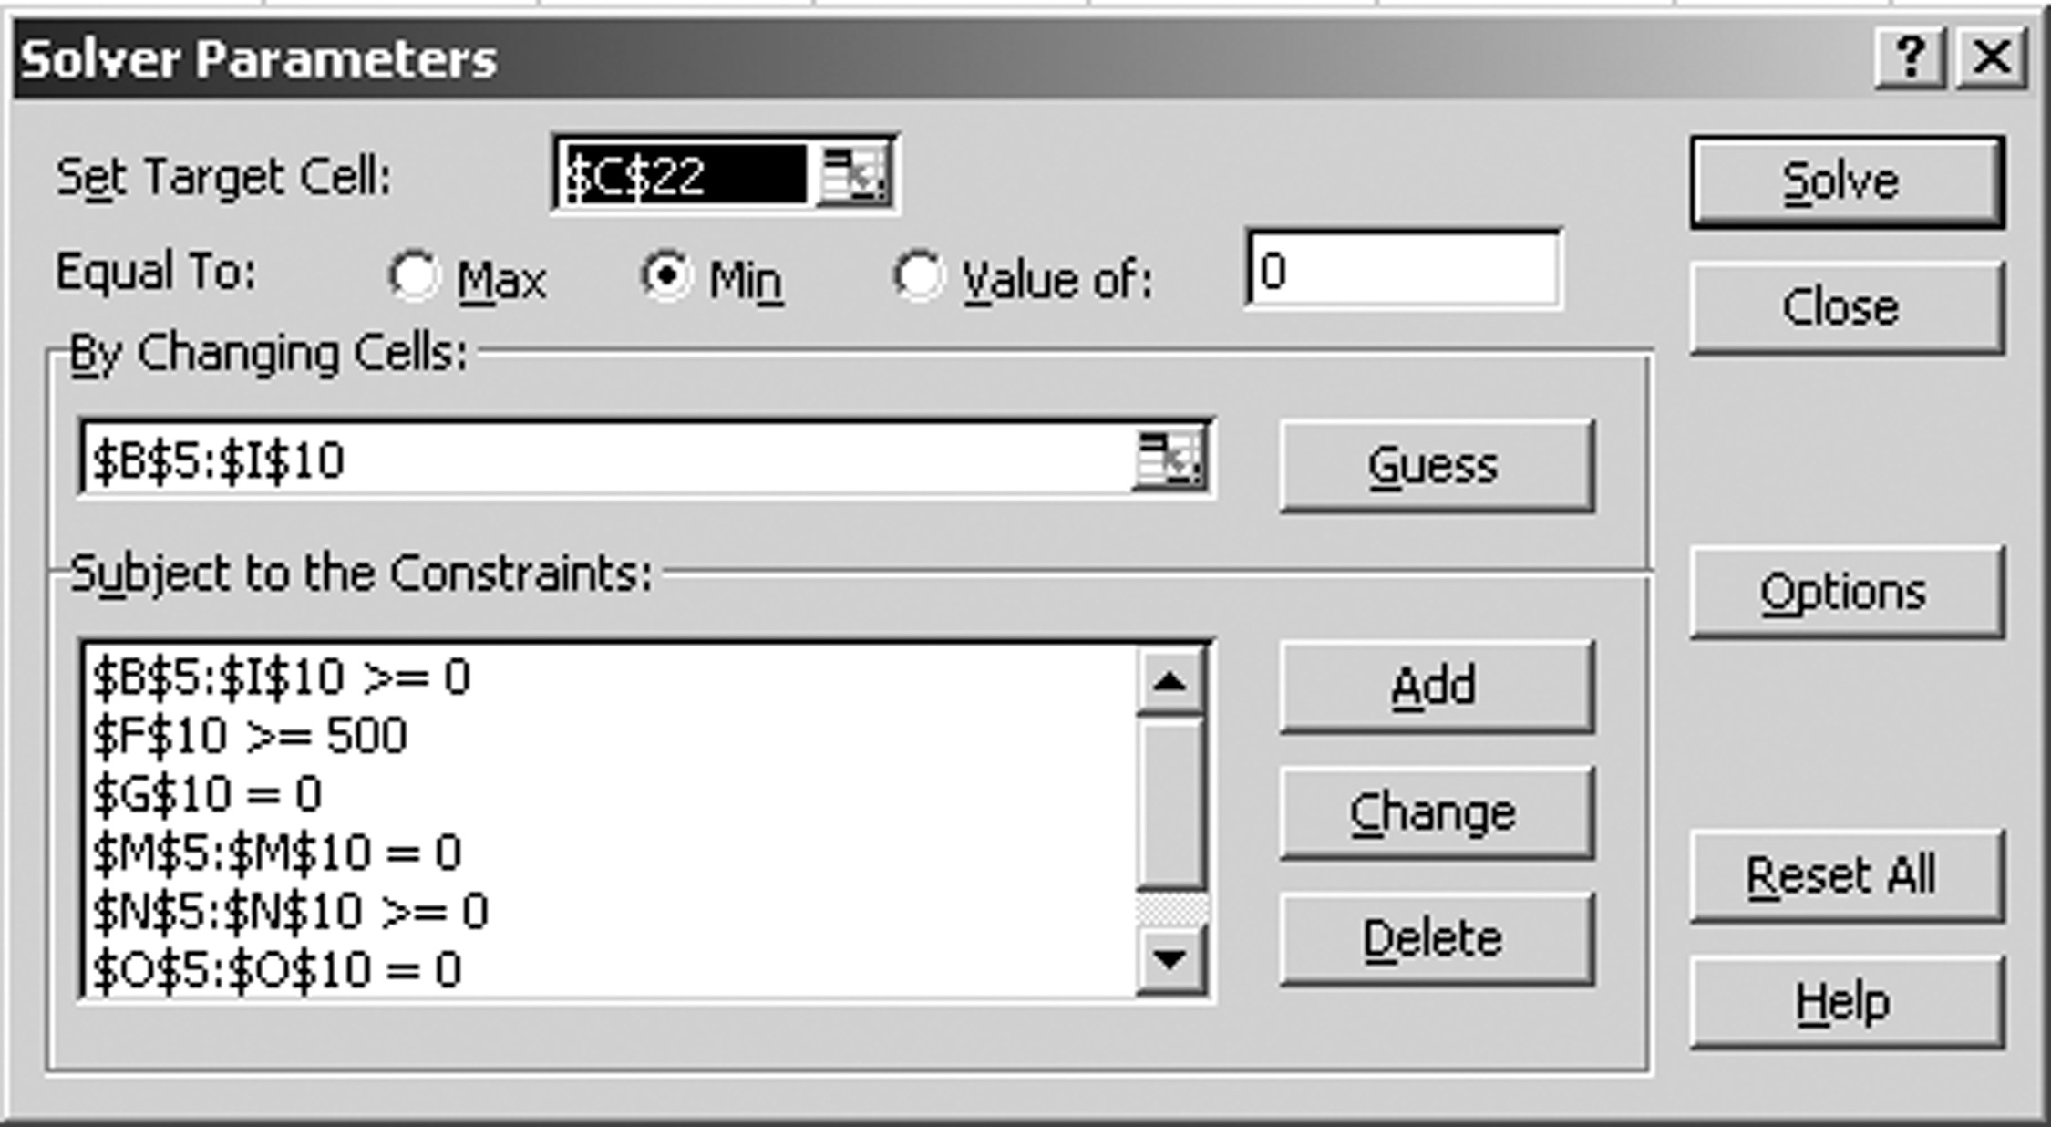
Aggregate Planning In Excel
Figure 8-4

Slide 33
Building a Rough Master Production Schedule
Disaggregate an aggregate plan
Family | Setup Time/Batch (hour) | Average Batch Size | Production Time/Unit (hour) | Production Quantity | Number of Setups | Setup Time (hours) | Production Time (hours)
A | 8 | 50 | 5.60 | 258 | 5 | 40 | 1,445
B | 6 | 150 | 3.00 | 646 | 4 | 24 | 1,938
C | 8 | 100 | 3.80 | 517 | 5 | 40 | 1,965
D | 10 | 50 | 4.80 | 258 | 5 | 50 | 1,238
E | 6 | 100 | 3.60 | 517 | 5 | 30 | 1,861
F | 5 | 75 | 4.30 | 387 | 5 | 25 | 1,664
Table 8-8

Slide 34
The Role of IT in
Aggregate Planning
The ability to handle large problems
The ability to handle complex problems (through either nonlinear optimization or linear approximations)
The ability to interact with other core IT systems such as inventory management and sourcing

Slide 35
Implementing Aggregate Planning in Practice
Think beyond the enterprise to the entire supply chain
Make plans flexible because forecasts are always inaccurate
Rerun the aggregate plan as new data emerge
Use aggregate planning as capacity utilization increases

Slide 36
Summary of Learning Objectives
Identify the decisions that are best solved by aggregate planning
Understand the importance of aggregate planning as a supply chain activity
Describe the information needed to produce an aggregate plan
Explain the basic trade-offs to consider when creating an aggregate plan
Formulate and solve aggregate planning problems using Microsoft Excel

Slide 37
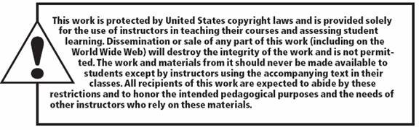
All rights reserved. No part of this publication may be reproduced, stored in a retrieval system, or transmitted, in any form or by any means, electronic, mechanical, photocopying, recording, or otherwise, without the prior written permission of the publisher.
Printed in the United States of America.

