Slide 1
Sales and Operations Planning: Planning Supply and Demand in a Supply Chain
9

Slide 2
Learning Objectives
Manage supply to improve synchronization in a supply chain in the face of predictable variability.
Manage demand to improve synchronization in a supply chain in the face of predictable variability.
Use sales and operations planning to maximize profitability when faced with predictable variability in a supply chain.

Slide 3
Responding to Predictable Variability in a Supply Chain
Predictable variability is change in demand that can be forecasted
Can cause increased costs and decreased responsiveness in the supply chain
Two broad approaches
  Manage supply using capacity, inventory, subcontracting, and backlogs
  Manage demand using short-term price discounts and trade promotions

Slide 4
Managing Supply
Managing capacity
  Time flexibility from workforce
  Use of seasonal workforce
  Use of subcontracting
  Use of dual facilities – specialized and flexible
  Designing product flexibility into production processes
Managing inventory
  Using common components across multiple products
  Build inventory of high demand or predictable demand products

Slide 5
Inventory/Capacity Trade-off
Leveling capacity forces inventory to build up in anticipation of seasonal variation in demand
Carrying low levels of inventory requires capacity to vary with seasonal variation in demand or enough capacity to cover peak demand during season
Notes:
Notes:

Slide 6
Managing Demand
Promotion at Red Tomato and Green Thumb
Item | Cost
Material cost | $10/unit
Inventory holding cost | $2/unit/month
Marginal cost of stockout/backlog | $5/unit/month
Hiring and training costs | $300/worker
Layoff cost | $500/worker
Labor hours required | 4/unit
Regular time cost | $4/hour
Overtime cost | $6/hour
Cost of subcontracting | $30/unit
Table 9-1

Slide 7
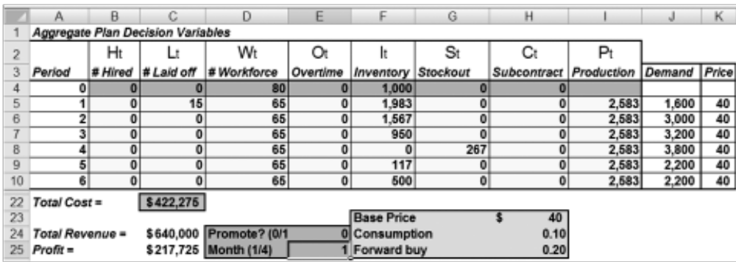
Managing Demand
Figure 9-1

Slide 8
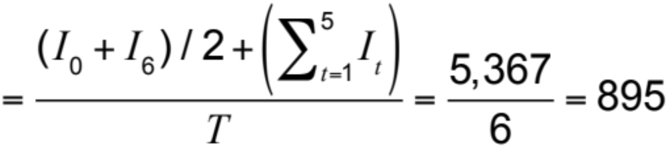
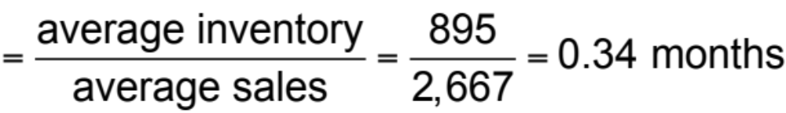
Managing Demand
Total cost over planning horizon = $422,275
Revenue over planning horizon = $640,000
Profit over planning horizon = $217,725
Average seasonal inventory
Average flow time

Slide 9
The Timing of a Promotion
Impact of the promotion on demand
Cost of holding inventory
Cost of changing the level of capacity
Product margins
Increase in demand from
  Market growth
  Stealing share
  Forward buying

Slide 10
When to Promote
Is it more effective to promote during the peak period of off-peak?
Analyze the impact of a promotion on demand and the resulting optimal aggregate plan

Slide 11
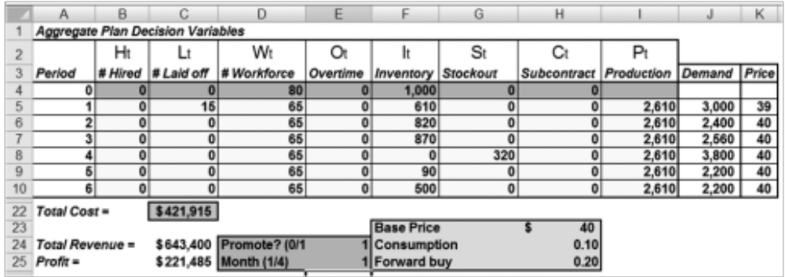
Promotion in January
Figure 9-2

Slide 12
Promotion in January
Total cost over planning horizon = $421,915
Revenue over planning horizon = $643,400
Profit over planning horizon = $221,485
Lower seasonal inventory
A somewhat lower total cost
A higher total profit

Slide 13
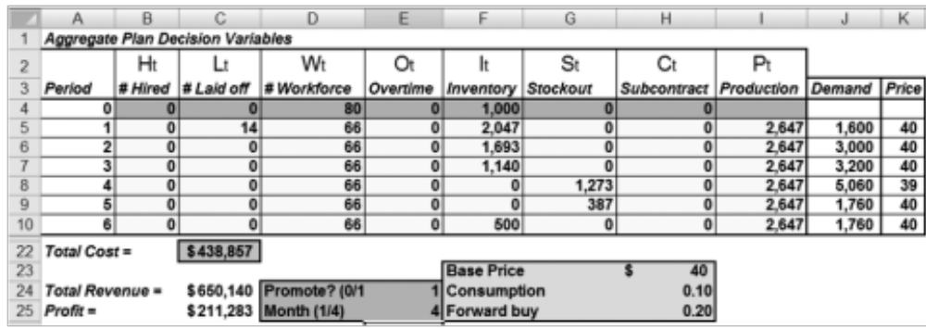
Promotion in April
Figure 9-3

Slide 14
Promotion in April
Total cost over planning horizon = $438,857
Revenue over planning horizon = $650,140
Profit over planning horizon = $211,283
Higher seasonal inventory
A somewhat higher total cost
A slightly smaller total profit

Slide 15
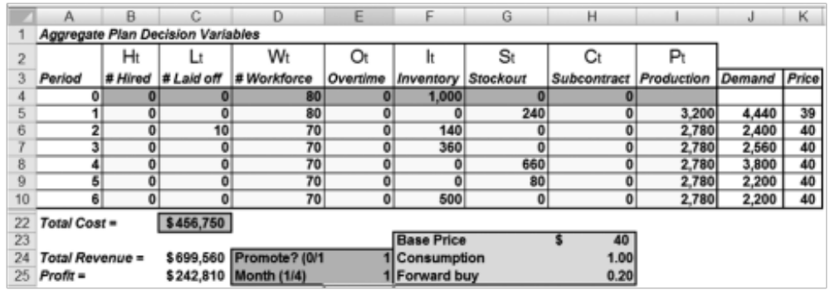
Discount Leads to
Large Increase in Consumption
Promotion in January
Figure 9-4

Slide 16
Discount Leads to
Large Increase in Consumption
Total cost over planning horizon = $456,750
Revenue over planning horizon = $699,560
Profit over planning horizon = $242,810
Higher total profit than base case

Slide 17
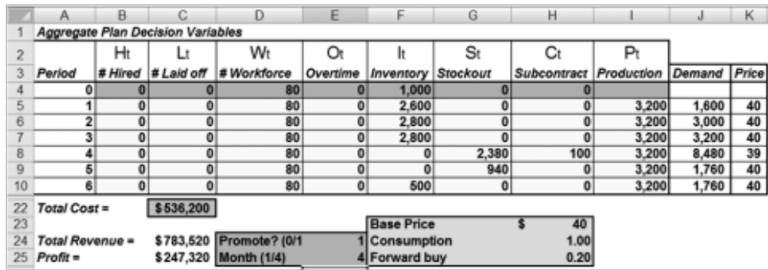
Discount Leads to
Large Increase in Consumption
Promotion in April
Figure 9-5

Slide 18
Discount Leads to
Large Increase in Consumption
Total cost over planning horizon = $536,200
Revenue over planning horizon = $783,520
Profit over planning horizon = $247,320
Much higher level of seasonal inventory
Uses more stockouts and subcontracting
Revenues increase
Overall profits higher

Slide 19
Supply Chain Performance
Regular Price | Promotion Price | Promotion Period | Percentage of Increase in Demand | Percentage of Forward Buying | Profit | Average Inventory
$40 | $40 | NA | NA | NA | $217,725 | 895
$40 | $39 | January | 10% | 20% | $221,485 | 523
$40 | $39 | April | 10% | 20% | $211,283 | 938
$40 | $39 | January | 100% | 20% | $242,810 | 208
$40 | $39 | April | 100% | 20% | $247,320 | 1,492
$31 | $31 | NA | NA | NA | $ 73,725 | 895
$31 | $30 | January | 100% | 20% | $ 84,410 | 208
$31 | $30 | April | 100% | 20% | $ 69,120 | 1,492
Table 9-2

Slide 20
Impact on Promotion Timing
Factor | Impact on Timing of Promotion/Forward Buy
High forward buying | Favors promotion during low-demand periods
High ability to steal market share | Favors promotion during peak-demand periods
High ability to increase overall market | Favors promotion during peak-demand periods
High margin | Favors promotion during peak-demand periods
Low margin | Favors promotion during low-demand periods
High manufacturer holding costs | Favors promotion during low-demand periods
High costs of changing capacity | Favors promotion during low-demand periods
High retailer holding costs | Decreases forward buying by retailer
High promotion elasticity of consumer | Decreases forward buying by retailer
Table 9-3

Slide 21
Conclusions on Promotion
Average inventory increases if a promotion is run during the peak period and decreases if the promotion is run during the off-peak period
Promoting during a peak-demand month may decrease overall profitability if there is a small increase in consumption and a significant fraction of the demand increase results from a forward buy

Slide 22
Conclusions on Promotion
As consumption increase from discounting grows and forward buying becomes a smaller fraction of the demand increase from a promotion, it is more profitable to promote during the peak period
As the product margin declines, promoting during the peak-demand period becomes less profitable

Slide 23
Implementing Sales and Operations Planning in Practice
Coordinate planning across enterprises in the supply chain
Take predictable variability into account when making strategic decisions
Design S&OP to understand and manage the drivers of demand usage
Ensure that the S&OP process modifies plans as the reality or forecasts change

Slide 24
Summary of Learning Objectives
Manage supply to improve synchronization in a supply chain in the face of predictable variability
Manage demand to improve synchronization in a supply chain in the face of predictable variability
Use sales and operations planning to maximize profitability when faced with predictable variability in a supply chain

Slide 25

All rights reserved. No part of this publication may be reproduced, stored in a retrieval system, or transmitted, in any form or by any means, electronic, mechanical, photocopying, recording, or otherwise, without the prior written permission of the publisher.
Printed in the United States of America.

