Slide 1
Coordination in a Supply Chain
10

Slide 2
Learning Objectives
Describe supply chain coordination and the bullwhip effect, and their impact on supply chain performance.
Identify obstacles to coordination in a supply chain.
Discuss managerial levers that help achieve coordination in a supply chain.
Understand the different forms of collaborative planning, forecasting, and replenishment possible in a supply chain.

Slide 3
Lack of Supply Chain Coordination and the Bullwhip Effect
Supply chain coordination – all stages of the chain take actions that are aligned and increase total supply chain surplus
Requires that each stage share information and take into account the effects of its actions on the other stages
Lack of coordination results when:
  Objectives of different stages conflict
  Information moving between stages is delayed or distorted

Slide 4
Bullwhip Effect
Fluctuations in orders increase as they move up the supply chain from retailers to wholesalers to manufacturers to suppliers
Distorts demand information within the supply chain
Results from a loss of supply chain coordination

Slide 5
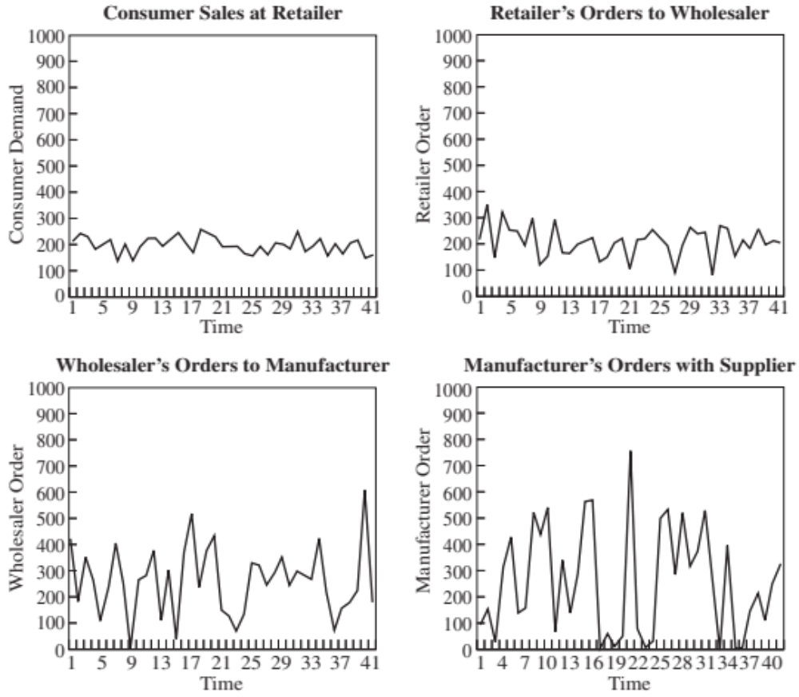
Demand at Different Stages
Figure 10-1

Slide 6
The Effect on Performance
Supply chain lacks coordination if each stage optimizes only its local objective
Reduces total profits
Performance measures include
  Manufacturing cost
  Inventory cost
  Replenishment lead time
  Transportation cost
  Labor cost for shipping and receiving
  Level of product availability
  Relationships across the supply chain

Slide 7
The Effect on Performance
Performance Measure | Impact of the Lack of Coordination
Manufacturing cost | Increases
Inventory cost | Increases
Replenishment lead time | Increases
Transportation cost | Increases
Shipping and receiving cost | Increases
Level of product availability | Decreases
Profitability | Decreases
Table 10-1

Slide 8
Obstacles to Coordination in a Supply Chain
Incentive Obstacles
Information Processing Obstacles
Operational Obstacles
Pricing Obstacles
Behavioral Obstacles

Slide 9
Incentive Obstacles
Occur when incentives offered to different stages or participants in a supply chain lead to actions that increase variability and reduce total supply chain profits
Local optimization within functions or stages of a supply chain
Sales force incentives

Slide 10
Information Processing Obstacles
When demand information is distorted as it moves between different stages of the supply chain, leading to increased variability in orders within the supply chain
Forecasting based on orders, not customer demand
Lack of information sharing

Slide 11
Operational Obstacles
Occur when placing and filling orders lead to an increase in variability
Ordering in large lots
Large replenishment lead times
Rationing and shortage gaming

Slide 12
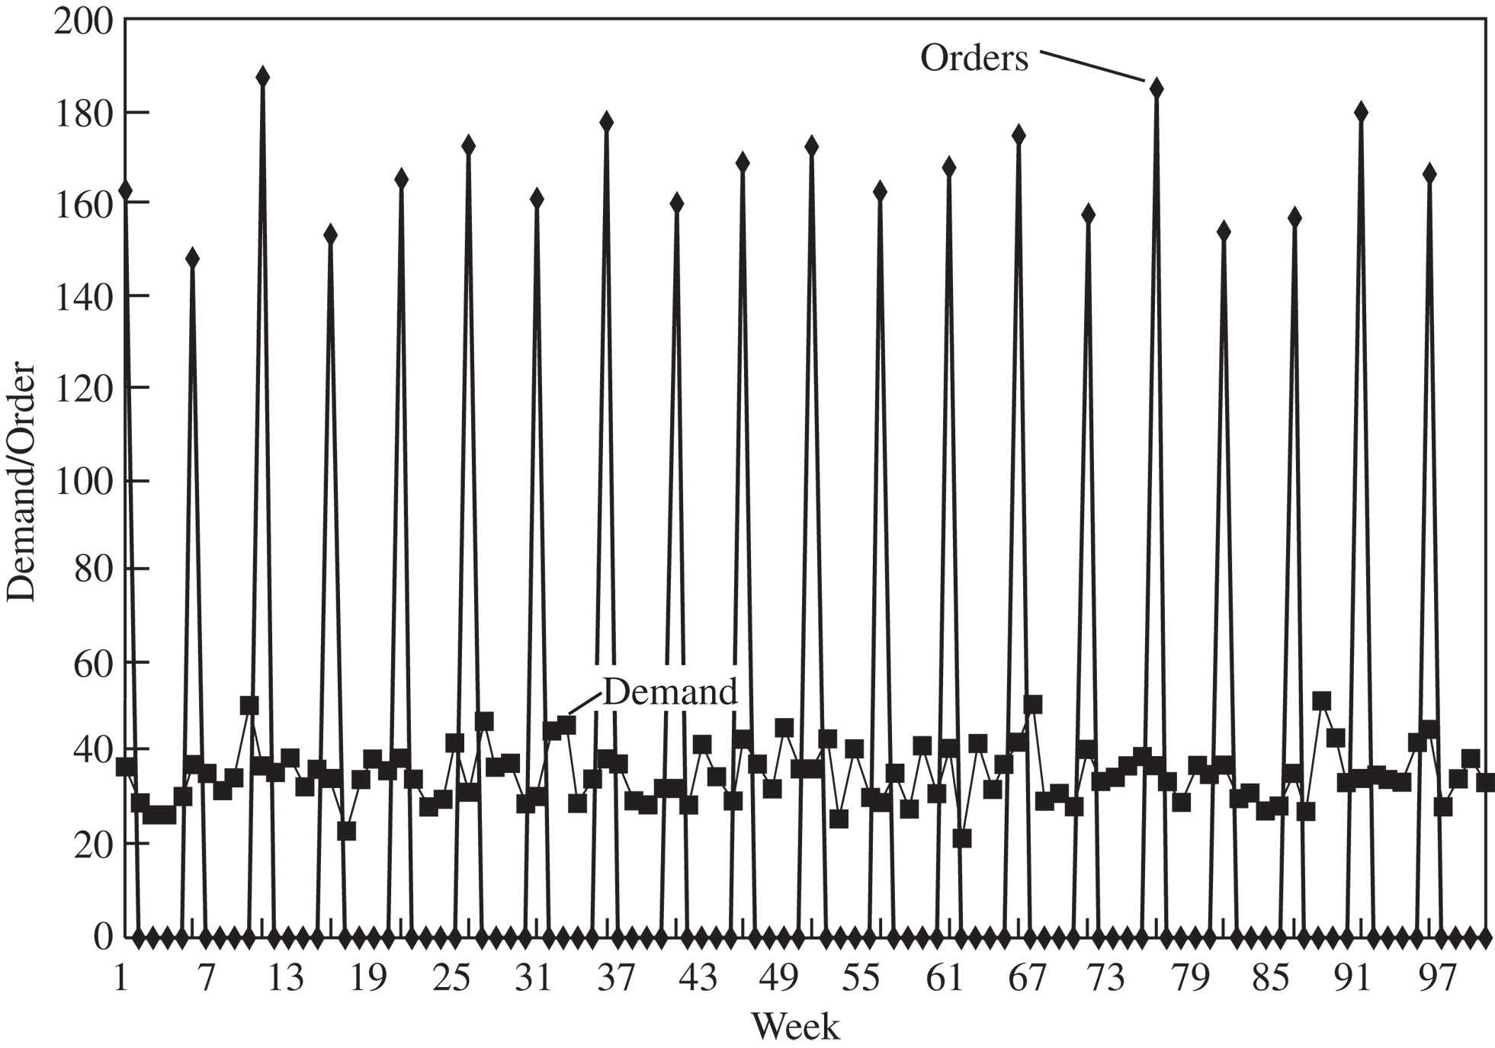
Operational Obstacles
Figure 10-2

Slide 13
Pricing Obstacles
When pricing policies for a product lead to an increase in variability of orders placed
Lot-size based quantity decisions
Price fluctuations

Slide 14
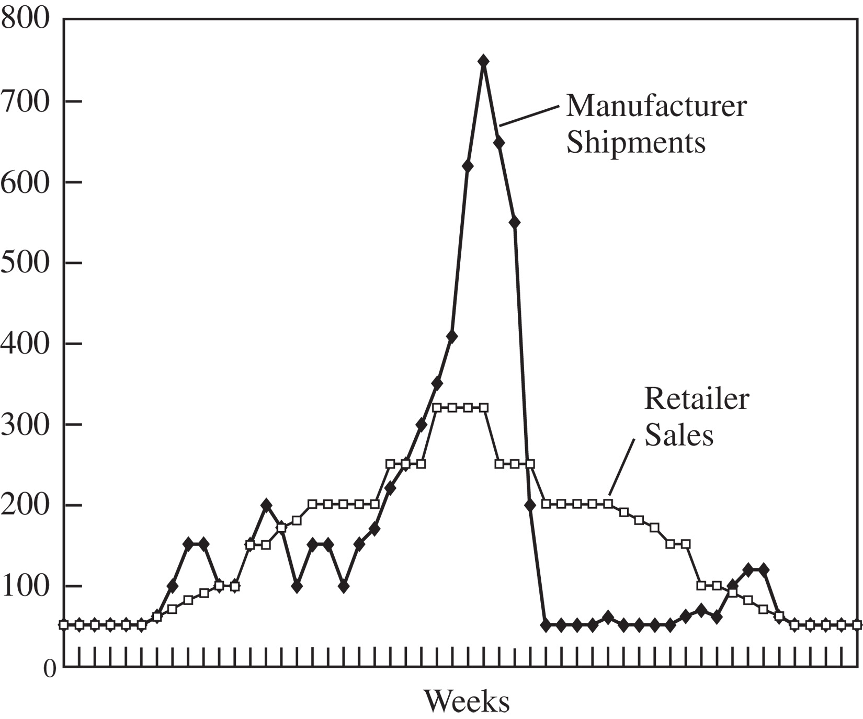
Pricing Obstacles
Figure 10-3

Slide 15
Behavioral Obstacles
Problems in learning within organizations that contribute to information distortion
  Each stage of the supply chain views its actions locally and is unable to see the impact of its actions on other stages
  Different stages of the supply chain react to the current local situation rather than trying to identify the root causes
  Different stages of the supply chain blame one another for the fluctuations
  No stage of the supply chain learns from its actions over time
  A lack of trust among supply chain partners causes them to be opportunistic at the expense of overall supply chain performance

Slide 16
Managerial Levers to
Achieve Coordination
Aligning goals and incentives
Improving information accuracy
Improving operational performance
Designing pricing strategies to stabilize orders
Building strategic partnerships and trust

Slide 17
Aligning Goals and Incentives
Align goals and incentives so that every participant in supply chain activities works to maximize total supply chain profits
Align goals across the supply chain
Align incentives across functions
Pricing for coordination
Alter sales force incentives from sell-in (to the retailer) to sell-through (by the retailer)

Slide 18
Improving Information Visibility and Accuracy
Sharing point of sale data
Implementing collaborative forecasting and planning
Designing single-stage control of replenishment
  Continuous replenishment programs (CRP)
  Vendor managed inventory (VMI)

Slide 19
Improving Operational Performance
Reducing replenishment lead time
Reducing lot sizes
Rationing based on past sales and sharing information to limit gaming

Slide 20
Designing Pricing Strategies to Stabilize Orders
Encouraging retailers to order in smaller lots and reduce forward buying
Moving from lot size-based to volume-based quantity discounts
Stabilizing pricing
Building strategic partnerships and trust

Slide 21
Continuous Replenishment and Vendor-Managed Inventories
A single point of replenishment
CRP – wholesaler or manufacturer replenishes based on POS data
VMI – manufacturer or supplier is responsible for all decisions regarding inventory
Substitutes

Slide 22
Collaborative Planning, Forecasting, and Replenishment (CPFR)
Sellers and buyers in a supply chain may collaborate along any or all of the following
  Strategy and planning
  Demand and supply management
  Execution
  Analysis
Retail event collaboration
DC replenishment collaboration

Slide 23
Common CPFR Scenarios
CPFR Scenario | Where Applied in Supply Chain | Industries Where Applied
Retail event collaboration | Highly promoted channels or categories | All industries other than those that practice EDLP
DC replenishment collaboration | Retail DC or distributor DC | Drugstores, hardware, grocery
Store replenishment collaboration | Direct store delivery or retail DC-to-store delivery | Mass merchants, club stores
Collaborative assortment planning | Apparel and seasonal goods | Department stores, specialty retail
Table 10-2

Slide 24
Collaborative Planning, Forecasting, and Replenishment (CPFR)
Store replenishment collaboration
Collaborative assortment planning
Organizational and technology requirements for successful CPFR
Risks and hurdles for a CPFR implementation

Slide 25
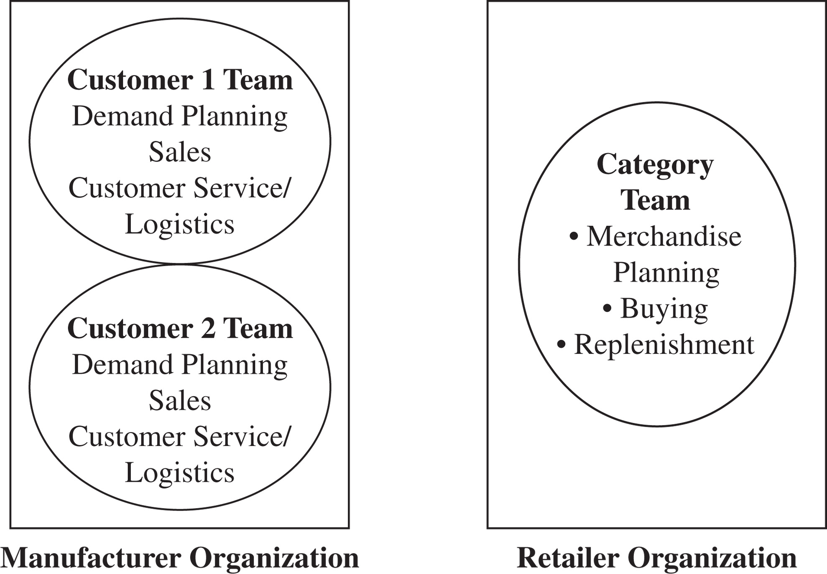
Collaborative Planning, Forecasting, and Replenishment (CPFR)
Figure 10-4

Slide 26
Achieving Coordination in Practice
Quantify the bullwhip effect
Get top management commitment for coordination
Devote resources to coordination
Focus on communication with other stages
Try to achieve coordination in the entire supply chain network
Use technology to improve connectivity in the supply chain
Share the benefits of coordination equitably

Slide 27
Summary of Learning Objectives
Describe supply chain coordination and the bullwhip effect, and their impact on supply chain performance
Identify obstacles to coordination in a supply chain
Discuss managerial levers that help achieve coordination in a supply chain
Understand the different forms of CPFR possible in a supply chain

Slide 28
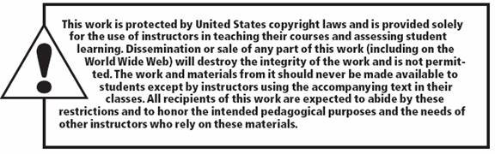
All rights reserved. No part of this publication may be reproduced, stored in a retrieval system, or transmitted, in any form or by any means, electronic, mechanical, photocopying, recording, or otherwise, without the prior written permission of the publisher.
Printed in the United States of America.

