Slide 1
Managing Economies of Scale in a Supply Chain: Cycle Inventory
11

Slide 2
Learning Objectives
Balance the appropriate costs to choose the optimal lot size and cycle inventory in a supply chain.
Understand the impact of quantity discounts on lot size and cycle inventory.
Devise appropriate discounting schemes for a supply chain.
Understand the impact of trade promotions on lot size and cycle inventory.
Identify managerial levers that reduce lot size and cycle inventory in a supply chain without increasing cost.

Slide 3
Role of Cycle Inventory in a Supply Chain
Lot or batch size is the quantity that a stage of a supply chain either produces or purchases at a time
Cycle inventory is the average inventory in a supply chain due to either production or purchases in lot sizes that are larger than those demanded by the customer
Q: Quantity in a lot or batch size
D: Demand per unit time

Slide 4
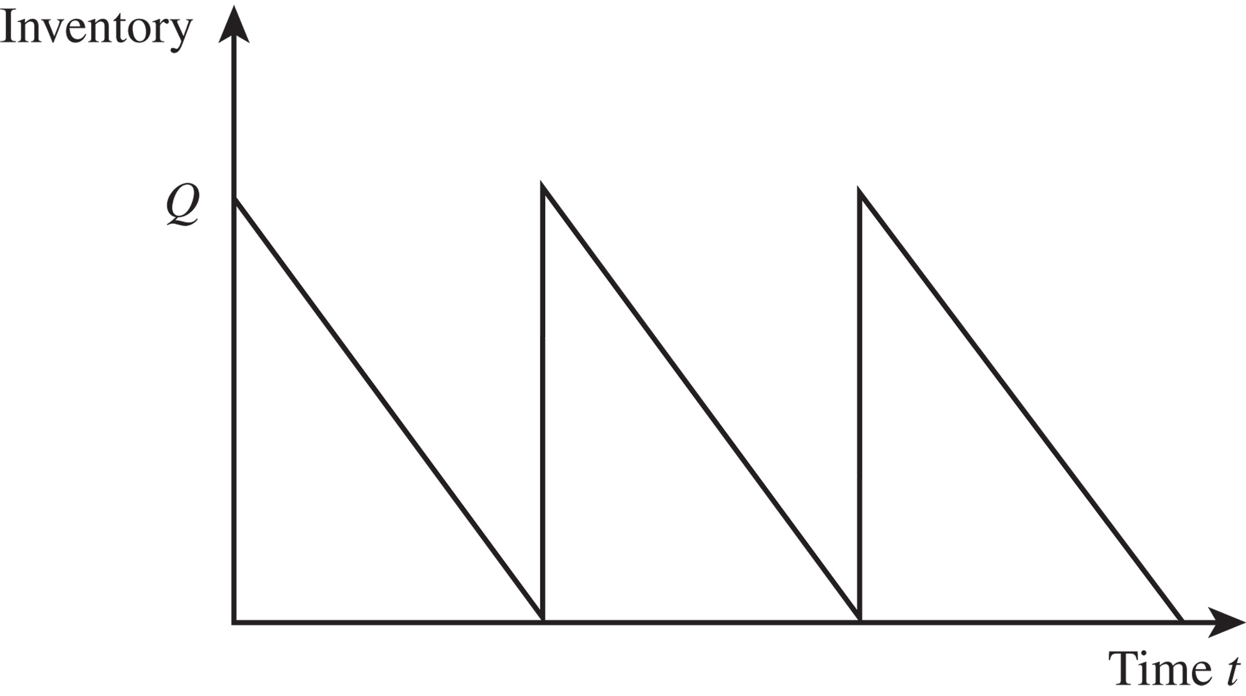
Inventory Profile
Figure 11-1

Slide 5
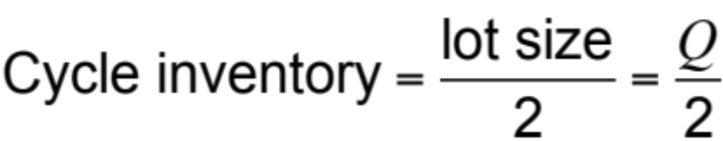
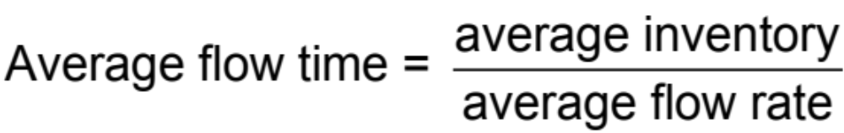
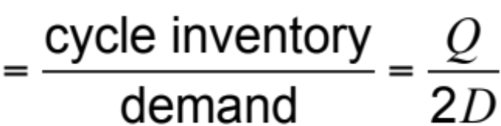
Role of Cycle Inventory in a Supply Chain
Average flow time resulting from cycle inventory

Slide 6
Role of Cycle Inventory in a Supply Chain
Lower cycle inventory has
  Shorter average flow time
  Lower working capital requirements
  Lower inventory holding costs
Cycle inventory is held to
  Take advantage of economies of scale
  Reduce costs in the supply chain

Slide 7
Role of Cycle Inventory in a Supply Chain
Average price paid per unit purchased is a key cost in the lot-sizing decision
Material cost = C
Fixed ordering cost includes all costs that do not vary with the size of the order but are incurred each time an order is placed
Fixed ordering cost = S
Holding cost is the cost of carrying one unit in inventory for a specified period of time
Holding cost = H = hC

Slide 8
Role of Cycle Inventory in a Supply Chain
Primary role of cycle inventory is to allow different stages to purchase product in lot sizes that minimize the sum of material, ordering, and holding costs
Ideally, cycle inventory decisions should consider costs across the entire supply chain
In practice, each stage generally makes its own supply chain decisions
Increases total cycle inventory and total costs in the supply chain

Slide 9
Role of Cycle Inventory in a Supply Chain
Economies of scale exploited in three typical situations
  A fixed cost is incurred each time an order is placed or produced
  The supplier offers price discounts based on the quantity purchased per lot
  The supplier offers short-term price discounts or holds trade promotions

Slide 10
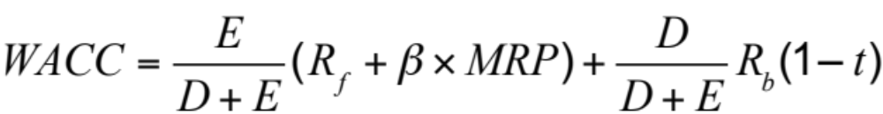
Estimating Cycle Inventory Related Costs in Practice
Inventory Holding Cost
  Cost of capital
where
E = amount of equity
D = amount of debt
R_{f} = risk-free rate of return
β = the firm’s beta
MRP = market risk premium
R_{b} = rate at which the firm can borrow money
t = tax rate

Slide 11
Estimating Cycle Inventory Related Costs in Practice
Inventory Holding Cost
  Cost of capital
Adjusted for pre-tax setting

Slide 12
Estimating Cycle Inventory Related Costs in Practice
Inventory Holding Cost
  Obsolescence cost
  Handling cost
  Occupancy cost
  Miscellaneous costs
    Theft, security, damage, tax, insurance

Slide 13
Estimating Cycle Inventory Related Costs in Practice
Ordering Cost
  Buyer time
  Transportation costs
  Receiving costs
  Other costs

Slide 14
Economies of Scale to Exploit Fixed Costs
Lot sizing for a single product (EOQ)
D = Annual demand of the product
S = Fixed cost incurred per order
C = Cost per unit
H = Holding cost per year as a fraction of product cost
Basic assumptions
  Demand is steady at D units per unit time
  No shortages are allowed
  Replenishment lead time is fixed

Slide 15
Economies of Scale to Exploit Fixed Costs
Minimize
  Annual material cost
  Annual ordering cost
  Annual holding cost

Slide 16
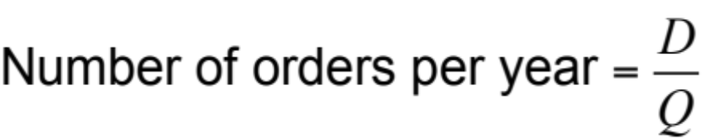
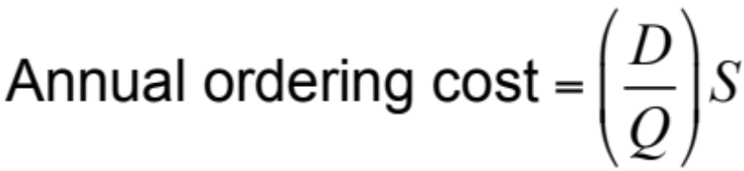
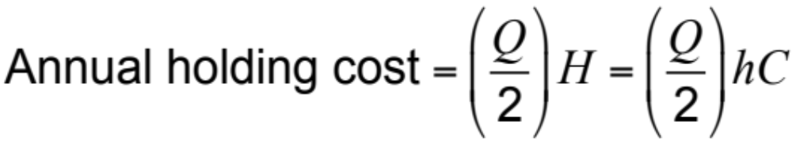
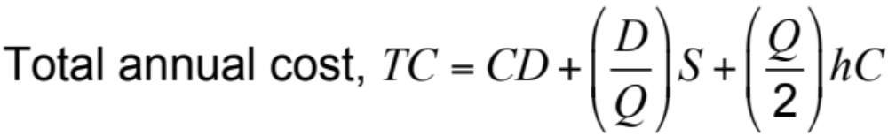
Lot Sizing for a Single Product

Slide 17
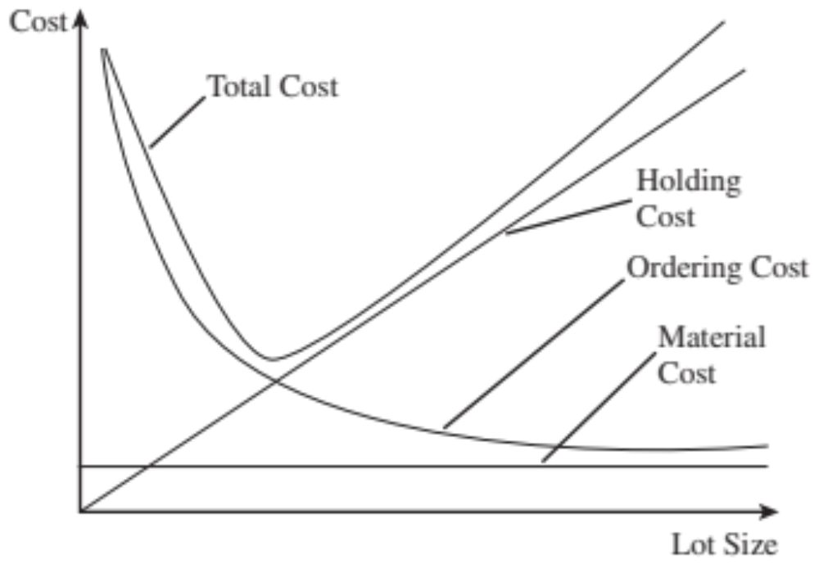
Lot Sizing for a Single Product
Figure 11-2

Slide 18
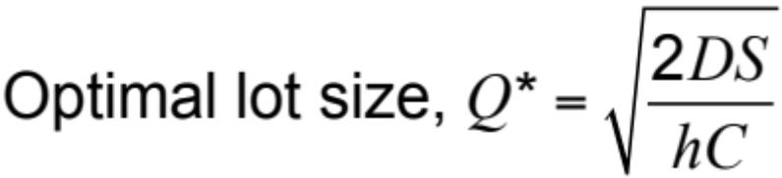
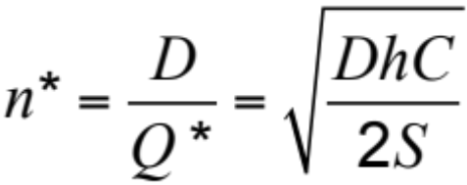
Lot Sizing for a Single Product
The economic order quantity (EOQ)
The optimal ordering frequency

Slide 19
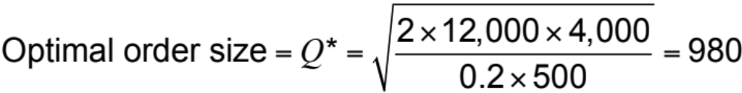
EOQ Example
Annual demand, D = 1,000 x 12 = 12,000 units
Order cost per lot, S = $4,000
Unit cost per computer, C = $500
Holding cost per year as a fraction of unit cost, h = 0.2
Notes:
Notes:

Slide 20
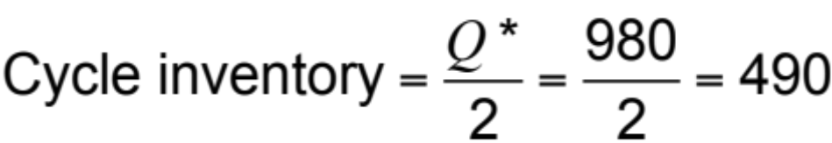
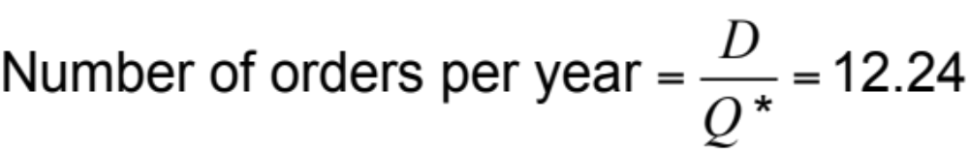
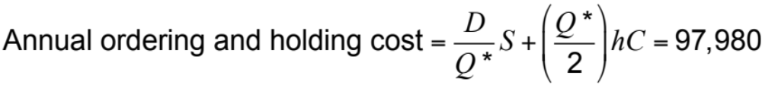
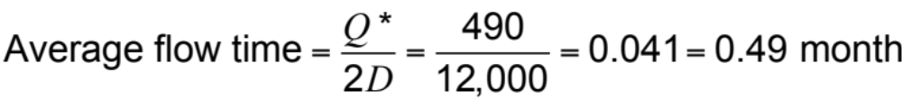
EOQ Example
Notes:
Notes:

Slide 21
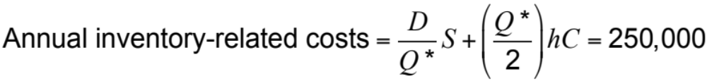
EOQ Example
Lot size reduced to Q = 200 units
Notes:
Notes:

Slide 22
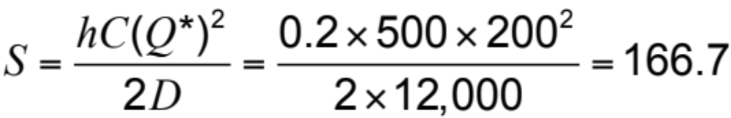
Lot Size and Ordering Cost
If the lot size Q* = 200, how much should the ordering cost be reduced?
Desired lot size, Q* = 200
Annual demand, D = 1,000 × 12 = 12,000 units
Unit cost per computer, C = $500
Holding cost per year as a fraction of inventory value, h = 0.2

Slide 23
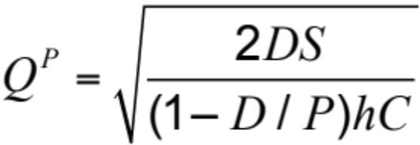
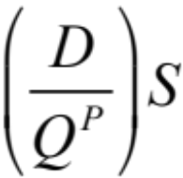
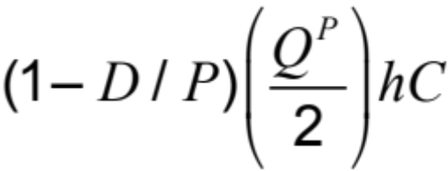
Production Lot Sizing
The entire lot does not arrive at the same time
Production occurs at a specified rate P
Inventory builds up at a rate of P – D
Annual setup cost
Annual holding cost

Slide 24
Aggregating Multiple Products in a Single Order
Savings in transportation costs
  Reduces fixed cost for each product
  Lot size for each product can be reduced
  Cycle inventory is reduced
Single delivery from multiple suppliers or single truck delivering to multiple retailers
Receiving and loading costs reduced

Slide 25
Lot Sizing with Multiple
Products or Customers
Ordering, transportation, and receiving costs grow with the variety of products or pickup points
Lot sizes and ordering policy that minimize total cost
D_{i}: Annual demand for product i
S: Order cost incurred each time an order is placed, independent of the variety of products in the order
s_{i}: Additional order cost incurred if product i is included in the order

Slide 26
Lot Sizing with Multiple
Products or Customers
Three approaches
  Each product manager orders his or her model independently
  The product managers jointly order every product in each lot
  Product managers order jointly but not every order contains every product; that is, each lot contains a selected subset of the products

Slide 27
Multiple Products Ordered and Delivered Independently
Demand
D_{L} = 12,000/yr, D_{M} = 1,200/yr, D_{H} = 120/yr
Common order cost
S = $4,000
Product-specific order cost
s_{L} = $1,000, s_{M} = $1,000, s_{H} = $1,000
Holding cost
h = 0.2
Unit cost
C_{L} = $500, C_{M} = $500, C_{H} = $500
Notes:
Notes:

Slide 28
Multiple Products Ordered and Delivered Independently
 | Litepro | Medpro | Heavypro
Demand per year | 12,000 | 1,200 | 120
Fixed cost/order | $5,000 | $5,000 | $5,000
Optimal order size | 1,095 | 346 | 110
Cycle inventory | 548 | 173 | 55
Annual holding cost | $54,772 | $17,321 | $5,477
Order frequency | 11.0/year | 3.5/year | 1.1/year
Annual ordering cost | $54,772 | $17,321 | $5,477
Average flow time | 2.4 weeks | 7.5 weeks | 23.7 weeks
Annual cost | $109,544 | $34,642 | $10,954
Total annual cost = $155,140
Table 11-1
Notes:
Notes:

Slide 29

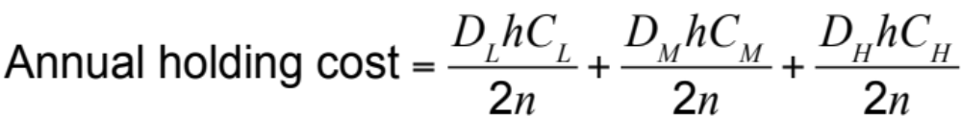
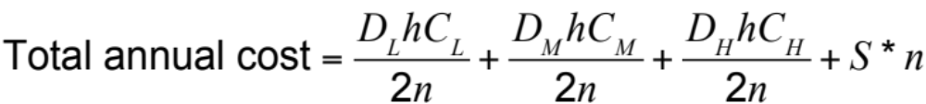
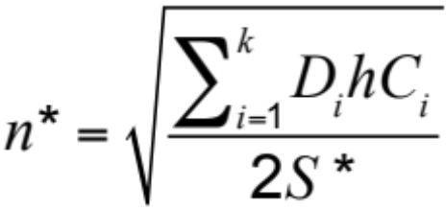
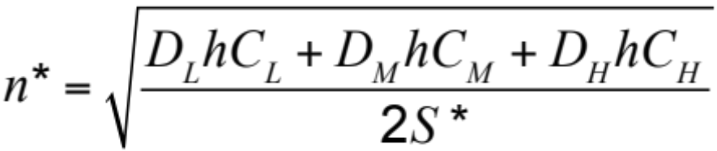
Lots Ordered and Delivered Jointly

Slide 30
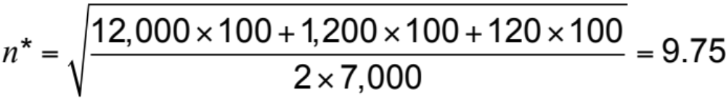
Products Ordered and Delivered Jointly
Annual order cost = 9.75 x 7,000 = $68,250
Annual ordering
and holding cost = $61,512 + $6,151 + $615 + $68,250
= $136,528

Slide 31
Products Ordered and Delivered Jointly
 | Litepro | Medpro | Heavypro
Demand per year (D) | 12,000 | 1,200 | 120
Order frequency (n∗) | 9.75/year | 9.75/year | 9.75/year
Optimal order size (D/n∗) | 1,230 | 123 | 12.3
Cycle inventory | 615 | 61.5 | 6.15
Annual holding cost | $61,512 | $6,151 | $615
Average flow time | 2.67 weeks | 2.67 weeks | 2.67 weeks
Table 11-2

Slide 32
Aggregation with Capacity Constraint
W.W. Grainger example
Demand per product, D_{i} = 10,000
Holding cost, h = 0.2
Unit cost per product, C_{i} = $50
Common order cost, S = $500
Supplier-specific order cost, s_{i} = $100
Notes:
Notes:

Slide 33
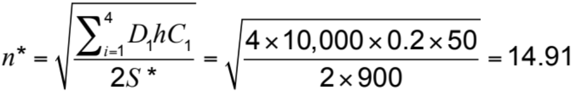
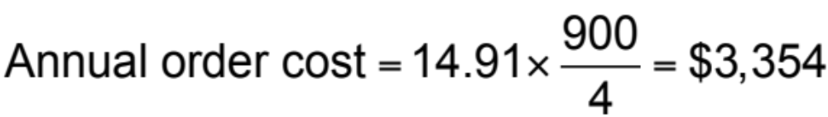
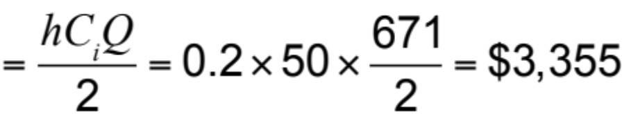
Aggregation with Capacity Constraint
Annual holding cost per supplier
Notes:
Notes:

Slide 34
Aggregation with Capacity Constraint
Total required capacity per truck = 4 x 671 = 2,684 units
Truck capacity = 2,500 units
Order quantity from each supplier = 2,500/4 = 625
Order frequency increased to 10,000/625 = 16
Annual order cost per supplier increases to $3,600
Annual holding cost per supplier decreases to $3,125.
Notes:
Notes:

Slide 35
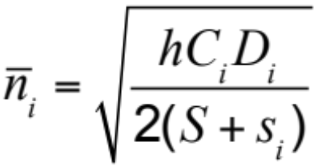
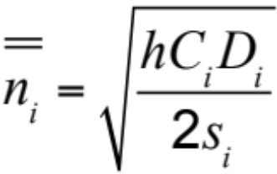
Lots Ordered and Delivered Jointly for a Selected Subset
Step 1: Identify the most frequently ordered product assuming each product is ordered independently
Step 2: For all products i ≠ i*, evaluate the ordering frequency

Slide 36
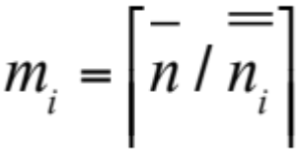
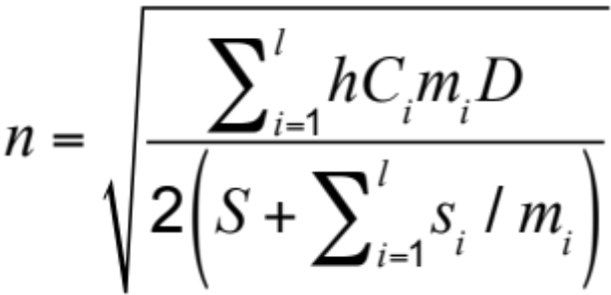
Lots Ordered and Delivered Jointly for a Selected Subset
Step 3: For all i ≠ i*, evaluate the frequency of product i relative to the most frequently ordered product i* to be m_{i}
Step 4: Recalculate the ordering frequency of the most frequently ordered product i* to be n

Slide 37
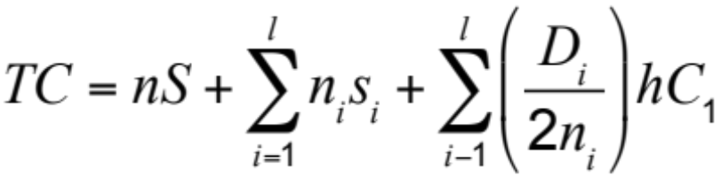
Lots Ordered and Delivered Jointly for a Selected Subset
Step 5: Evaluate an order frequency of n_{i} = n/m_{i} and the total cost of such an ordering policy
Tailored aggregation – higher-demand products ordered more frequently and lower-demand products ordered less frequently

Slide 38
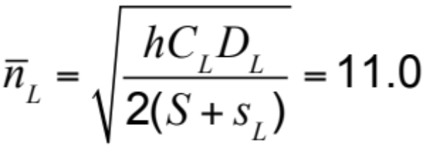
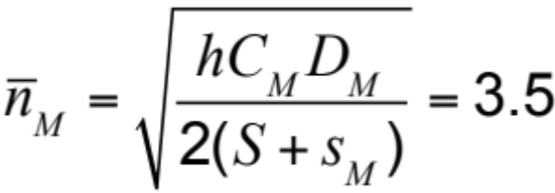

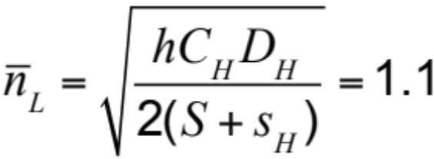
Ordered and Delivered Jointly – Frequency Varies by Order
Applying Step 1
Thus

Slide 39
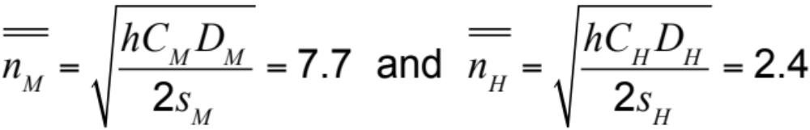
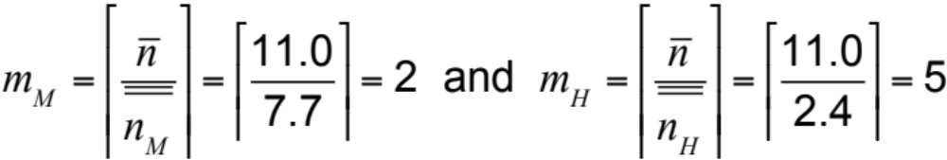
Ordered and Delivered Jointly – Frequency Varies by Order
Applying Step 2
Applying Step 3

Slide 40
Ordered and Delivered Jointly – Frequency Varies by Order
 | Litepro | Medpro | Heavypro
Demand per year (D) | 12,000 | 1,200 | 120
Order frequency (n∗) | 11.47/year | 5.74/year | 2.29/year
Optimal order size (D/n∗) | 1,046 | 209 | 52
Cycle inventory | 523 | 104.5 | 26
Annual holding cost | $52,307 | $10,461 | $2,615
Average flow time | 2.27 weeks | 4.53 weeks | 11.35 weeks
Table 11-3

Slide 41




Ordered and Delivered Jointly – Frequency Varies by Order
Applying Step 4
Applying Step 5
Annual order cost Total annual cost
$130,767

Slide 42
Economies of Scale to
Exploit Quantity Discounts
Lot size-based discount – discounts based on quantity ordered in a single lot
Volume based discount – discount is based on total quantity purchased over a given period
Two common schemes
  All-unit quantity discounts
  Marginal unit quantity discount or multi-block tariffs

Slide 43
Quantity Discounts
Two basic questions
  What is the optimal purchasing decision for a buyer seeking to maximize profits? How does this decision affect the supply chain in terms of lot sizes, cycle inventories, and flow times?
  Under what conditions should a supplier offer quantity discounts? What are appropriate pricing schedules that a supplier seeking to maximize profits should offer?

Slide 44
All-Unit Quantity Discounts
Pricing schedule has specified quantity break points q₀, q₁, …, q_{r}, where q₀ = 0
If an order is placed that is at least as large as q_{i} but smaller than q_{i+1}, then each unit has an average unit cost of C_{i}
Unit cost generally decreases as the quantity increases, i.e., C₀ > C₁ > … > C_{r}
Objective is to decide on a lot size that will minimize the sum of material, order, and holding costs

Slide 45
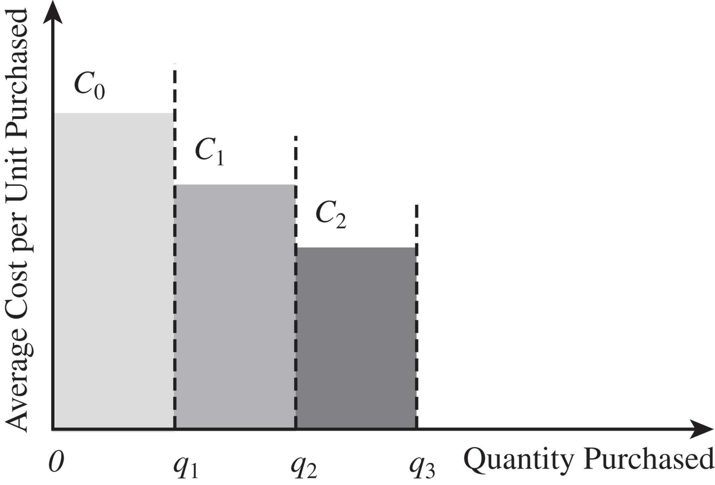
All-Unit Quantity Discounts
Figure 11-3

Slide 46
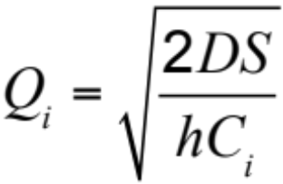
All-Unit Quantity Discounts
Step 1: Evaluate the optimal lot size for each price C_{i},0 ≤ i ≤ r as follows

Slide 47



All-Unit Quantity Discounts
Step 2: We next select the order quantity Q*_{i} for each price C_{i}
1.
2.
3.
Case 3 can be ignored as it is considered for Q_{i+1}
For Case 1 if , then set Q*_{i} = Q_{i}
If , then a discount is not possible
Set Q*_{i} = q_{i} to qualify for the discounted price of C_{i}

Slide 48
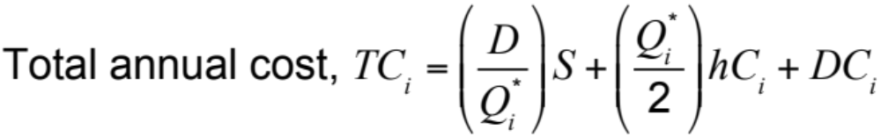
All-Unit Quantity Discounts
Step 3: Calculate the total annual cost of ordering Q*_{i} units

Slide 49
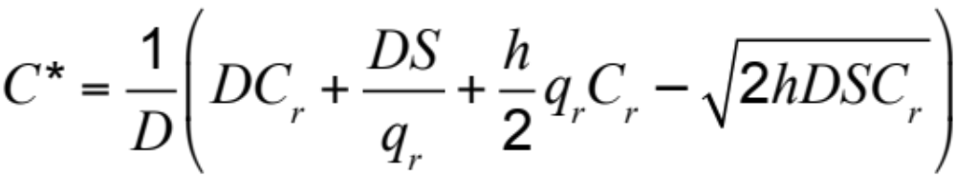
All-Unit Quantity Discounts
Step 4: Select Q*_{i} with the lowest total cost TC_{i}
Cutoff price

Slide 50
All-Unit Quantity Discount Example
Order Quantity | Unit Price
0–4,999 | $3.00
5,000–9,999 | $2.96
10,000 or more | $2.92
q₀ = 0, q₁ = 5,000, q₂ = 10,000
C₀ = $3.00, C₁ = $2.96, C₂ = $2.92
D = 120,000/year, S = $100/lot, h = 0.2

Slide 51
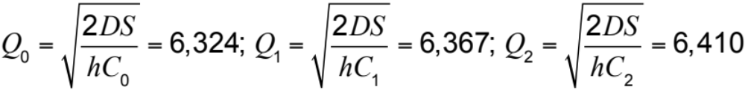

All-Unit Quantity Discount Example
Step 1
Step 2
Ignore i = 0 because Q₀ = 6,324 > q₁ = 5,000
For i = 1, 2

Slide 52
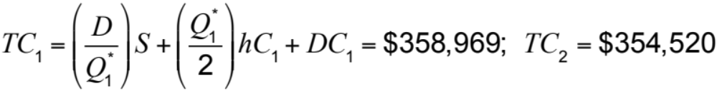

All-Unit Quantity Discount Example
Step 3
Lowest total cost is for i = 2
Order bottles per lot at $2.92 per bottle

Slide 53
Marginal Unit Quantity Discounts
Multi-block tariffs – the marginal cost of a unit that decreases at a breakpoint
For each value of i, 0 ≤ i ≤ r, let V_{i} be the cost of ordering q_{i} units

Slide 54
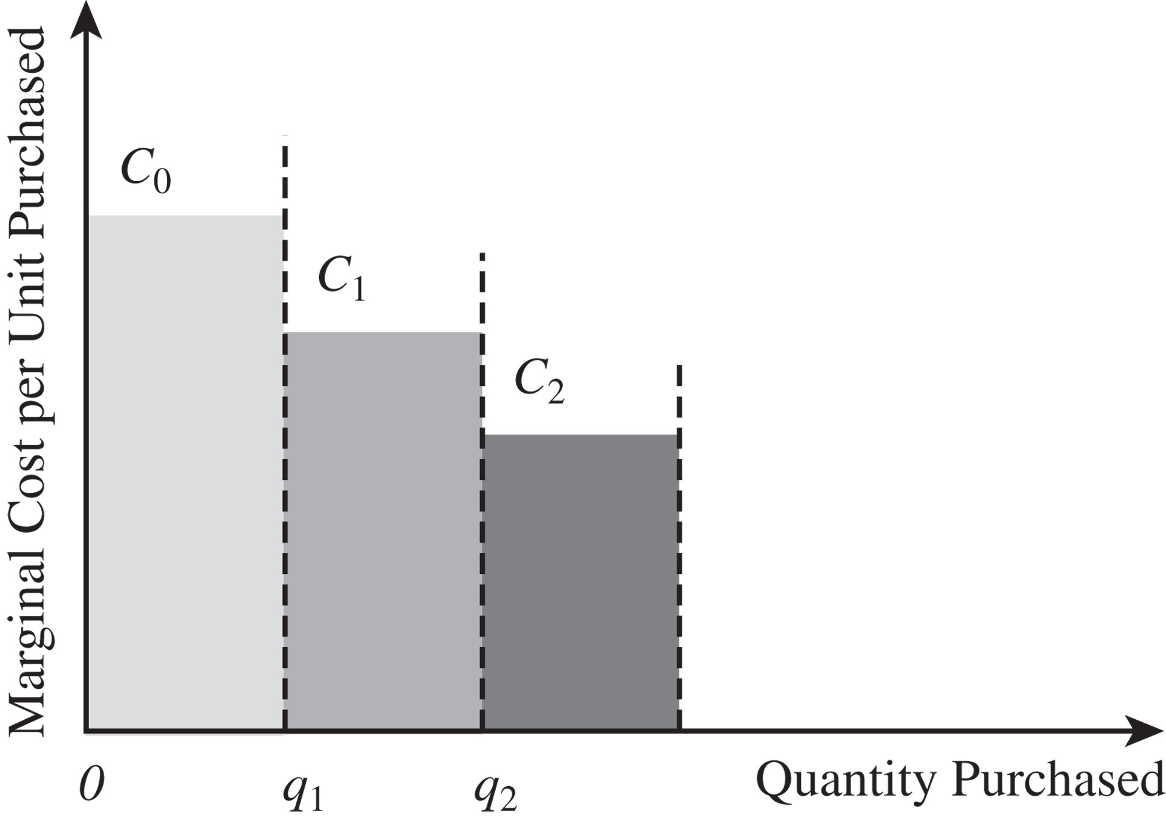
Marginal Unit Quantity Discounts
Figure 11-4

Slide 55
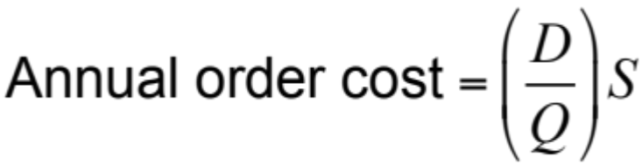
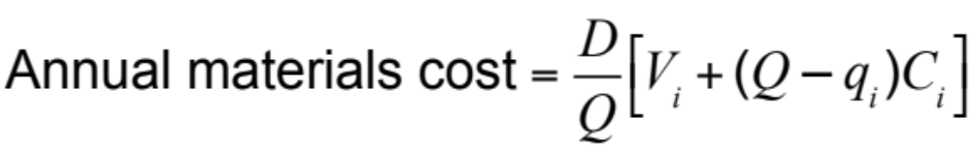
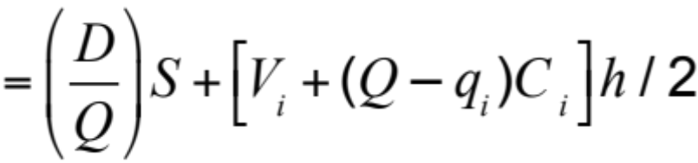

Marginal Unit Quantity Discounts
Material cost of each order Q is V_{i} + (Q – q_{i})C_{i}
Total annual cost

Slide 56

Marginal Unit Quantity Discounts
Step 1: Evaluate the optimal lot size for each price C_{i}

Slide 57



Marginal Unit Quantity Discounts
Step 2: Select the order quantity Q_{i}* for each price C_{i}
1.
2.
3.

Slide 58

Marginal Unit Quantity Discounts
Step 3: Calculate the total annual cost of ordering Q_{i}*
Step 4: Select the order size Q_{i}* with the lowest total cost TC_{i}

Slide 59
Marginal Unit Quantity Discount Example
Original data now a marginal discount
Order Quantity | Unit Price
0–4,999 | $3.00
5,000–9,999 | $2.96
10,000 or more | $2.92
q₀ = 0, q₁ = 5,000, q₂ = 10,000
C₀ = $3.00, C₁ = $2.96, C₂ = $2.92
D = 120,000/year, S = $100/lot, h = 0.2

Slide 60




Marginal Unit Quantity Discount Example
Step 1

Slide 61




Marginal Unit Quantity Discount Example
Step 2
Step 3

Slide 62
Why Quantity Discounts?
Quantity discounts can increase the supply chain surplus for the following two main reasons
  Improved coordination to increase total supply chain profits
  Extraction of surplus through price discrimination
Notes:
Notes:

Slide 63



Quantity Discounts for Commodity Products
D = 120,000 bottles/year, S_{R} = $100, h_{R} = 0.2, C_{R} = $3
S_{M} = $250, h_{M} = 0.2, C_{M} = $2
Annual supply chain cost (manufacturer + DO)
= $6,009 + $3,795 = $9,804
Notes:
Notes:

Slide 64




Locally Optimal Lot Sizes
Annual cost for DO and manufacturer
Annual supply chain cost (manufacturer + DO)
= $5,106 + $4,059 = $9,165
Notes:
Notes:

Slide 65
Designing a Suitable Lot Size-Based Quantity Discount
Design a suitable quantity discount that gets DO to order in lots of 9,165 units when its aims to minimize only its own total costs
Manufacturer needs to offer an incentive of at least $264 per year to DO in terms of decreased material cost if DO orders in lots of 9,165 units
Appropriate quantity discount is $3 if DO orders in lots smaller than 9,165 units and $2.9978 for orders of 9,165 or more
Notes:
Notes:

Slide 66




Quantity Discounts When
Firm Has Market Power
Demand curve = 360,000 – 60,000p
Production cost = C_{M} = $2 per bottle
p to maximize Prof_{R}
Notes:
Notes:

Slide 67

Quantity Discounts When
Firm Has Market Power
C_{R} = $4 per bottle, p = $5 per bottle
Total market demand = 360,000 – 60,000p = 60,000
Prof_{R} = (5 – 4)(360,000 – 60,000 × 5) = $60,000
Prof_{M} = (4 – 2)(360,000 – 60,000 × 5) = $120,000
Prof_{SC} = (p – C_{M})(360,000 – 60,000p)
Coordinated retail price
Prof_{SC} = ($4 – $2) x 120,000 = $240,000
Notes:
Notes:

Slide 68
Two-Part Tariff
Manufacturer charges its entire profit as an up-front franchise fee ff
Sells to the retailer at cost
Retail pricing decision is based on maximizing its profits
Effectively maximizes the coordinated supply chain profit
Notes:
Notes:

Slide 69
Volume-Based Quantity Discounts
Design a volume-based discount scheme that gets the retailer to purchase and sell the quantity sold when the two stages coordinate their actions
Notes:
Notes:

Slide 70
Lessons from Discounting Schemes
Quantity discounts play a role in supply chain coordination and improved supply chain profits
Discount schemes that are optimal are volume based and not lot size based unless the manufacturer has large fixed costs associated with each lot
Even in the presence of large fixed costs for the manufacturer, a two-part tariff or volume-based discount, with the manufacturer passing on some of the fixed cost to the retailer, optimally coordinates the supply chain and maximizes profits

Slide 71
Lessons from Discounting Schemes
Lot size–based discounts tend to raise the cycle inventory in the supply chain
Volume-based discounts are compatible with small lots that reduce cycle inventory
Retailers will tend to increase the size of the lot toward the end of the evaluation period, the hockey stick phenomenon
With multiple retailers with different demand curves optimal discount continues to be volume based with the average price charged to the retailers decreasing as the rate of purchase increases

Slide 72
Price Discrimination to Maximize Supplier Profits
Firm charges differential prices to maximize profits
Setting a fixed price for all units does not maximize profits for the manufacturer
Manufacturer can obtain maximum profits by pricing each unit differently based on customers’ marginal evaluation at each quantity
Quantity discounts are one mechanism for price discrimination because customers pay different prices based on the quantity purchased

Slide 73
Short-Term Discounting:
Trade Promotions
Trade promotions are price discounts for a limited period of time
Key goals
  Induce retailers to use price discounts, displays, or advertising to spur sales
  Shift inventory from the manufacturer to the retailer and the customer
  Defend a brand against competition

Slide 74
Short-Term Discounting:
Trade Promotions
Impact on the behavior of the retailer and supply chain performance
Retailer has two primary options
  Pass through some or all of the promotion to customers to spur sales
  Pass through very little of the promotion to customers but purchase in greater quantity during the promotion period to exploit the temporary reduction in price (forward buy)

Slide 75

Forward Buying Inventory Profile
Figure 11-5

Slide 76
Forward Buy
Costs to be considered – material cost, holding cost, and order cost
Three assumptions
  The discount is offered once, with no future discounts
  The retailer takes no action to influence customer demand
  Analyze a period over which the demand is an integer multiple of Q*

Slide 77


Forward Buy
Optimal order quantity
Retailers are often aware of the timing of the next promotion

Slide 78

Impact of Trade Promotions on Lot Sizes
Q* = 6,324 bottles, C = $3 per bottle
d = $0.15, D = 120,000, h = 0.2
Cycle inventory at DO = Q*/2 = 6,324/2 = 3,162 bottles
Average flow time = Q*/2D = 6,324/(2D) = 0.3162 months
Notes:
Notes:
Optimal order quantity =

Slide 79
Impact of Trade Promotions on Lot Sizes
With trade promotions
Cycle inventory at DO = Q^{d}/2 = 38,236/2 = 19,118 bottles
Average flow time = Q^{d}/2D = 38,236/(20,000)
= 1.9118 months
Forward buy = Q^{d} – Q* = 38,236 – 6,324 = 31,912 bottles
Notes:
Notes:
Optimal order quantity =

Slide 80
How Much of a Discount Should the Retailer Pass Through?
Profits for the retailer
Prof_{R} = (300,000 – 60,000p)p – (300,000 – 60,000p)C_{R}
Optimal price
p = (300,000 + 60,000C_{R})/120,000
Demand with no promotion
D_{R} = 30,000 – 60,000p = 60,000
Optimal price with discount
p = (300,000 + 60,000 x 2.85)/120,000 = $3.925
Demand with promotion
D_{R} = 300,000 - 60,000p = 64,500

Slide 81
Trade Promotions
Trade promotions generally increase cycle inventory in a supply chain and hurt performance
Counter measures
  EDLP (every day low pricing)
  Discount applies to items sold to customers (sell-through) not the quantity purchased by the retailer (sell-in)
  Scan based promotions
Notes:
Notes:

Slide 82
Managing Multiechelon
Cycle Inventory
Multi-echelon supply chains have multiple stages with possibly many players at each stage
Lack of coordination in lot sizing decisions across the supply chain results in high costs and more cycle inventory than required
The goal is to decrease total costs by coordinating orders across the supply chain

Slide 83

Managing Multiechelon
Cycle Inventory
Figure 11-6

Slide 84
Integer Replenishment Policy
Divide all parties within a stage into groups such that all parties within a group order from the same supplier and have the same reorder interval
Set reorder intervals across stages such that the receipt of a replenishment order at any stage is synchronized with the shipment of a replenishment order to at least one of its customers
For customers with a longer reorder interval than the supplier, make the customer’s reorder interval an integer multiple of the supplier’s interval and synchronize replenishment at the two stages to facilitate cross-docking

Slide 85
Integer Replenishment Policy
For customers with a shorter reorder interval than the supplier, make the supplier’s reorder interval an integer multiple of the customer’s interval and synchronize replenishment at the two stages to facilitate cross-docking
The relative frequency of reordering depends on the setup cost, holding cost, and demand at different parties
These polices make the most sense for supply chains in which cycle inventories are large and demand is relatively predictable

Slide 86

Integer Replenishment Policy
Figure 11-7

Slide 87

Integer Replenishment Policy
Figure 11-8

Slide 88
Summary of Learning Objectives
Balance the appropriate costs to choose the optimal lot size and cycle inventory in a supply chain
Understand the impact of quantity discounts on lot size and cycle inventory
Devise appropriate discounting schemes for a supply chain
Understand the impact of trade promotions on lot size and cycle inventory

Slide 89
Summary of Learning Objectives
Identify managerial levers that reduce lot size and cycle inventory in a supply chain without increasing cost
  Reduce fixed ordering and transportation costs incurred per order
  Implement volume-based discounting schemes rather than individual lot size–based discounting schemes
  Eliminate or reduce trade promotions and encourage EDLP – base trade promotions on sell-through rather than sell-in to the retailer

Slide 90

All rights reserved. No part of this publication may be reproduced, stored in a retrieval system, or transmitted, in any form or by any means, electronic, mechanical, photocopying, recording, or otherwise, without the prior written permission of the publisher.
Printed in the United States of America.

