Slide 1
Managing Uncertainty in a Supply Chain: Safety Inventory
12

Slide 2
Learning Objectives
Understand the role of safety inventory in a supply chain
Identify factors that influence the required level of safety inventory
Describe different measures of product availability
Utilize managerial levers available to lower safety inventory and improve product availability

Slide 3
The Role of Safety Inventory
Safety inventory is carried to satisfy demand that exceeds the amount forecasted
  Raising the level of safety inventory increases product availability and thus the margin captured from customer purchases
  Raising the level of safety inventory increases inventory holding costs

Slide 4
The Role of Safety Inventory
Three key questions
  What is the appropriate level of product availability?
  How much safety inventory is needed for the desired level of product availability?
  What actions can be taken to improve product availability while reducing safety inventory?

Slide 5
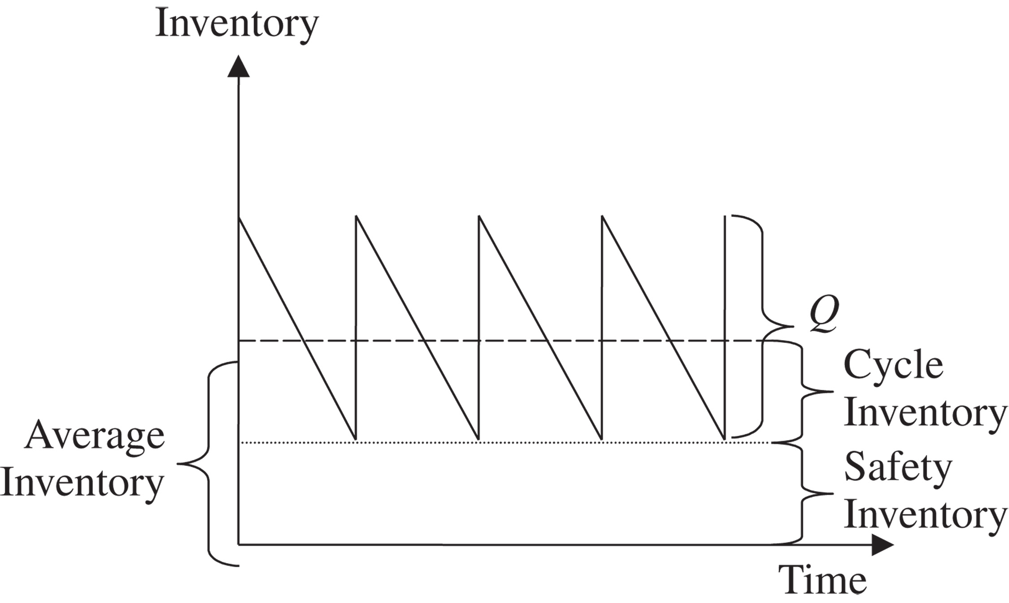
The Role of Safety Inventory
Figure 12-1

Slide 6
Determining the Appropriate Level
Determined by two factors
  The uncertainty of both demand and supply
  The desired level of product availability
Measuring Demand Uncertainty
D = Average demand per period
σ_{D} = Standard deviation of demand (forecast error) per period
Lead time (L) is the gap between when an order is placed and when it is received

Slide 7
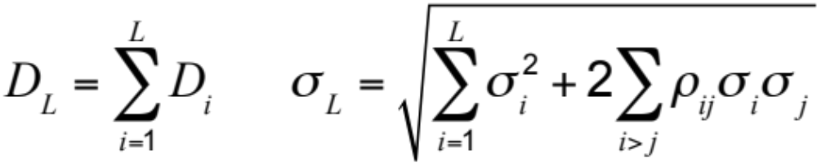
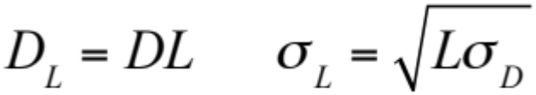

Evaluating Demand Distribution Over L Periods
The coefficient of variation

Slide 8
Measuring Product Availability
Product fill rate (fr)
  Fraction of product demand satisfied from product in inventory
Order fill rate
  Fraction of orders filled from available inventory
Cycle service level (CSL)
  Fraction of replenishment cycles that end with all customer demand being met

Slide 9
Replenishment Policies
Continuous review
  Inventory is continuously tracked
  Order for a lot size Q is placed when the inventory declines to the reorder point (ROP)
Periodic review
  Inventory status is checked at regular periodic intervals
  Order is placed to raise the inventory level to a specified threshold

Slide 10
Evaluating Cycle Service Level and Fill Rate
Evaluating Safety Inventory Given a Replenishment Policy
Expected demand during lead time = DL
Safety inventory, ss = ROP – DL

Slide 11
Evaluating Cycle Service Level and Fill Rate
Average demand per week, D = 2,500
Standard deviation of weekly demand, σ_{D} = 500
Average lead time for replenishment, L = 2 weeks
Reorder point, ROP = 6,000
Average lot size, Q = 10,000
Safety inventory, ss = ROP – DL = 6,000 – 5,000 = 1,000
Cycle inventory = Q/2 = 10,0002 = 5,000

Slide 12
Evaluating Cycle Service Level and Fill Rate
Average inventory = cycle inventory + safety inventory
= 5,000 + 1,000 = 6,000
Average flow time = average inventory/throughput
= 6,000/2,500 = 2.4 weeks

Slide 13
Evaluating Cycle Service Level and Fill Rate
Evaluating Cycle Service Level Given a Replenishment Policy
CSL = Prob(ddlt of L weeks ≤ ROP)
CSL = F(ROP, D_{L}, σ_{L}) = NORMDIST(ROP, D_{L}, σ_{L}, 1)
(ddlt = demand during lead time)

Slide 14
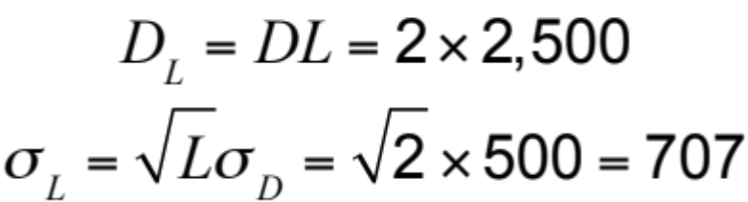
Evaluating Cycle Service Level and Fill Rate
Q = 10,000, ROP = 6,000, L = 2 weeks
D = 2,500/week, σ_{D} = 500
CSL = F(ROP,D_{L},σ_{L}) = NORMDIST(ROP,D_{L},σ_{L},1)
= NORMDIST(6,000,5,000,707,1) = 0.92

Slide 15
Evaluating Fill Rate Given a Replenishment Policy
Expected shortage per replenishment cycle (ESC) is the average units of demand that are not satisfied from inventory in stock per replenishment cycle
Product fill rate
fr = 1 – ESC/Q = (Q – ESC)/Q

Slide 16
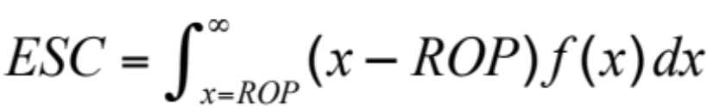
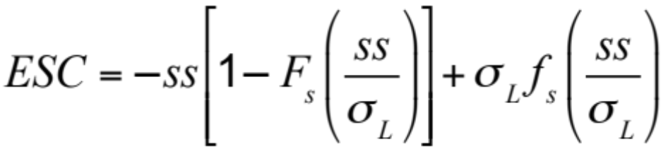

Evaluating Fill Rate Given a Replenishment Policy

Slide 17
Evaluating Fill Rate Given a Replenishment Policy
Lot size, Q = 10,000
Average demand during lead time, D_{L} = 5,000
Standard deviation of demand during lead time, σ_{L} = 707
Safety inventory, ss = ROP – DL = 6,000 – 5,000 = 1,000
fr = (Q – ESC)/Q = 110,000 – 252/10,000 = 0.9975

Slide 18
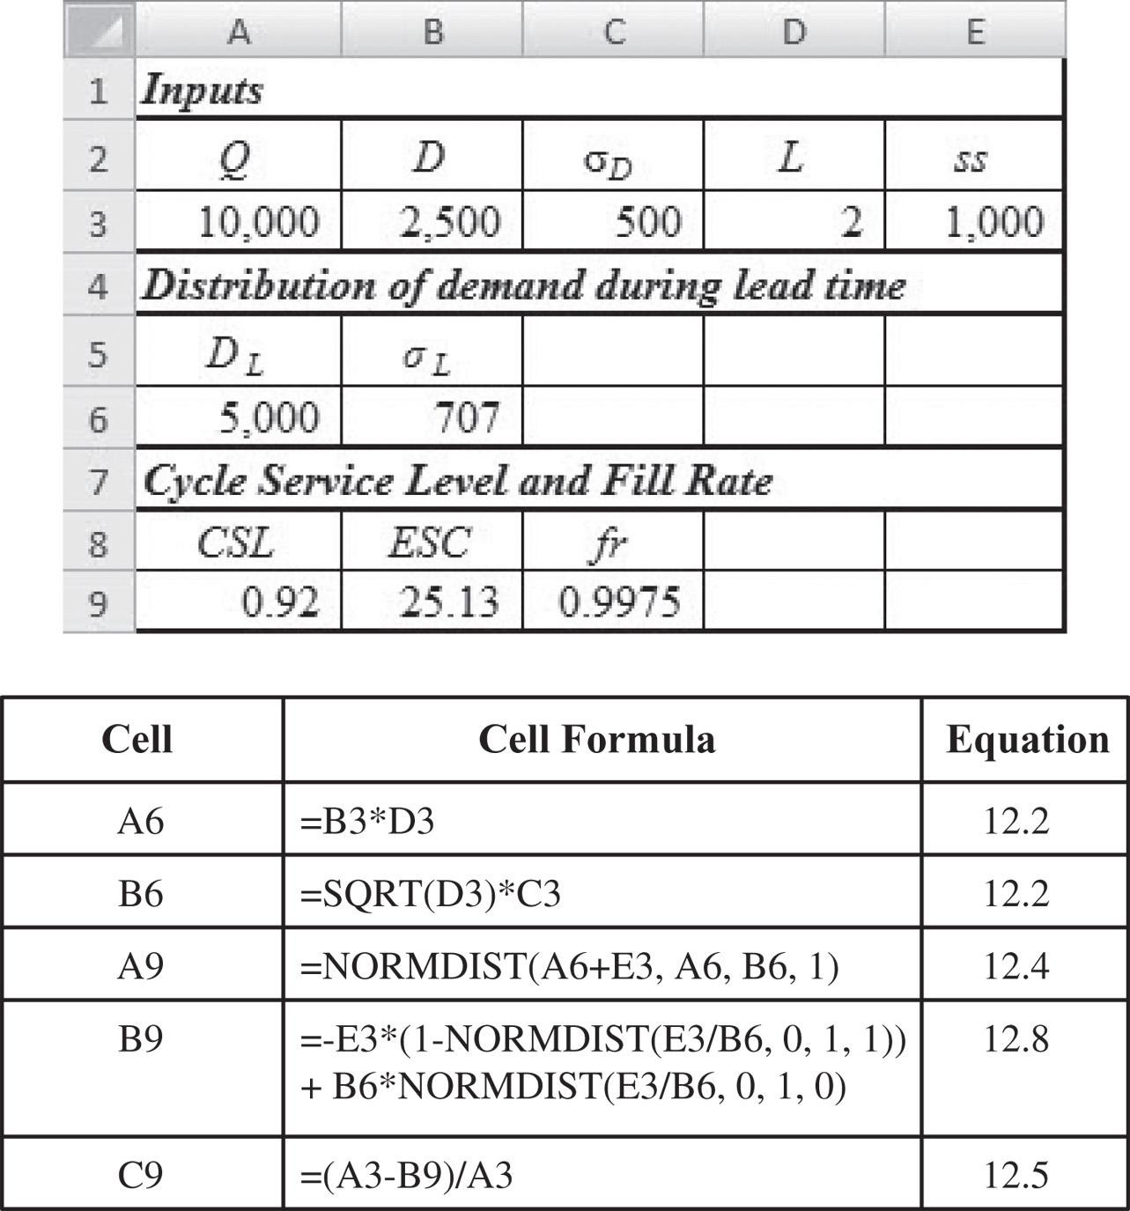
Evaluating Fill Rate Given a Replenishment Policy
Figure 12-2

Slide 19
Evaluating Safety Inventory Given Desired Cycle Service Level
Desired cycle service level = CSL
Mean demand during lead time = D_{L}
Standard deviation of demand during lead time = σ_{L}
Probability(demand during lead time ≤ D_{L} + ss) = CSL
Identify safety inventory so that
F(D_{L} + ss, D_{L}, s_{L}) = CSL

Slide 20
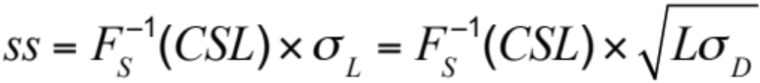
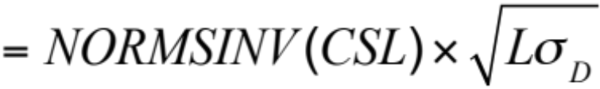
Evaluating Safety Inventory Given Desired Cycle Service Level
or

Slide 21
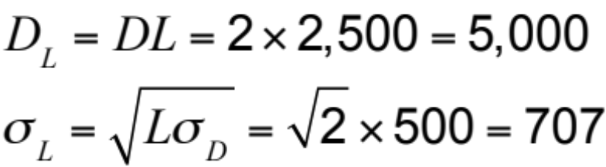
Evaluating Safety Inventory Given Desired Cycle Service Level
Q = 10,000, CSL = 0.9, L = 2 weeks
D = 2,500/week, σ_{D} = 500

Slide 22
Evaluating Safety Inventory Given Desired Fill Rate
Expected shortage per replenishment cycle is
ESC = (1 – fr)Q
No equation for ss
Try values or use GOALSEEK in Excel

Slide 23
Evaluating Safety Inventory Given Desired Fill Rate
Desired fill rate, fr = 0.975
Lot size, Q = 10,000 boxes
Standard deviation of ddlt, σ_{L} = 707
ESC = (1 – fr)Q = (1 – 0.975)10,000 = 250

Slide 24
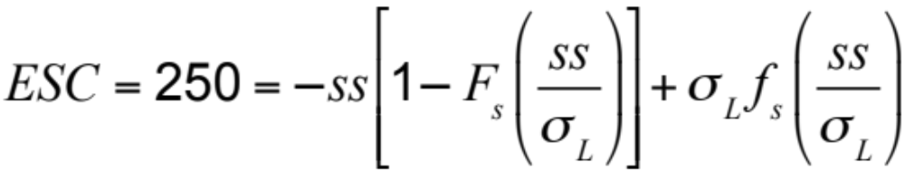
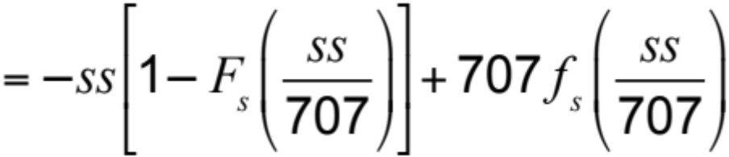
Evaluating Safety Inventory Given Desired Fill Rate
Use GOALSEEK to find safety inventory ss = 67 boxes

Slide 25
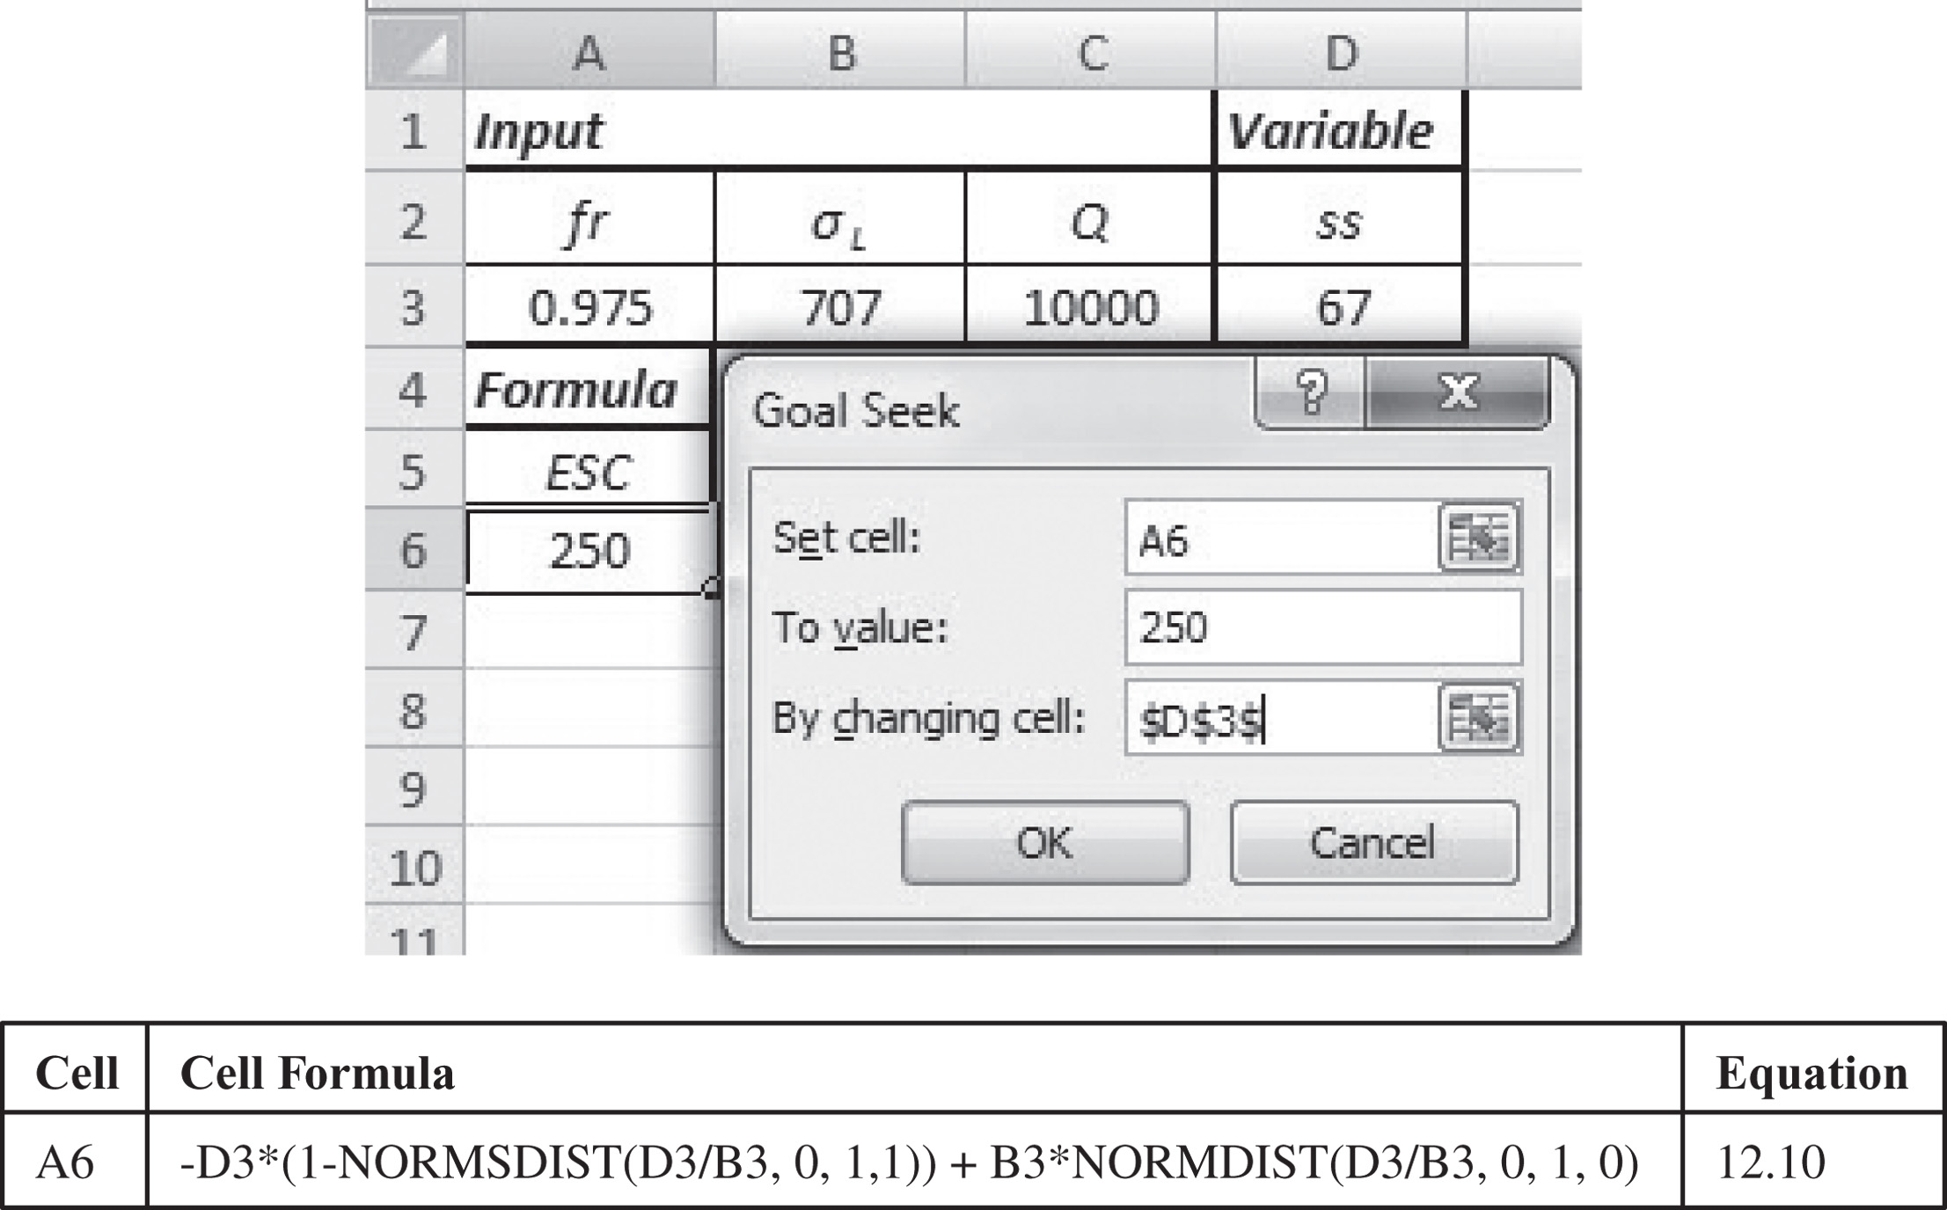
Evaluating Safety Inventory Given Desired Fill Rate
Figure 12-3

Slide 26
Impact of Desired Product Availability and Uncertainty
As desired product availability goes up the required safety inventory increases
Fill Rate | Safety Inventory
97.5% | 67
98.0% | 183
98.5% | 321
99.0% | 499
99.5% | 767
Table 12-1

Slide 27
Impact of Desired Product Availability and Uncertainty
Goal is to reduce the level of safety inventory required in a way that does not adversely affect product availability
  Reduce the supplier lead time L
  Reduce the underlying uncertainty of demand (represented by σ_{D})

Slide 28
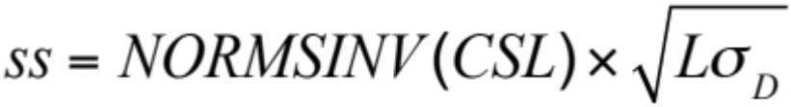
Benefits of Reducing Lead Time
D = 2,500/week, σ_{D} = 800, CSL = 0.95
If lead time is reduced to one week
If standard deviation is reduced to 400

Slide 29
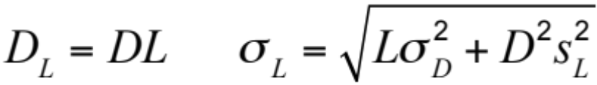
Impact of Supply Uncertainty on Safety Inventory
We incorporate supply uncertainty by assuming that lead time is uncertain
D: Average demand per period
σ_{D}: Standard deviation of demand per period
L: Average lead time for replenishment
σ_{L}: Standard deviation of lead time

Slide 30
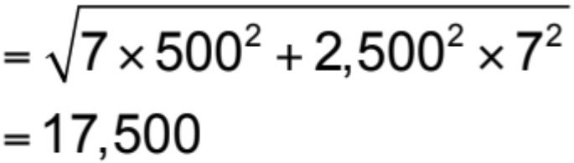
Impact of Lead Time Uncertainty on Safety Inventory
Average demand per period, D = 2,500
Standard deviation of demand per period, σ_{D} = 500
Average lead time for replenishment, L = 7 days
Standard deviation of lead time, σ_{L} = 7 days
Mean ddlt, D_{L} = DL = 2,500 x 7 = 17,500

Slide 31
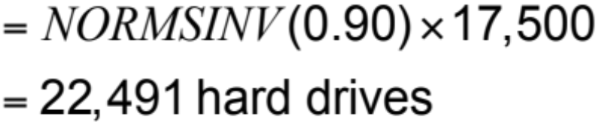
Impact of Lead Time Uncertainty on Safety Inventory
Required safety inventory
Table 12-2
s_{L} | σ_{L} | ss (units) | ss (days)
6 | 15,058 | 19,298 | 7.72
5 | 12,570 | 16,109 | 6.44
4 | 10,087 | 12,927 | 5.17
3 | 7,616 | 9,760 | 3.90
2 | 5,172 | 6,628 | 2.65
1 | 2,828 | 3,625 | 1.45
0 | 1,323 | 1,695 | 0.68

Slide 32
Impact of Aggregation on Safety Inventory
How does aggregation affect forecast accuracy and safety inventories
D_{i}: Mean weekly demand in region i, i = 1,…, k
σ_{i}: Standard deviation of weekly demand in region i, i = 1,…, k
ρ_{ij}: Correlation of weekly demand for regions i, j,
1 ≤ i ≠ j ≤ k

Slide 33
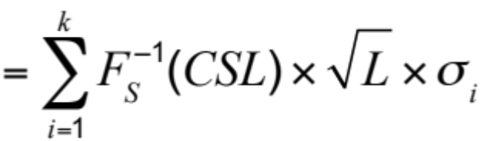
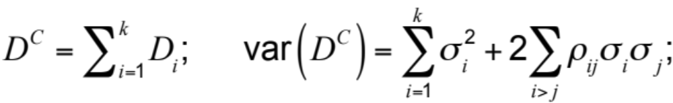
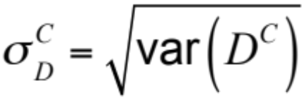
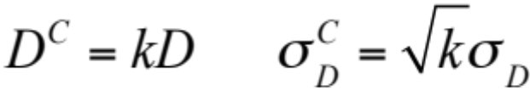
Impact of Aggregation on Safety Inventory
Total safety inventory
in decentralized option

Slide 34
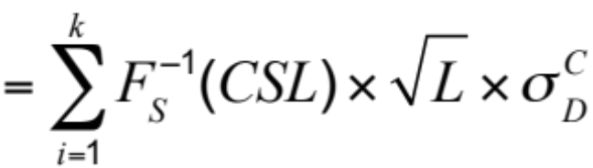
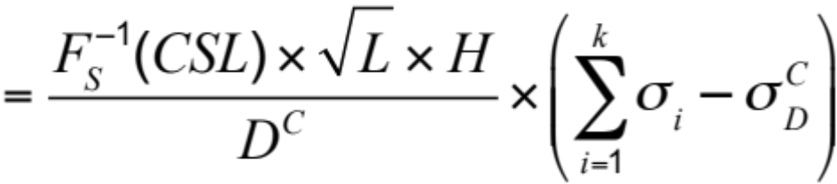
Impact of Aggregation on Safety Inventory
Require safety inventory on aggregation
Holding-cost savings on aggregation per unit sold

Slide 35
Impact of Aggregation on Safety Inventory
The safety inventory savings on aggregation increase with the desired cycle service level CSL
The safety inventory savings on aggregation increase with the replenishment lead time L
The safety inventory savings on aggregation increase with the holding cost H
The safety inventory savings on aggregation increase with the coefficient of variation of demand
The safety inventory savings on aggregation decrease as the correlation coefficients increase

Slide 36
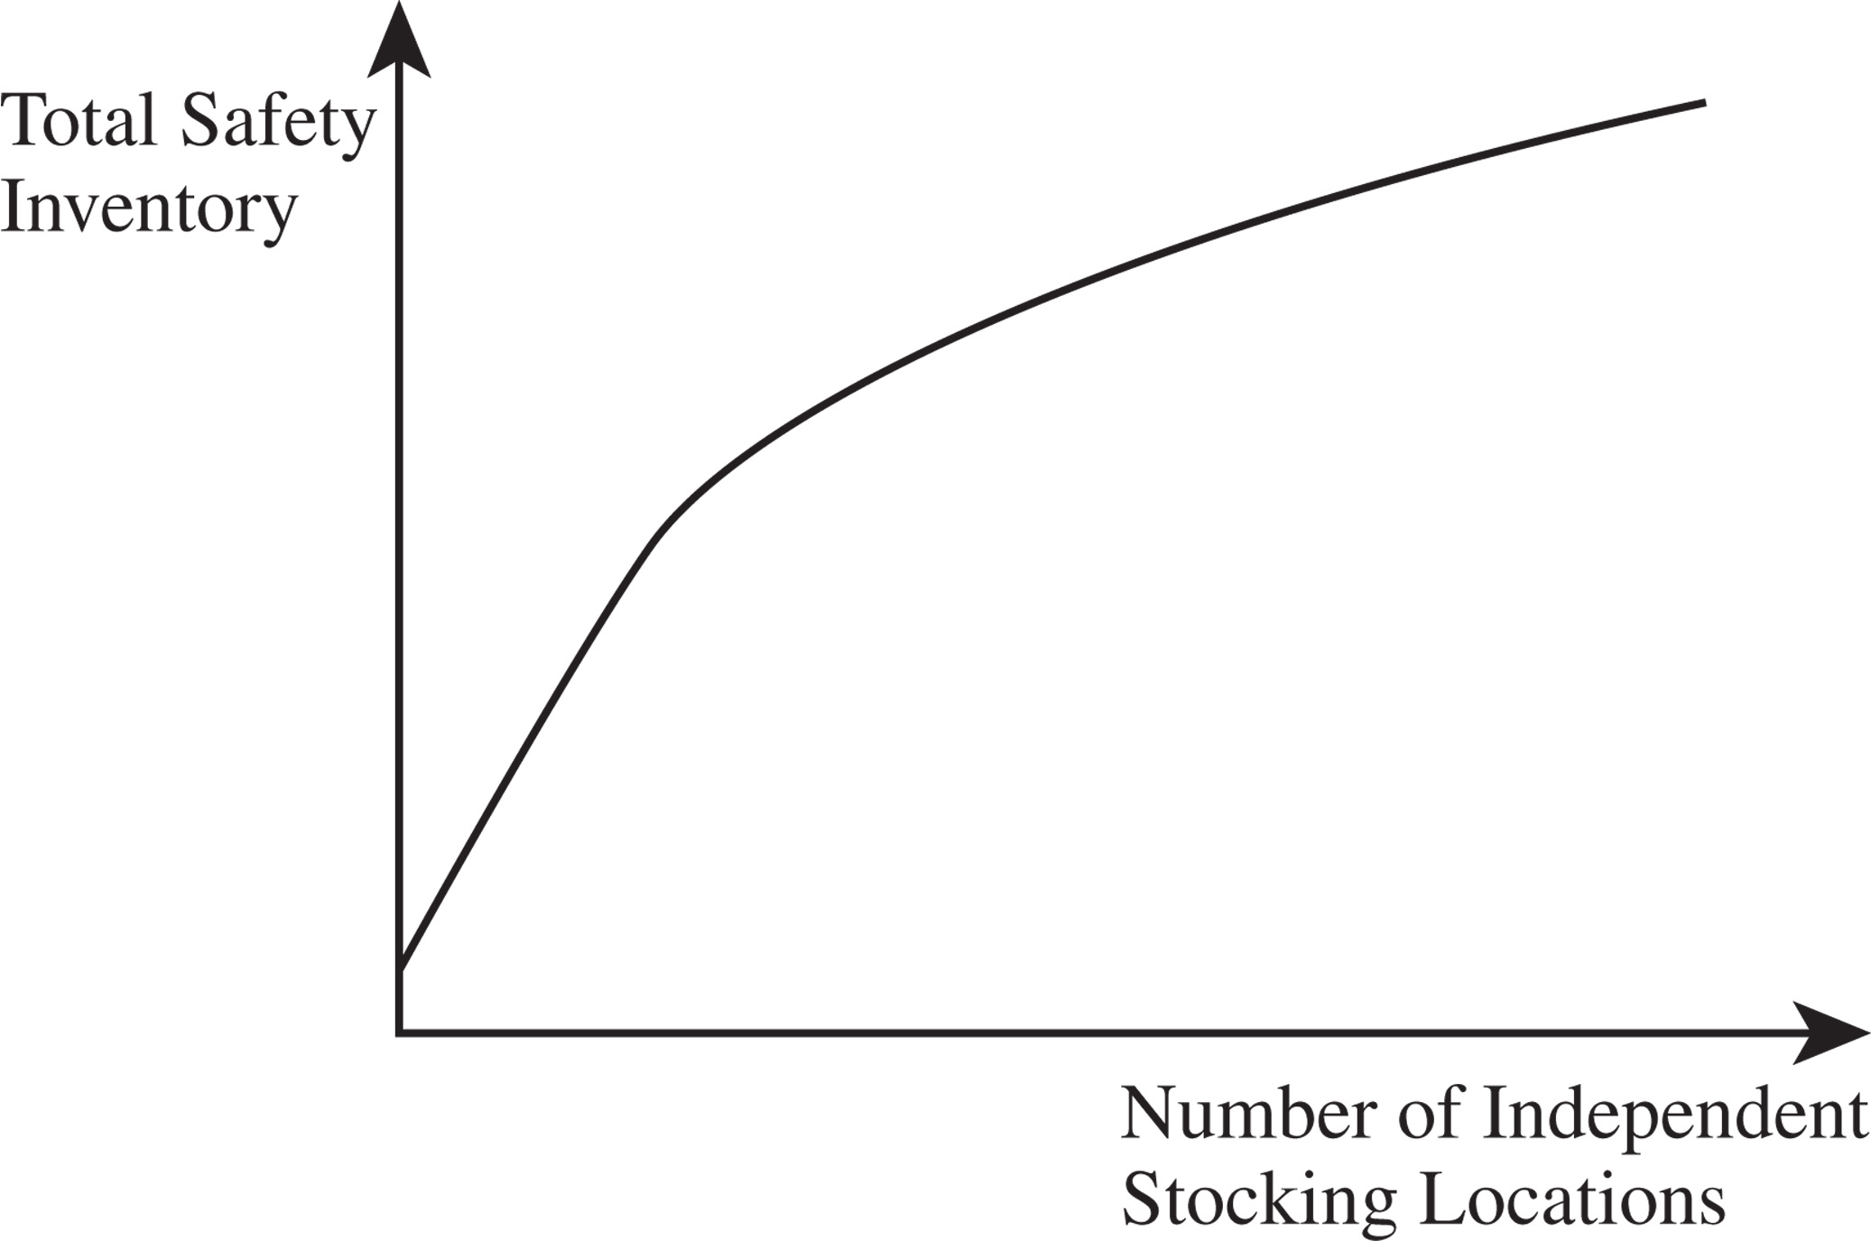
Impact of Aggregation on Safety Inventory
The Square-Root Law
Figure 12-4

Slide 37
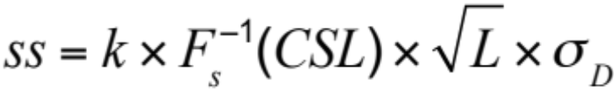
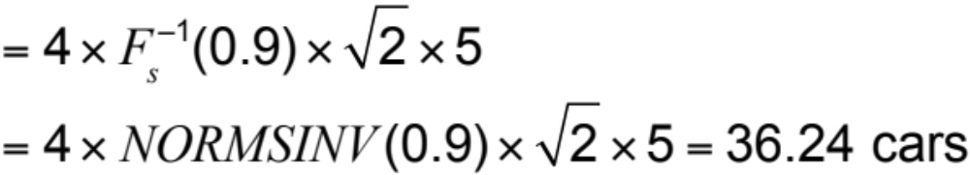
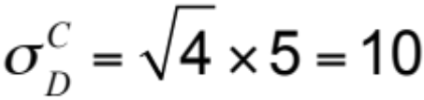
Impact of Correlation on
Value of Aggregation
Standard deviation of weekly demand, σ_{D} = 5;
Replenishment, L = 2 weeks; Decentralized CSL = 0.9
Total required safety inventory,
Aggregate ρ = 0
Standard deviation of weekly demand at central outlet,

Slide 38
Impact of Correlation on
Value of Aggregation
ρ | Disaggregate Safety Inventory | Aggregate Safety Inventory
0 | 36.24 | 18.12
0.2 | 36.24 | 22.92
0.4 | 36.24 | 26.88
0.6 | 36.24 | 30.32
0.8 | 36.24 | 33.41
1.0 | 36.24 | 36.24
Table 12-3

Slide 39
Impact of Correlation on
Value of Aggregation
Two possible disadvantages to aggregation
  Increase in response time to customer order
  Increase in transportation cost to customer

Slide 40
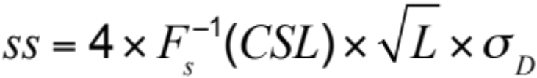
Trade-offs of Physical Centralization
Use four regional or one national distribution center
D = 1,000/week, σ_{D} = 300, L = 4 weeks, CSL = 0.95
Four regional centers
Total required safety inventory,

Slide 41
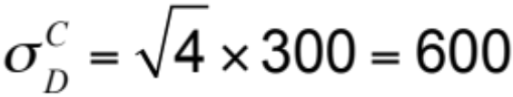
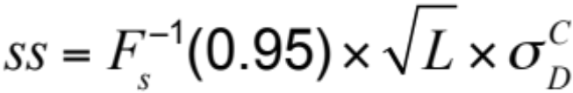
Trade-offs of Physical Centralization
One national distribution center, ρ = 0
Standard deviation of weekly demand,
Decrease in holding costs = (3,948 – 1,974) $1,000 x 0.2
= $394,765
Decrease in facility costs = $150,000
Increase in transportation = 52 x 1,000 x (13 – 10)
= $624,000

Slide 42
Information Centralization
Online systems that allow customers or stores to locate stock
Improves product availability without adding to inventories
Reduces the amount of safety inventory

Slide 43
Specialization
Inventory is carried at multiple locations
Should all products should be stocked at every location?
  Required level of safety inventory
  Affected by coefficient of variation of demand
  Low demand, slow-moving items, typically have a high coefficient of variation
  High demand, fast-moving items, typically have a low coefficient of variation

Slide 44
Impact of Coefficient of Variation on Value of Aggregation
Table 12-4
 | Motors | Cleaner
Inventory is stocked in each store
Mean weekly demand per store | 20 | 1,000
Standard deviation | 40 | 100
Coefficient of variation | 2.0 | 0.1
Safety inventory per store | 132 | 329
Total safety inventory | 211,200 | 526,400
Value of safety inventory | $105,600,000 | $15,792,000
Inventory is aggregated at the DC
Mean weekly aggregate demand | 32,000 | 1,600,000
Standard deviation of aggregate demand | 1,600 | 4,000
Coefficient of variation | 0.05 | 0.0025
Aggregate safety inventory | 5,264 | 13,159
Value of safety inventory | $2,632,000 | $394,770
Savings
Total inventory saving on aggregation | $102,968,000 | $15,397,230
Total holding cost saving on aggregation | $25,742,000 | $3,849,308
Holding cost saving per unit sold | $15.47 | $0.046
Savings as a percentage of product cost | 3.09% | 0.15%

Slide 45
Product Substitution
The use of one product to satisfy demand for a different product
  Manufacturer-driven substitution
    Allows aggregation of demand
    Reduce safety inventories
    Influenced by the cost differential, correlation of demand
  Customer-driven substitution
    Allows aggregation of safety inventory

Slide 46
Component Commonality
Without common components
  Uncertainty of demand for a component is the same as for the finished product
  Results in high levels of safety inventor
With common components
  Demand for a component is an aggregation of the demand for the finished products
  Component demand is more predictable
  Component inventories are reduced

Slide 47


Value of Component Commonality
27 PCs, 3 components, 3 x 27 = 81 distinct components
Monthly demand = 5,000
Standard deviation = 3,000
Replenishment lead time = 1 month
CSL = 0.95
Total safety inventory required
Safety inventory per common component

Slide 48

Value of Component Commonality
With component commonality
Nine distinct components
Total safety inventory required

Slide 49
Value of Component Commonality
Number of Finished Products per Component | Safety Inventory | Marginal Reduction in Safety Inventory | Total Reduction in Safety Inventory
1 | 399,699
2 | 282,630 | 117,069 | 117,069
3 | 230,766 | 51,864 | 168,933
4 | 199,849 | 30,917 | 199,850
5 | 178,751 | 21,098 | 220,948
6 | 163,176 | 15,575 | 236,523
7 | 151,072 | 12,104 | 248,627
8 | 141,315 | 9,757 | 258,384
9 | 133,233 | 8,082 | 266,466
Table 12-5

Slide 50
Postponement
Delay product differentiation or customization until closer to the time the product is sold
  Have common components in the supply chain for most of the push phase
  Move product differentiation as close to the pull phase of the supply chain as possible
  Inventories in the supply chain are mostly aggregate

Slide 51
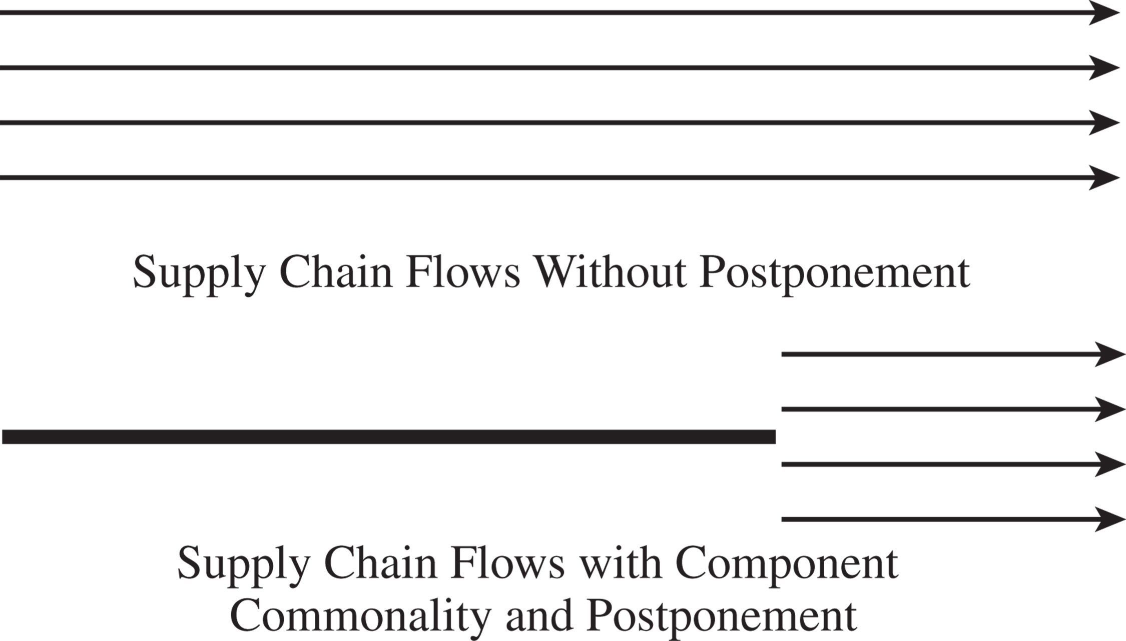
Postponement
Figure 12-5

Slide 52
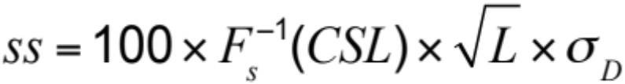
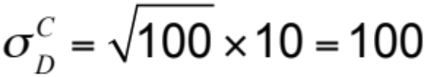
Value of Postponement
100 different paint colors, D = 30/week, σ_{D} = 10,
L = 2 weeks, CSL = 0.95
Total required safety inventory,
Standard deviation of
base paint weekly demand,

Slide 53
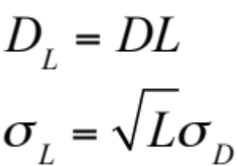
Impact of Replenishment Policies on Safety Inventory
Continuous Review Policies
D: Average demand per period
σ_{D}: Standard deviation of demand per period
L: Average lead time for replenishment
Mean demand during lead time,
Standard deviation of demand during lead time,

Slide 54
Impact of Replenishment Policies on Safety Inventory
Periodic Review Policies
  Lot size determined by prespecified order-up-to level (OUL)
D: Average demand per period
σ_{D}: Standard deviation of demand per period
L: Average lead time for replenishment
T: Review interval
CSL: Desired cycle service level

Slide 55
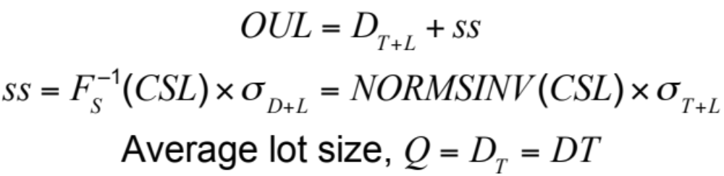
Impact of Replenishment Policies on Safety Inventory
Probability(demand during L + T ≤ OUL) = CSL

Slide 56
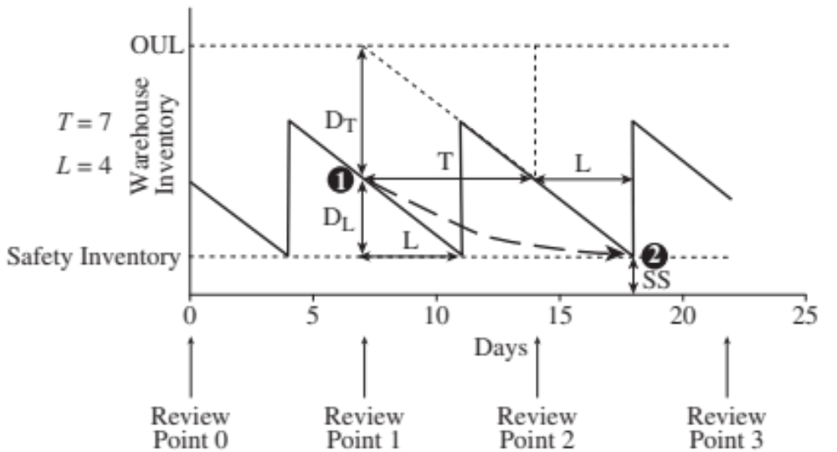
Impact of Replenishment Policies on Safety Inventory
Figure 12-6

Slide 57
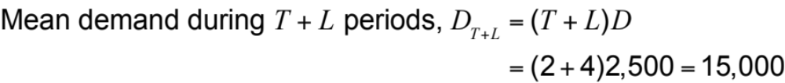
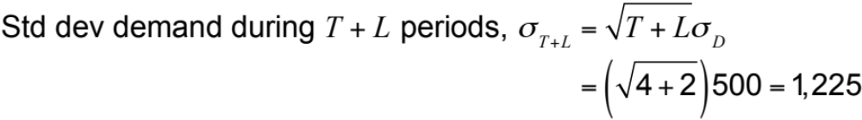
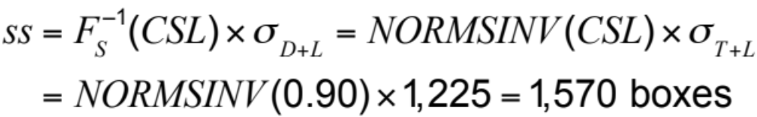
Evaluation Safety Inventory for a Periodic Review Policy
D = 2,500, σ_{D} = 500, L = 2 weeks, T = 4 weeks

Slide 58
Managing Safety Inventory in a Multiechelon Supply Chain
In multiechelon supply chains stages often do not know demand and supply distributions
Inventory between a stage and the final customer is called the echelon inventory
Reorder points and order-up-to levels at any stage should be based on echelon inventory
Decisions must be made about the level of safety inventory carried at different stages

Slide 59
The Role of IT in
Inventory Management
IT systems can help
  Improve inventory visibility
  Coordination in the supply chain
  Track inventory (RFID)
Value tightly linked to the accuracy of the inventory information

Slide 60
Estimating and Managing Safety Inventory in Practice
Account for the fact that supply chain demand is lumpy
Adjust inventory policies if demand is seasonal
Use simulation to test inventory policies
Start with a pilot
Monitor service levels
Focus on reducing safety inventories

Slide 61
Summary of Learning Objectives
Understand the role of safety inventory in a supply chain
Identify factors that influence the required level of safety inventory
Describe different measures of product availability
Utilize managerial levers available to lower safety inventory and improve product availability

Slide 62

All rights reserved. No part of this publication may be reproduced, stored in a retrieval system, or transmitted, in any form or by any means, electronic, mechanical, photocopying, recording, or otherwise, without the prior written permission of the publisher.
Printed in the United States of America.

