Slide 1
Determining the Optimal Level of Product Availability
13

Slide 2
Learning Objectives
Identify the factors affecting the optimal level of product availability and evaluate the optimal cycle service level
Use managerial levers that improve supply chain profitability through optimal service levels
Understand conditions under which postponement is valuable in a supply chain
Allocate limited supply capacity among multiple products to maximize expected profits
Notes:
Notes:

Slide 3
Importance of the Level of Product Availability
Product availability measured by cycle service level or fill rate
Also referred to as the customer service level
Product availability affects supply chain responsiveness
Trade-off:
  High levels of product availability ➔ increased responsiveness and higher revenues
  High levels of product availability ➔ increased inventory levels and higher costs
Product availability is related to profit objectives and strategic and competitive issues

Slide 4
Factors Affecting the Optimal Level of Product Availability
Cost of overstocking, C_{o}
Cost of understocking, C_{u}
Possible scenarios
  Seasonal items with a single order in a season
  One-time orders in the presence of quantity discounts
  Continuously stocked items
  Demand during stockout is backlogged
  Demand during stockout is lost

Slide 5
L.L. Bean Example
Table 13-1
Demand D_{i} (in hundreds) | Probability p_{i} | Cumulative Probability of Demand Being D_{i} or Less (P_{i}) | Probability of Demand Being Greater than D_{i}
4 | 0.01 | 0.01 | 0.99
5 | 0.02 | 0.03 | 0.97
6 | 0.04 | 0.07 | 0.93
7 | 0.08 | 0.15 | 0.85
8 | 0.09 | 0.24 | 0.76
9 | 0.11 | 0.35 | 0.65
10 | 0.16 | 0.51 | 0.49
11 | 0.20 | 0.71 | 0.29
12 | 0.11 | 0.82 | 0.18
13 | 0.10 | 0.92 | 0.08
14 | 0.04 | 0.96 | 0.04
15 | 0.02 | 0.98 | 0.02
16 | 0.01 | 0.99 | 0.01
17 | 0.01 | 1.00 | 0.00

Slide 6
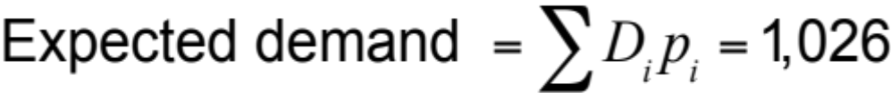
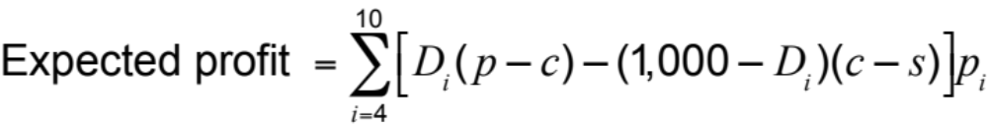
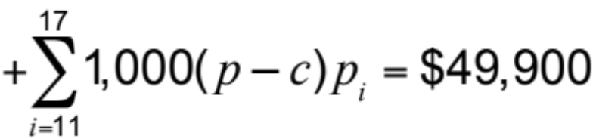
L.L. Bean Example
Expected profit
from extra 100 parkas = 5,500 x Prob(demand ≥ 1,100) – 500
x Prob(demand < 1,100)
= $5,500 x 0.49 – $500 x 0.51 = $2,440
Expected profit from
ordering 1,300 parkas = $49,900 + $2,440 + $1,240 + $580
= $54,160

Slide 7
L.L. Bean Example
Additional Hundreds | Expected Marginal Benefit | Expected Marginal Cost | Expected Marginal Contribution
11th | 5,500 x 0.49 = 2,695 | 500 x 0.51 = 255 | 2,695 – 255 = 2,440
12th | 5,500 x 0.29 = 1,595 | 500 x 0.71 = 355 | 1,595 – 355 = 1,240
13th | 5,500 x 0.18 = 990 | 500 x 0.82 = 410 | 990 – 410 = 580
14th | 5,500 x 0.08 = 440 | 500 x 0.92 = 460 | 440 – 460 = –20
15th | 5,500 x 0.04 = 220 | 500 x 0.96 = 480 | 220 – 480 = –260
16th | 5,500 x 0.02 = 110 | 500 x 0.98 = 490 | 110 – 490 = –380
17th | 5,500 x 0.01 = 55 | 500 x 0.99 = 495 | 55 – 495 = –440
Table 13-2

Slide 8
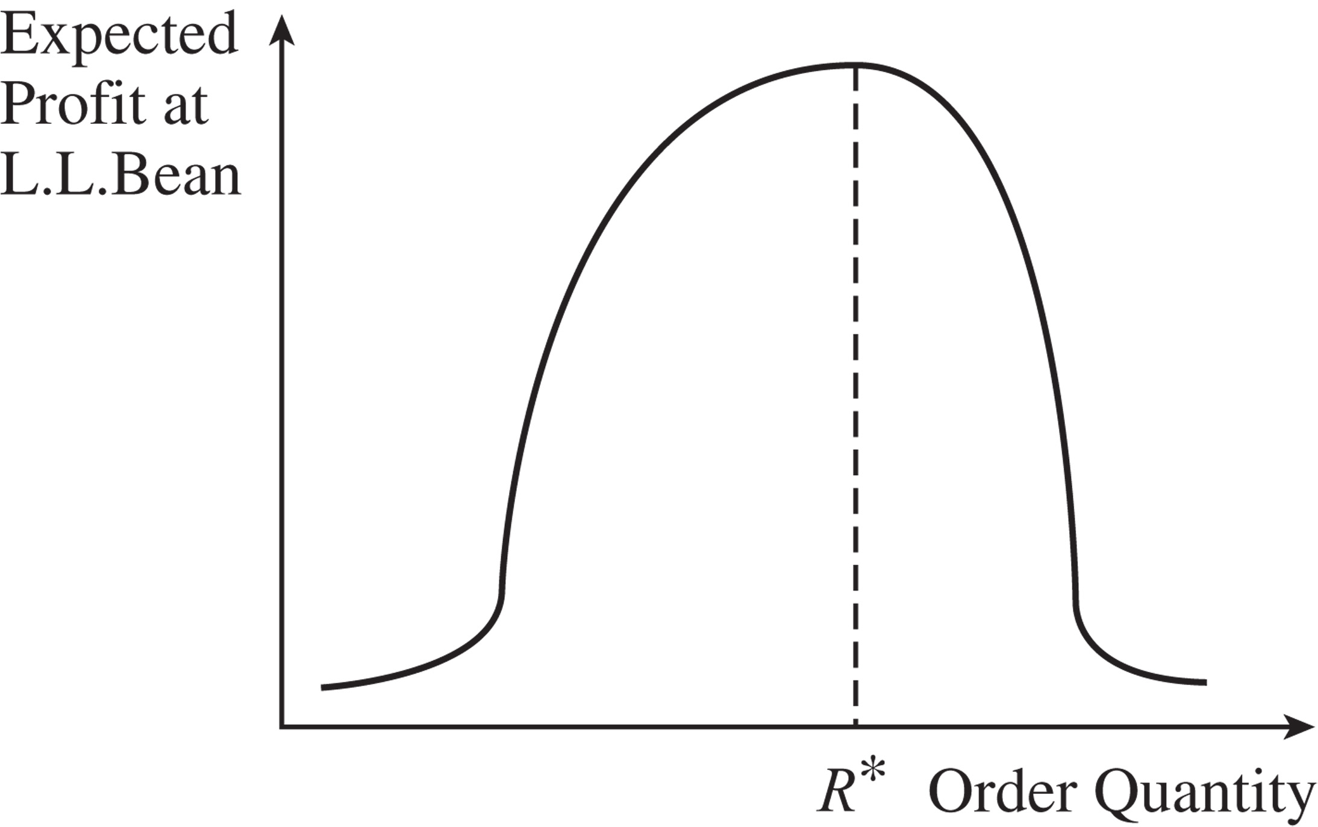
L.L. Bean Example
Figure 13-1

Slide 9
Optimal Cycle Service Level for Seasonal Items – Single Order
C_{o}: Cost of overstocking by one unit, C_{o} = c – s
C_{u}: Cost of understocking by one unit, C_{u} = p – c
CSL*: Optimal cycle service level
O*: Corresponding optimal order size
Expected benefit of purchasing extra unit = (1 – CSL*)(p – c)
Expected cost of purchasing extra unit = CSL*(c – s)
Expected marginal
contribution of raising = (1 – CSL*)(p – c) – CSL*(c – s)
order size

Slide 10
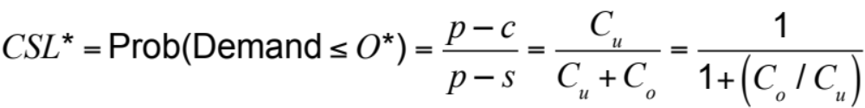
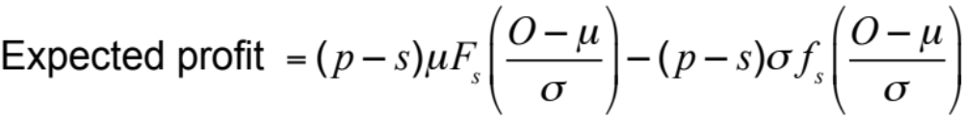
Optimal Cycle Service Level for Seasonal Items – Single Order

Slide 11
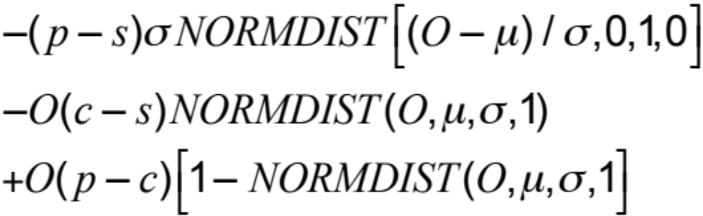
Optimal Cycle Service Level for Seasonal Items – Single Order

Slide 12
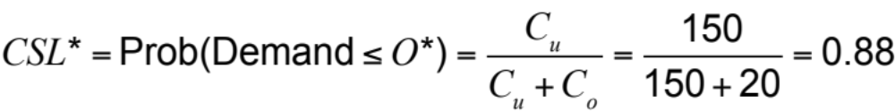
Evaluating the Optimal Service Level for Seasonal Items
Demand μ = 350, σ = 100, c = $100, p = $250,
disposal value = $85, holding cost = $5
Salvage value = $85 – $5 = $80
Cost of understocking = C_{u} = p – c = $250 – $100 = $150
Cost of overstocking = C_{o} = c – s = $100 – $80 = $20

Slide 13
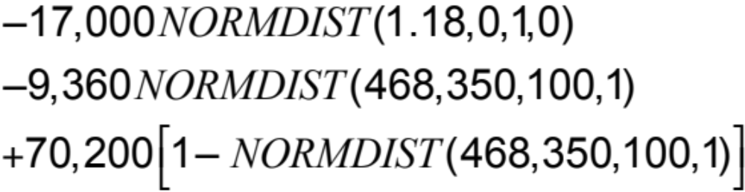

Evaluating the Optimal Service Level for Seasonal Items

Slide 14
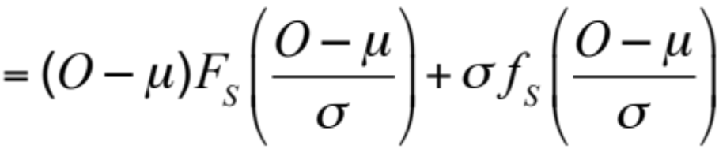
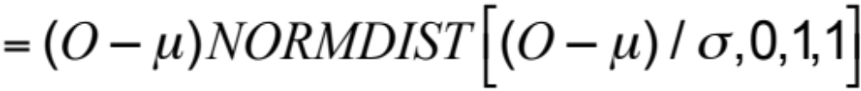
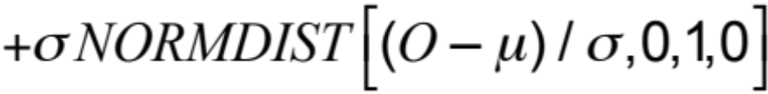
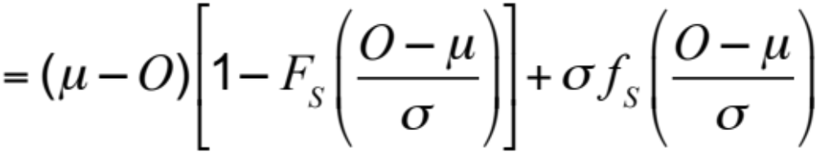
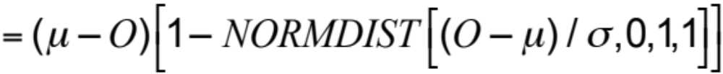
Evaluating the Optimal Service Level for Seasonal Items
Expected overstock
Expected overstock
Expected understock
Expected understock

Slide 15
Evaluating Expected Overstock and Understock
μ = 350, σ = 100, O = 450
Expected overstock
Expected understock

Slide 16
One-Time Orders in the Presence of Quantity Discounts
Using C_{o} = c – s and C_{u} = p – c, evaluate the optimal cycle service level CSL* and order size O* without a discount
  Evaluate the expected profit from ordering O*
Using C_{o} = c_{d} – s and C_{u} = p – c_{d}, evaluate the optimal cycle service level CSL*_{d} and order size O*_{d} with a discount
  If O*_{d} ≥ K, evaluate the expected profit from ordering O*_{d}
  If O*_{d} < K, evaluate the expected profit from ordering K units
Order O* units if the profit in step 1 is higher
  If the profit in step 2 is higher, order O*_{d} units if O*_{d} ≥ K or K units if O*_{d} < K

Slide 17
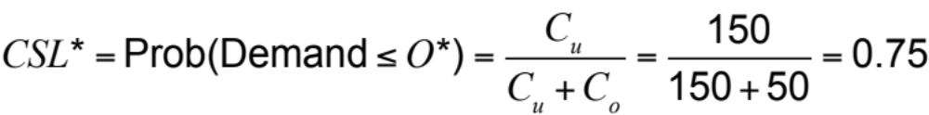
Evaluating Service Level with Quantity Discounts
Step 1, c = $50
Cost of understocking = C_{u} = p – c = $200 – $50 = $150
Cost of overstocking = C_{o} = c – s = $50 – $0 = $50
Expected profit from ordering 177 units = $19,958

Slide 18
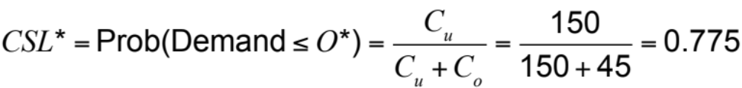
Evaluating Service Level with Quantity Discounts
Step 2, c = $45
Cost of understocking = C_{u} = p – c = $200 – $45 = $155
Cost of overstocking = C_{o} = c – s = $45 – $0 = $45
Expected profit from ordering 200 units = $20,595

Slide 19
Desired Cycle Service Level for Continuously Stocked Items
Two extreme scenarios
  All demand that arises when the product is out of stock is backlogged and filled later, when inventories are replenished
  All demand arising when the product is out of stock is lost

Slide 20
Desired Cycle Service Level for Continuously Stocked Items
Q: Replenishment lot size
S: Fixed cost associated with each order
ROP: Reorder point
D: Average demand per unit time
σ: Standard deviation of demand per unit time
ss: Safety inventory (ss = ROP – D_{L})
CSL: Cycle service level
C: Unit cost
h: Holding cost as a fraction of product cost per unit time
H: Cost of holding one unit for one unit of time. H = hC

Slide 21
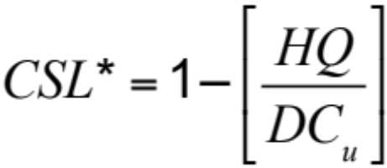
Demand During Stockout is Backlogged
Increased cost per replenishment cycle
of additional safety inventory of 1 unit = (Q > D)H
Benefit per replenishment cycle of
additional safety inventory of 1 unit = (1 – CSL)C_{u}

Slide 22
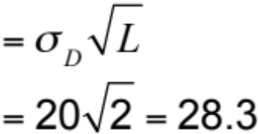
Demand During Stockout is Backlogged
Lot size, Q = 400 gallons
Reorder point, ROP = 300 gallons
Average demand per year, D = 100 x 52 = 5,200
Standard deviation of demand per week, σ_{D} = 20
Unit cost, C = $3
Holding cost as a fraction of product cost per year, h = 0.2
Cost of holding one unit for one year, H = hC = $0.6
Lead time, L = 2 weeks
Mean demand over lead time, D_{L} = 200 gallons
Standard deviation of demand over lead time, σ_{L}

Slide 23
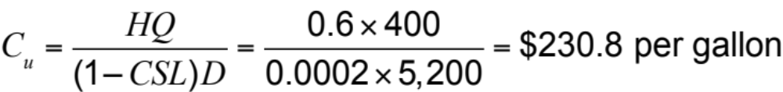
Demand During Stockout is Backlogged

Slide 24
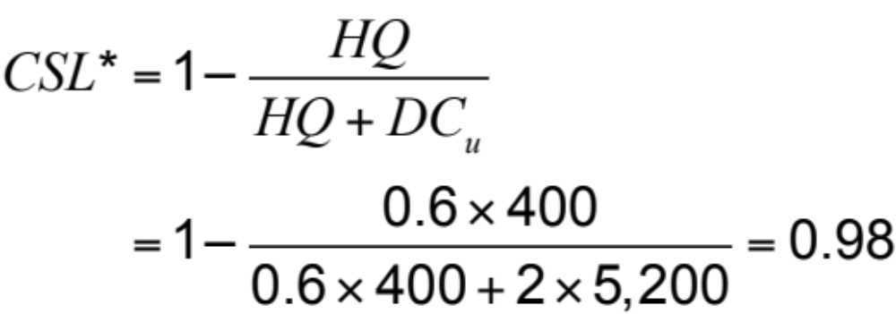
Evaluating Optimal Service Level When Unmet Demand Is Lost
Lot size, Q = 400 gallons
Average demand per year, D = 100 x 52 = 5,200
Cost of holding one unit for one year, H = $0.6
Cost of understocking, C_{u} = $2

Slide 25
Managerial Levers to Improve Supply Chain Profitability
“Obvious” actions
  Increase salvage value of each unit
  Decrease the margin lost from a stockout
Improved forecasting
Quick response
Postponement
Tailored sourcing

Slide 26
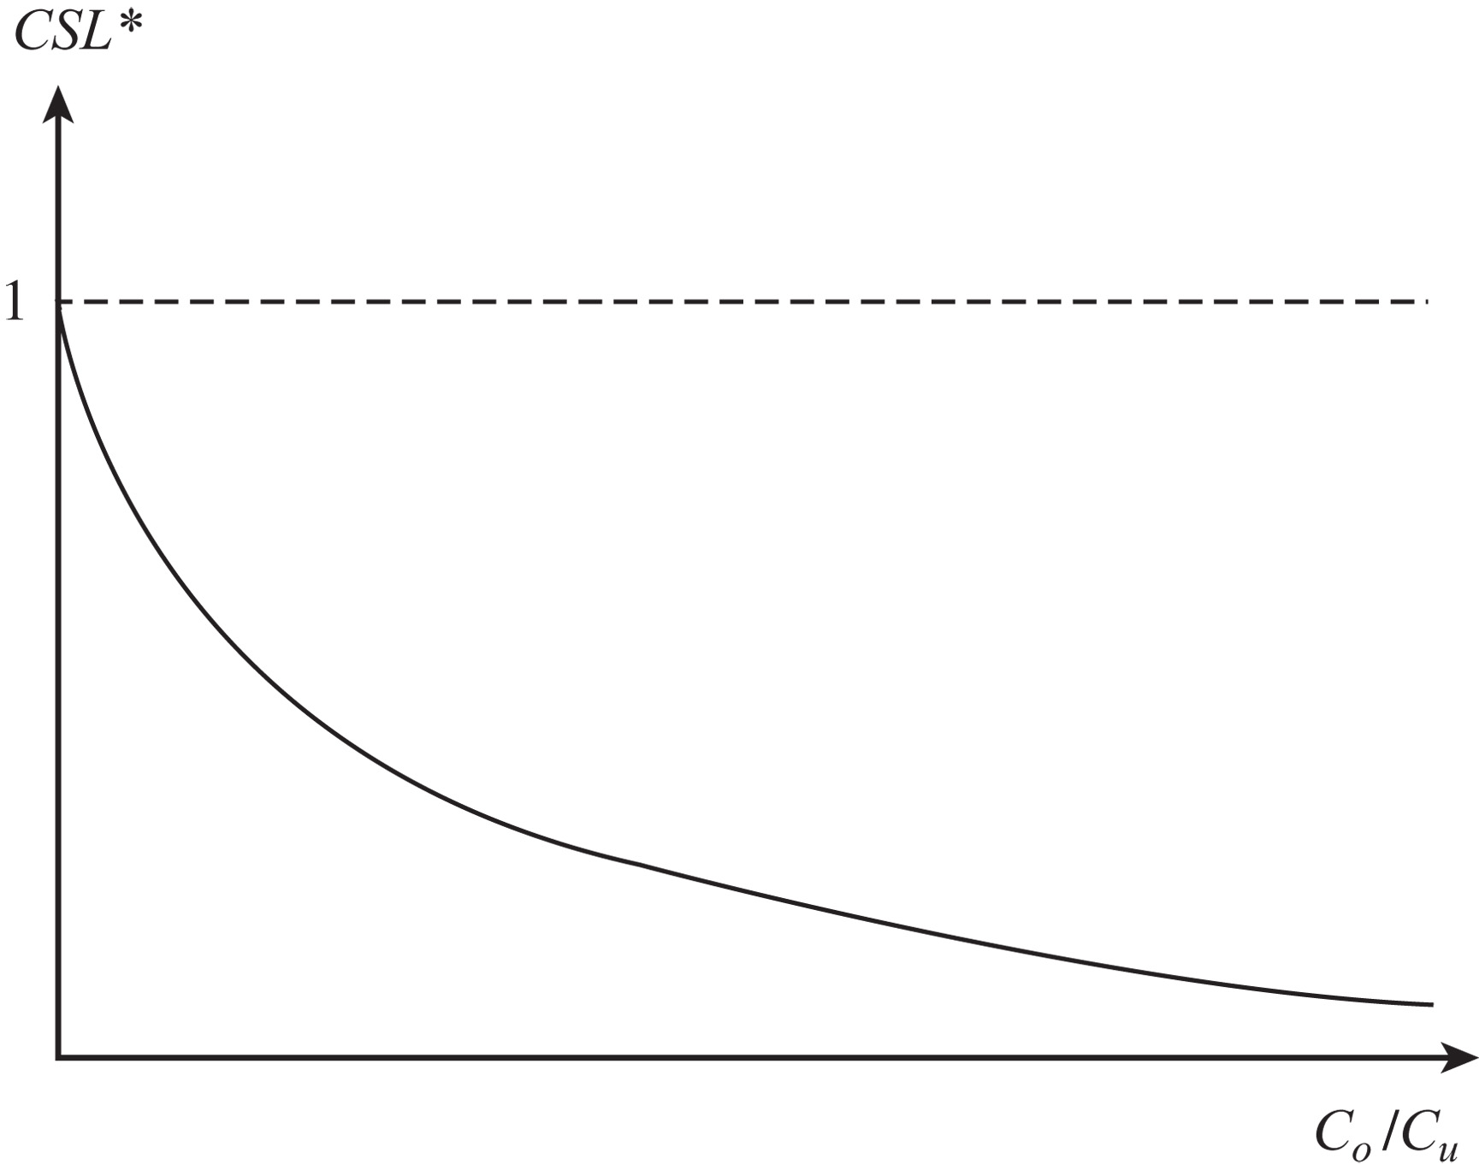
Managerial Levers to Improve Supply Chain Profitability
Figure 13-2

Slide 27
Improved Forecasts
Improved forecasts result in reduced uncertainty
Less uncertainty results in
  Lower levels of safety inventory (and costs) for the same level of product availability, or
  Higher product availability for the same level of safety inventory, or
  Both

Slide 28
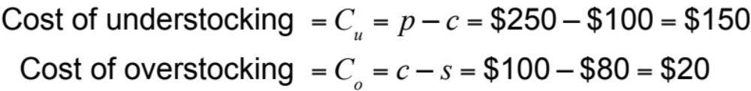
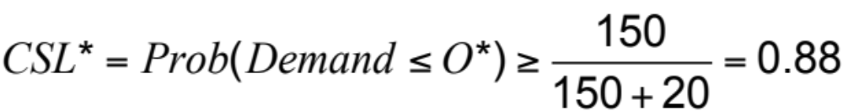
Impact of Improved Forecasts
Demand: μ = 350, σ = 150
Cost: c = $100, Price: p = $250, Salvage: s = $80
Notes:
Note:
Cost of understocking = 250-100 = $150
Cost of overstocking = 100+5-85 = $20
p = 150/(150+20) = 0.88
Order size = 426

Slide 29
Impact of Improved Forecasts
Standard Deviation of Forecast Error σ | Optimal Order Size O* | Expected Overstock | Expected Understock | Expected Profit
150 | 526 | 186.7 | 8.6 | $47,469
120 | 491 | 149.3 | 6.9 | $48,476
90 | 456 | 112.0 | 5.2 | $49,482
60 | 420 | 74.7 | 3.5 | $50,488
30 | 385 | 37.3 | 1.7 | $51,494
0 | 350 | 0 | 0 | $52,500
Table 13-3
Notes:
Note:
Cost of understocking = 250-100 = $150
Cost of overstocking = 100+5-85 = $20
p = 150/(150+20) = 0.88
Order size = 426

Slide 30
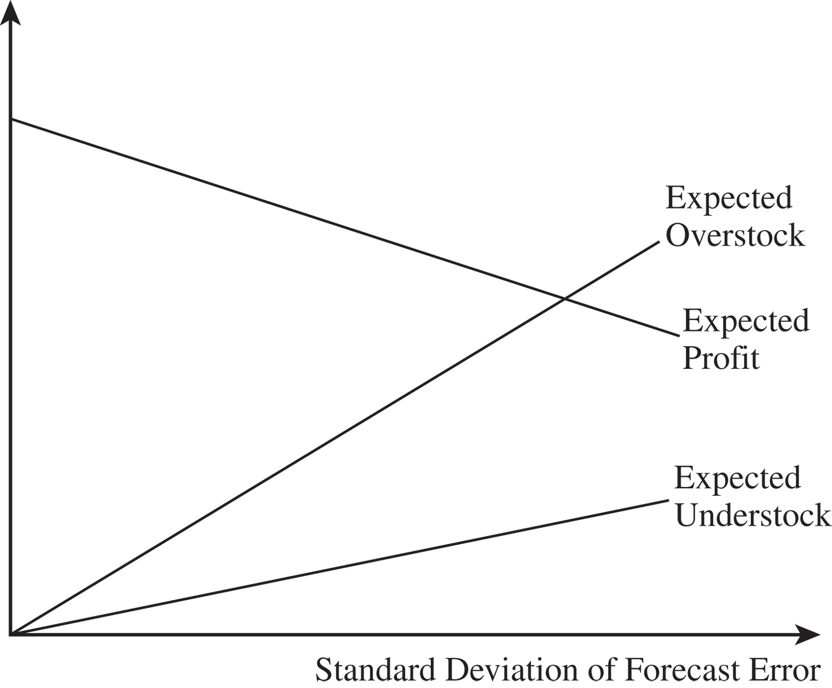
Impact of Improved Forecasts
Figure 13-3
Notes:
Note:
Cost of understocking = 250-100 = $150
Cost of overstocking = 100+5-85 = $20
p = 150/(150+20) = 0.88
Order size = 426

Slide 31
Quick Response: Impact on Profits and Inventories
Set of actions taken by managers to reduce replenishment lead time
Reduced lead time results in improved forecasts
Benefits
  Lower order quantities thus less inventory with same product availability
  Less overstock
  Higher profits

Slide 32
Quick Response: Multiple
Orders Per Season
Ordering shawls at a department store
  Selling season = 14 weeks
  Cost per shawl = $40
  Retail price = $150
  Disposal price = $30
  Holding cost = $2 per week
  Expected weekly demand D = 20
  Standard deviation σ_{D} = 15

Slide 33
Quick Response: Multiple
Orders Per Season
Two ordering policies
  Supply lead time is more than 15 weeks
    Single order placed at the beginning of the season
    Supply lead time is reduced to six weeks
  Two orders are placed for the season
    One for delivery at the beginning of the season
    One at the end of week 1 for delivery in week 8

Slide 34
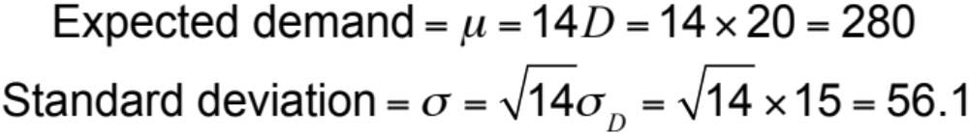
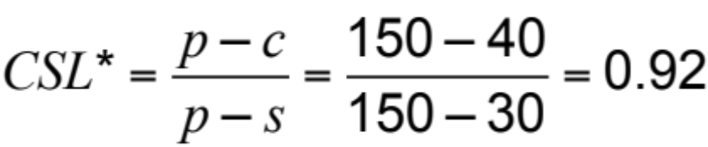
Single Order Policy

Slide 35
Single Order Policy
Expected profit with a single order = $29,767
Expected overstock = 79.8
Expected understock = 2.14
Cost of overstocking = $10
Cost of understocking = $110
Expected cost of overstocking = 79.8 x $10 = $798
Expected cost of understocking = 2.14 x $110 = $235

Slide 36
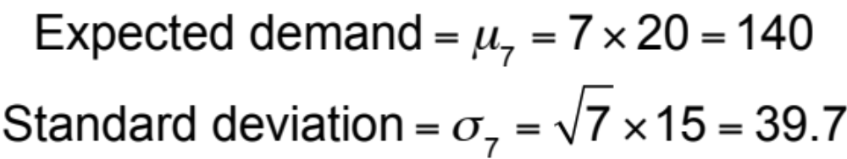
Two Order Policy
Expected profit from seven weeks = $14,670
Expected overstock = 56.4
Expected understock = 1.51
Expected profit from season = $14,670 + 56.4
x $10 + $14,670
= $29,904

Slide 37
Quick Response: Multiple
Orders Per Season
Three important consequences
  The expected total quantity ordered during the season with two orders is less than that with a single order for the same cycle service level
  The average overstock to be disposed of at the end of the sales season is less if a follow-up order is allowed after observing some sales
  The profits are higher when a follow-up order is allowed during the sales season

Slide 38
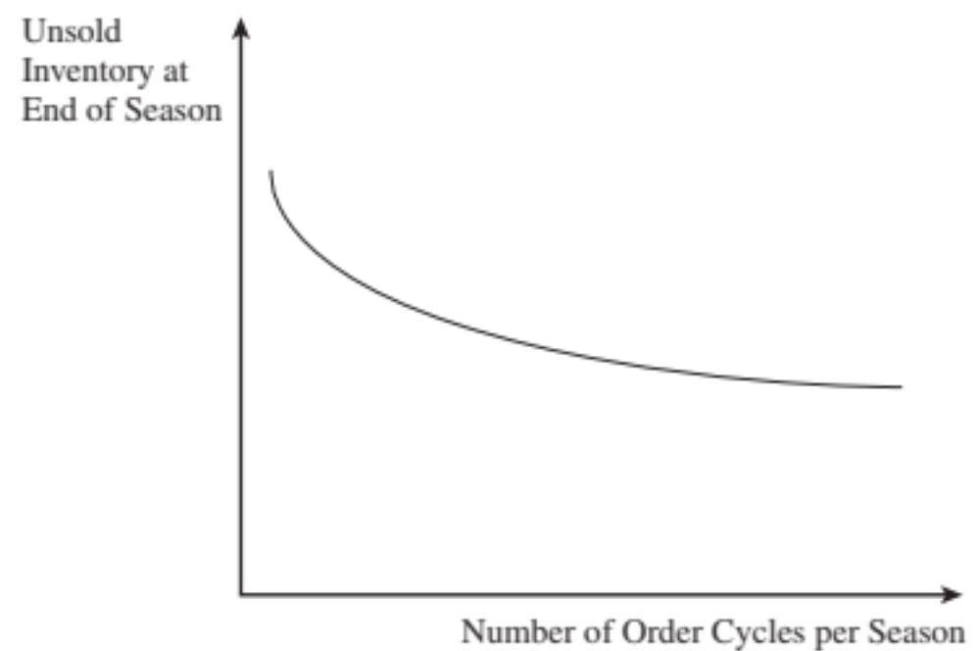
Quick Response: Multiple
Orders Per Season
Figure 13-4

Slide 39
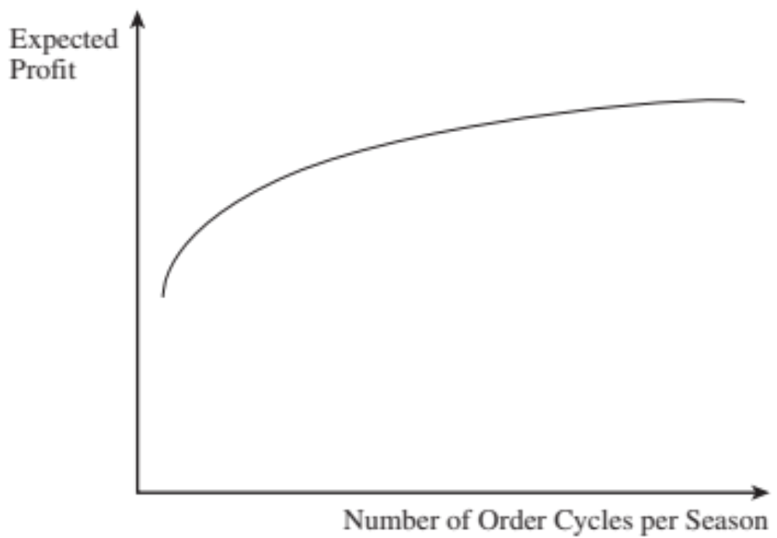
Quick Response: Multiple
Orders Per Season
Figure 13-5

Slide 40
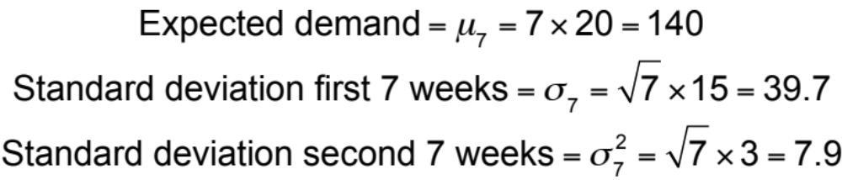
Two Order Policy with Improved Forecast Accuracy
Expected profit from second order = $15,254
Expected overstock = 11.3
Expected understock = 0.30
Expected profit from season = $14,670 + 56.4
x $10 + $15,254
= $30,488

Slide 41
Postponement: Impact on Profits and Inventories
Delay of product differentiation until closer to the sale of the product
Activities prior to product differentiation require aggregate forecasts more accurate than individual product forecasts
Individual product forecasts are needed close to the time of sale
Results in a better match of supply and demand
Valuable in online sales
Higher profits through better matching of supply and demand

Slide 42
Value of Postponement: Benetton
For each of four colors
Demand μ = 1,000, σ = 50,
Sale price p = $50, Salvage value s = $10
  Production cost Option 1 (no postponement) = $20
  Production cost Option 2 (postponement) = $22

Slide 43
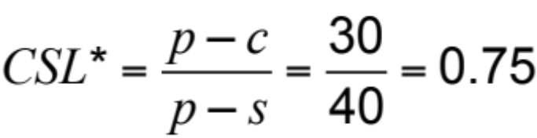
Value of Postponement: Benetton
Option 1, for each color
Expected profits = $23,664
Expected overstock = 412
Expected understock = 75
Total production = 4 x 1,337 = 5,348
Expected profit = 4 x 23,644 = $94,576

Slide 44

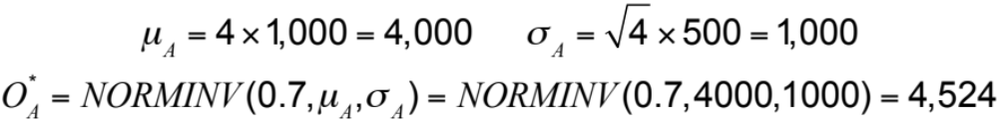
Value of Postponement: Benetton
Option 2, for all sweaters
Expected profits = $98,092
Expected overstock = 715
Expected understock = 190

Slide 45
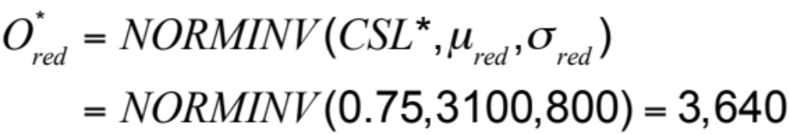
Value of Postponement: Benetton
Postponement is not very effective if a large fraction of demand comes from a single product
Option 1
Red sweaters demand μ_{red} = 3,100, σ_{red} = 800
Other colors μ = 300, σ = 200
Expected profits_{red} = $82,831
Expected overstock = 659
Expected understock = 119

Slide 46
Value of Postponement: Benetton
Other colors μ = 300, σ = 200
Expected profits_{other} = $6,458
Expected overstock = 165
Expected understock = 30
Total production = 3,640 + 3 x 435 = 4,945
Expected profit = $82,831 + 3 x $6,458 = $102,205
Expected overstock = 659 + 3 x 165 = 1,154
Expected understock = 119 + 3 x 30 = 209

Slide 47
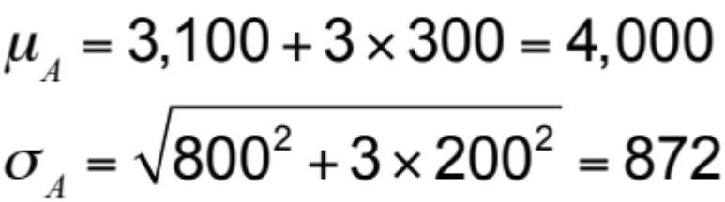
Value of Postponement: Benetton
Option 2
Total production = 4,475
Expected profit = $99,872
Expected overstock = 623
Expected understock = 166

Slide 48
Tailored Postponement: Benetton
Use production with postponement to satisfy a part of demand, the rest without postponement
Produce red sweaters without postponement, postpone all others
Profit = $103,213
Tailored postponement allows a firm to increase profits by postponing differentiation only for products with uncertain demand

Slide 49
Tailored Postponement: Benetton
Separate all demand into base load and variation
  Base load manufactured without postponement
  Variation is postponed
  Four colors
  Demand mean μ = 1,000, σ = 500
  Identify base load and variation for each color

Slide 50
Tailored Postponement: Benetton
Table 13-4
Manufacturing Policy
Q₁ | Q₂ | Average Profit | Average Overstock | Average Understock
0 | 4,524 | $97,847 | 510 | 210
1,337 | 0 | $94,377 | 1,369 | 282
700 | 1,850 | $102,730 | 308 | 168
800 | 1,550 | $104,603 | 427 | 170
900 | 950 | $101,326 | 607 | 266
900 | 1,050 | $101,647 | 664 | 230
1,000 | 850 | $100,312 | 815 | 195
1,000 | 950 | $100,951 | 803 | 149
1,100 | 550 | $99,180 | 1,026 | 211
1,100 | 650 | $100,510 | 1,008 | 185

Slide 51
Tailored Sourcing
A firm uses a combination of two supply sources
  One is lower cost but is unable to deal with uncertainty well
  Second more flexible but is higher cost
Focus on different capabilities
Increase profits, better match supply and demand
May be volume based or product based

Slide 52
Setting Product Availability for Multiple Products Under Capacity Constraints
Two styles of sweaters from Italian supplier
High end | Mid-range
μ₁ = 1,000 | μ₂ = 2,000
σ₁ = 300 | σ₂ = 400
p₁ = $150 | p₂ = $100
c₁ = $50 | c₂ = $40
s₁ = $35 | s₂ = $25
CSL = 0.87 | CSL = 0.80
O = 1,337 | O = 2,337

Slide 53
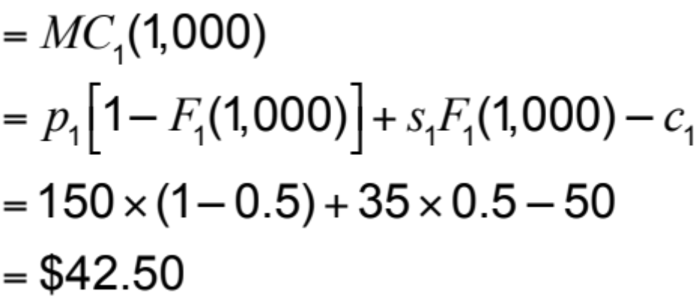
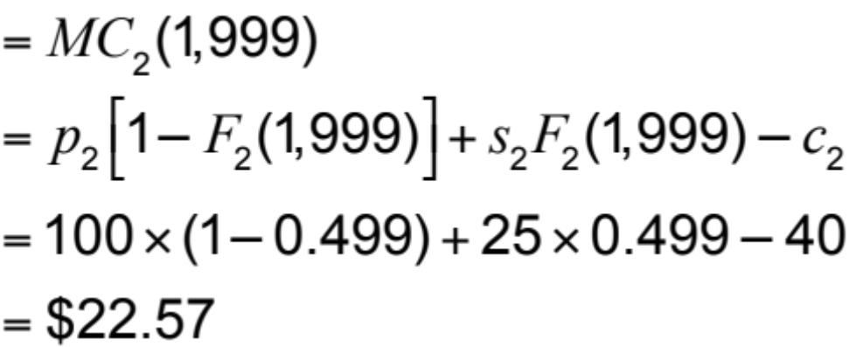
Setting Product Availability for Multiple Products Under Capacity Constraints
Supplier capacity constraint, 3,000 units
Expected marginal contribution high-end
Expected marginal contribution mid-range

Slide 54
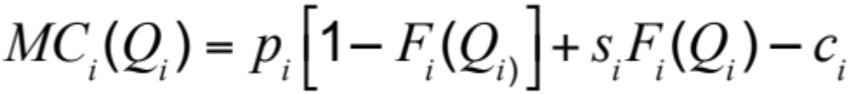
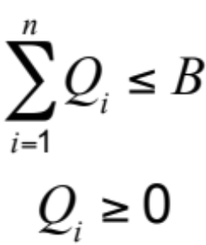
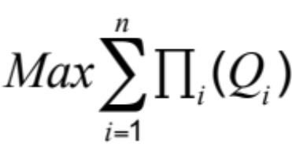
Setting Product Availability for Multiple Products Under Capacity Constraints
Set quantity Q_{i} = 0 for all products i
Compute the expected marginal contribution MC_{i}(Q_{i}) for each product i
If positive, stop, otherwise, let j be the product with the highest expected marginal contribution and increase Q_{j} by one unit
If the total quantity is less than B, return to step 2, otherwise capacity constraint are met and quantities are optimal
subject to:

Slide 55
Setting Product Availability for Multiple Products Under Capacity Constraints
 | Expected Marginal Contribution |  | Order Quantity
Capacity Left | High End | Mid Range | High End | Mid Range
3,000 | 99.95 | 60.00 | 0 | 0
2,900 | 99.84 | 60.00 | 100 | 0
2,100 | 57.51 | 60.00 | 900 | 0
2,000 | 57.51 | 60.00 | 900 | 100
800 | 57.51 | 57.00 | 900 | 1,300
780 | 54.59 | 57.00 | 920 | 1,300
300 | 42.50 | 43.00 | 1,000 | 1,700
200 | 42.50 | 36.86 | 1,000 | 1,800
180 | 39.44 | 36.86 | 1,020 | 1,800
40 | 31.89 | 30.63 | 1,070 | 1,890
30 | 30.41 | 30.63 | 1,080 | 1,890
10 | 29.67 | 29.54 | 1,085 | 1,905
1 | 29.23 | 29.10 | 1,088 | 1,911
0 | 29.09 | 29.10 | 1,089 | 1,911
Table 13-5

Slide 56
Setting Optimal Levels of
Product Availability in Practice
Beware of preset levels of availability
Use approximate costs because profit-maximizing solutions are quite robust
Estimate a range for the cost of stocking out
Tailor your response to uncertainty

Slide 57
Summary of Learning Objectives
Identify the factors affecting the optimal level of product availability and evaluate the optimal cycle service level
Use managerial levers that improve supply chain profitability through optimal service levels
Understand conditions under which postponement is valuable in a supply chain
Allocate limited supply capacity among multiple products to maximize expected profits
Notes:
Notes:

Slide 58

All rights reserved. No part of this publication may be reproduced, stored in a retrieval system, or transmitted, in any form or by any means, electronic, mechanical, photocopying, recording, or otherwise, without the prior written permission of the publisher.
Printed in the United States of America.

