Slide 1
Transportation in a Supply Chain
14

Slide 2
Learning Objectives
Understand the role of transportation in a supply chain
Evaluate the strengths and weaknesses of different modes of transportation
Discuss the role of infrastructure and policies in transportation
Identify the relative strengths and weaknesses of various transportation network design options
Identify trade-offs that shippers need to consider when designing a transportation network

Slide 3
The Role of Transportation in a Supply Chain
Movement of product from one location to another
Products rarely produced and consumed in the same location
Significant cost component
Shipper requires the movement of the product
Carrier moves or transports the product

Slide 4
Modes of Transportation and their Performance Characteristics
Air
Package carriers
Truck
Rail
Water
Pipeline
Intermodal
Notes:
Notes:

Slide 5
Modes of Transportation and their Performance Characteristics
Mode | Freight Value ($ billions) in 2002 | Freight Tons (billions) in 2002 | Freight Ton-Miles (millions) in 2002 | Value Added to GNP (billion $) in 2009
Air (includes truck and air) | 563 | 6 | 13 | 61.9
Truck | 9,075 | 11,712 | 1,515 | 113.1
Rail | 392 | 1,979 | 1,372 | 30.8
Water | 673 | 1,668 | 485 | 14.3
Pipeline | 896 | 3,529 | 688 | 12.0
Multimodal | 1,121 | 229 | 233
Table 14-1
Notes:
Notes:

Slide 6
Air
Cost components
  Fixed infrastructure and equipment
  Labor and fuel
  Variable – passenger/cargo
Key issues
  Location/number of hubs
  Fleet assignment
  Maintenance schedules
  Crew scheduling
  Prices and availability
Notes:
Notes:

Slide 7
Package Carriers
Small packages up to about 150 pounds
Expensive
Rapid and reliable delivery
Small and time-sensitive shipments
Provide other value-added services
Consolidation of shipments a key factor

Slide 8
Truck
Significant fraction of the goods moved
Truckload (TL)
  Low fixed cost
  Imbalance between flows
Less than truckload (LTL)
  Small lots
  Hub and spoke system
  May take longer than TL
Notes:
Notes:

Slide 9
Rail
Move commodities over large distances
High fixed costs in equipment and facilities
Scheduled to maximize utilization
Transportation time can be long
  Trains ‘built’ not scheduled
Notes:
Notes:

Slide 10
Water
Limited to certain geographic areas
Ocean, inland waterway system, coastal waters
Very large loads at very low cost
Slowest
Dominant in global trade
Containers

Slide 11
Pipeline
High fixed cost
Primarily for crude petroleum, refined petroleum products, natural gas
Best for large and stable flows
Pricing structure encourages use for predicable component of demand

Slide 12
Intermodal
Use of more than one mode of transportation to move a shipment
Grown considerably with increased use of containers
May be the only option for global trade
More convenient for shippers – one entity
Key issue – exchange of information to facilitate transfer between different modes

Slide 13
Transportation Infrastructure and Policies
Governments generally take full responsibility or played a significant role in building and managing infrastructure elements
Without a monopoly, deregulation and market forces help create an effective industry structure
Pricing should reflect the marginal impact on the cost to society

Slide 14
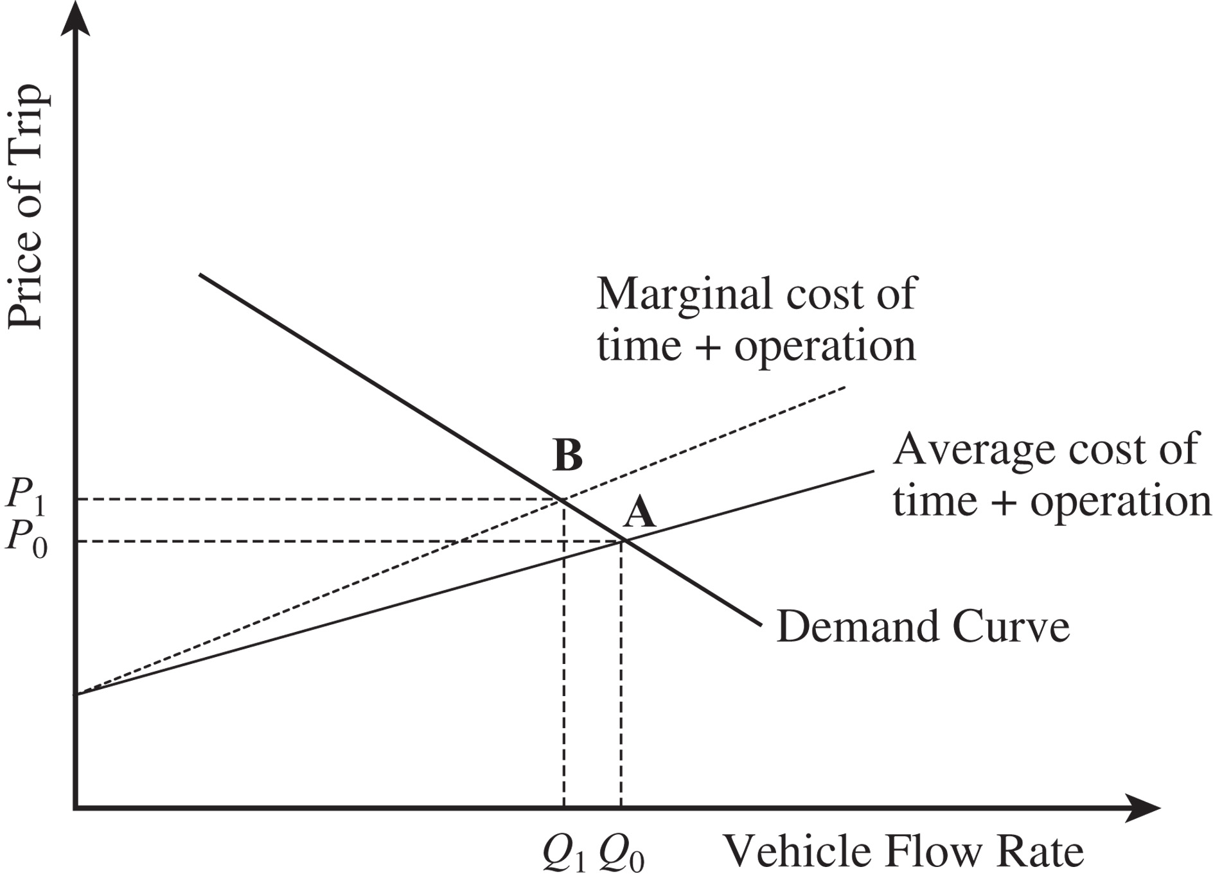
Transportation Infrastructure and Policies
Figure 14-1

Slide 15
Design Options for a
Transportation Network
When designing a transportation network
  Should transportation be direct or through an intermediate site?
  Should the intermediate site stock product or only serve as a cross-docking location?
  Should each delivery route supply a single destination or multiple destinations (milk run)?
Notes:
Notes:

Slide 16
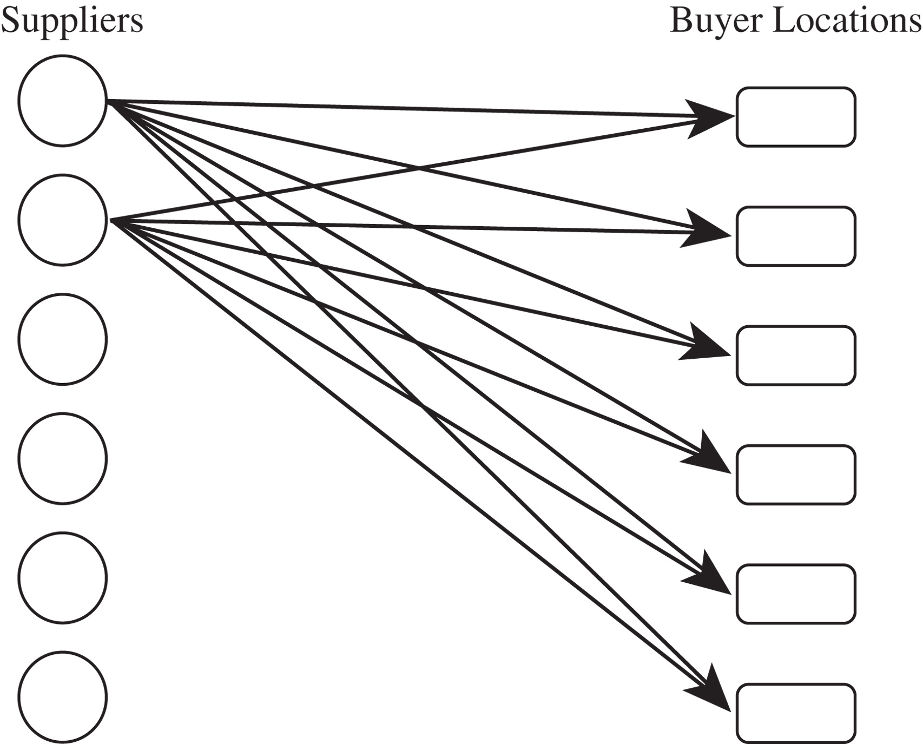
Direct Shipment Network to Single Destination
Figure 14-2

Slide 17
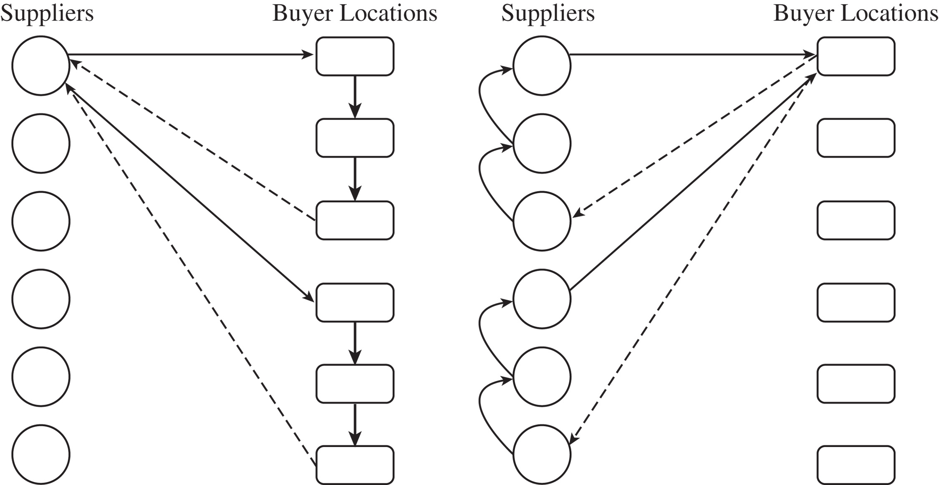
Direct Shipping with Milk Runs
Figure 14-3

Slide 18
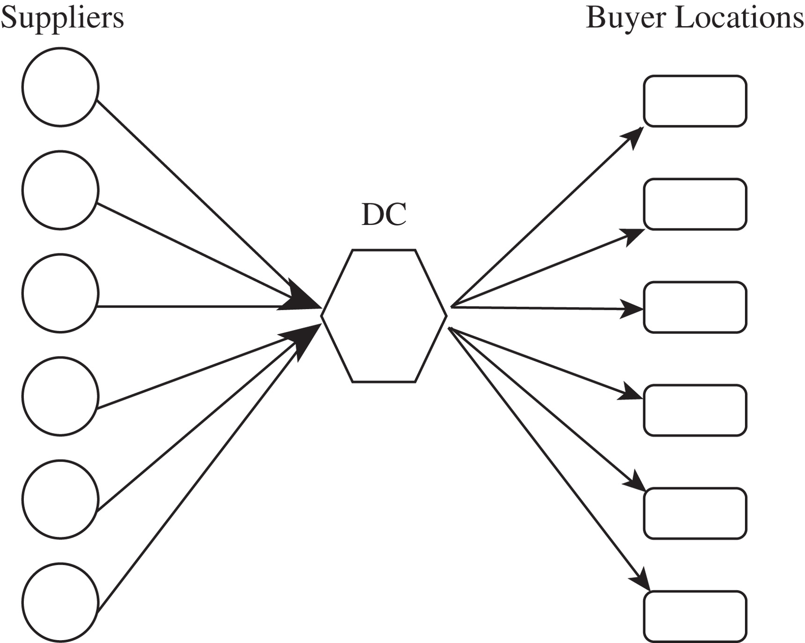
All Shipments via Intermediate Distribution Center with Storage
Figure 14-4

Slide 19
All Shipments via Intermediate Transit Point with Cross-Docking
Suppliers send their shipments to an intermediate transit point
They are cross-docked and sent to buyer locations without storing them

Slide 20
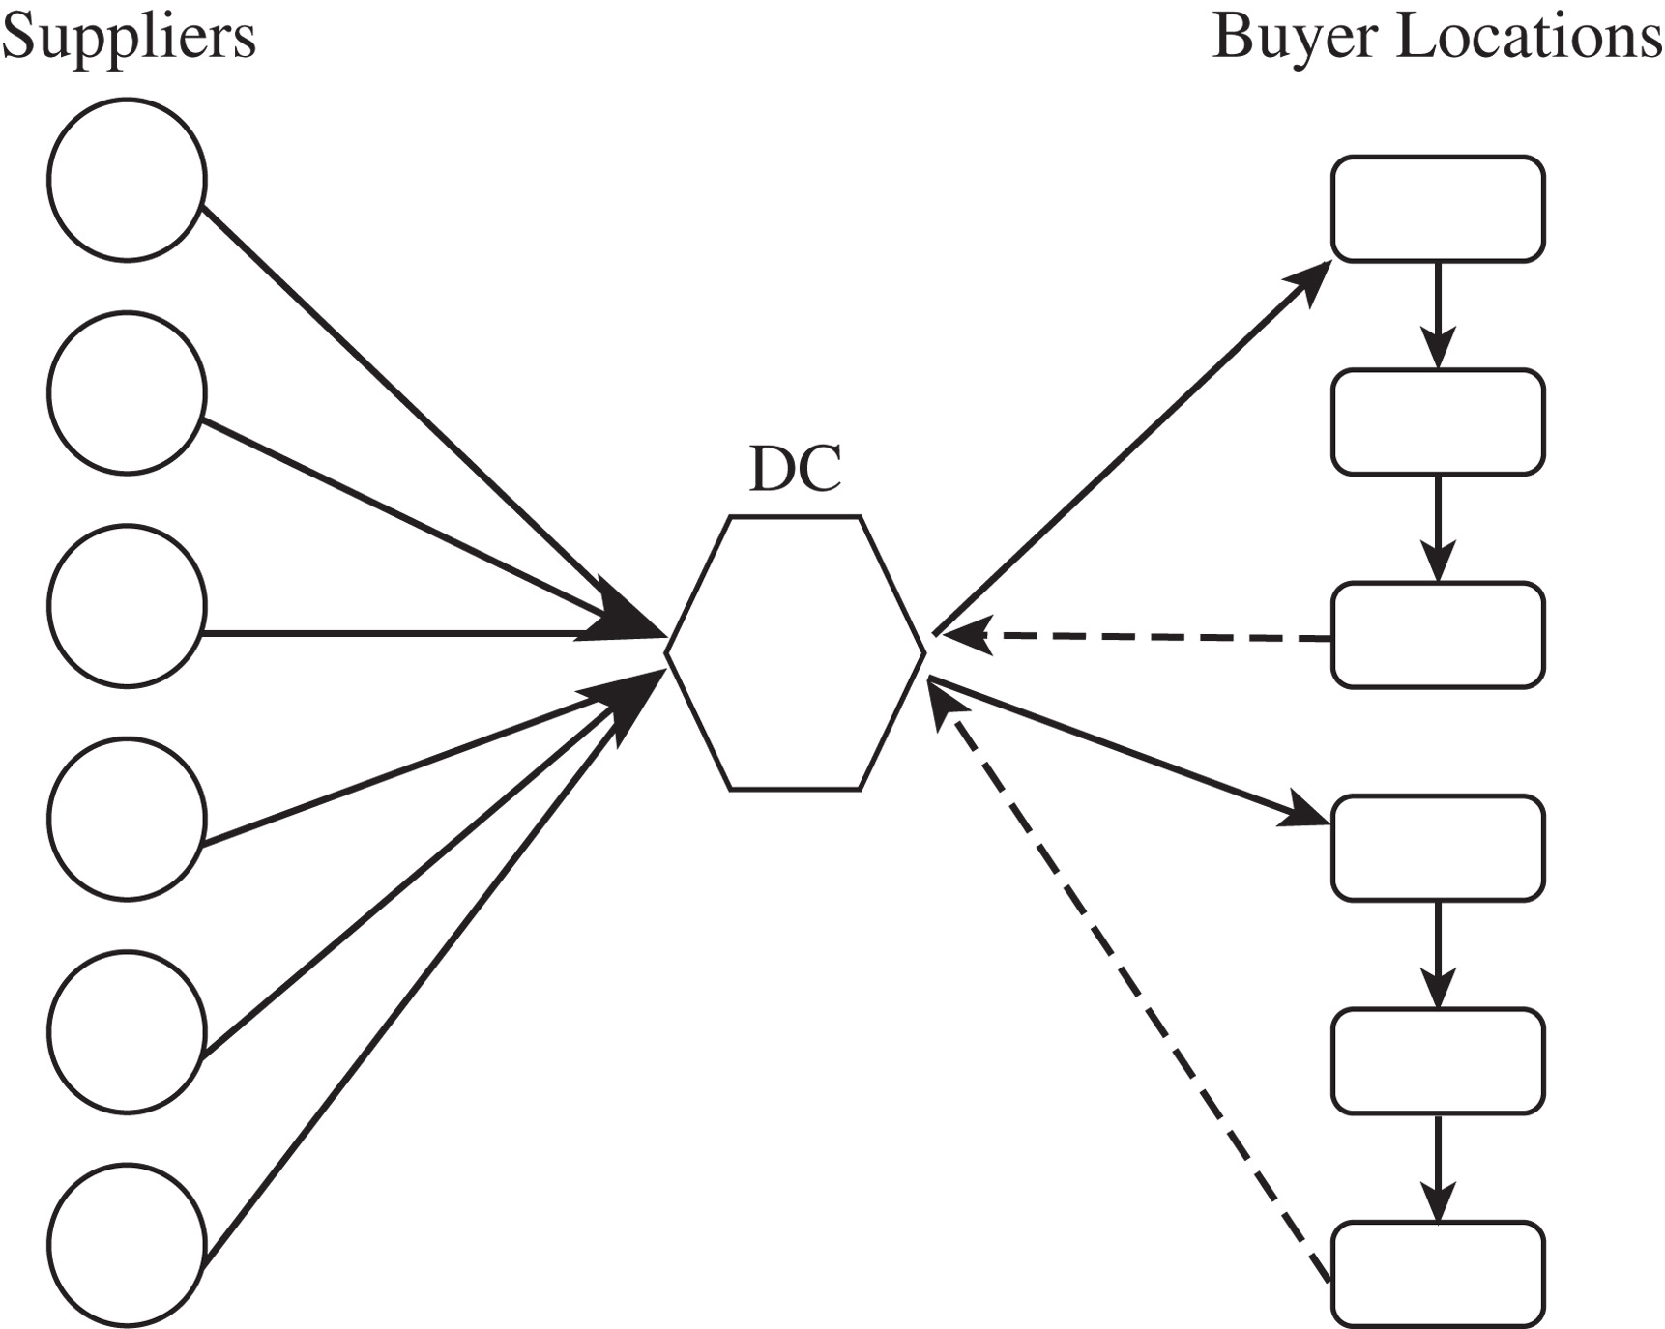
Shipping via DC Using Milk Runs
Figure 14-5

Slide 21
Tailored Network
Network Structure | Pros | Cons
Direct shipping | No intermediate warehouse Simple to coordinate | High inventories (due to large lot size) Significant receiving expense
Direct shipping with milk runs | Lower transportation costs for small lots Lower inventories | Increased coordination complexity
All shipments via central DC with inventory storage | Lower inbound transportation cost through consolidation | Increased inventory cost Increased handling at DC
All shipments via central DC with cross-dock | Low inventory requirement Lower transportation cost through consolidation | Increased coordination complexity
Shipping via DC using milk runs | Lower outbound transportation cost for small lots | Further increase in coordination complexity
Tailored network | Transportation choice best matches needs of individual product and store | Highest coordination complexity
Table 14-2

Slide 22
Selecting a Transportation Network
Eight stores, four supply sources
Truck capacity = 40,000 units
Cost $1,000 per load, $100 per delivery
Holding cost = $0.20/year

Slide 23
Selecting a Transportation Network
Annual sales = 960,000/store Direct shipping
Batch size shipped from each
supplier to each store = 40,000 units
Number of shipments/yr from
each supplier to each store = 960,000/40,000 = 24
Annual trucking cost
for direct network = 24 x 1,100 x 4 x 8 = $844,800
Average inventory at each
store for each product = 40,000/2 = 20,000 units
Annual inventory cost
for direct network = 20,000 x 0.2 x 4 x 8 = $128,000
Total annual cost of
direct network = $844,800 + $128,000 = $972,800

Slide 24
Selecting a Transportation Network
Annual sales = 960,000/store Milk runs
Batch size shipped from each
supplier to each store = 40,000/2 = 20,000 units
Number of shipments/yr from
each supplier to each store = 960,000/20,000 = 48
Transportation cost per shipment
per store (two stores/truck) = 1,000/2 + 100 = $600
Annual trucking cost
for direct network = 48 x 600 x 4 x 8 = $921,600
Average inventory at each
store for each product = 20,000/2 = 10,000 units
Annual inventory cost
for direct network = 10,000 x 0.2 x 4 x 8 = $64,000
Total annual cost of
direct network = $921,600 + $64,000 = $985,600

Slide 25
Selecting a Transportation Network
Annual sales = 120,000/store Direct shipping
Batch size shipped from each
supplier to each store = 40,000 units
Number of shipments/yr from
each supplier to each store = 120,000/40,000 = 3
Annual trucking cost
for direct network = 3 x 1,100 x 4 x 8 = $105,600
Average inventory at each
store for each product = 40,000/2 = 20,000 units
Annual inventory cost
for direct network = 20,000 x 0.2 x 4 x 8 = $128,000
Total annual cost of
direct network = $105,600 + $128,000 = $233,600

Slide 26
Selecting a Transportation Network
Annual sales = 120,000/store Milk runs
Batch size shipped from each
supplier to each store = 40,000/4 = 10,000 units
Number of shipments/yr from
each supplier to each store = 120,000/10,000 = 12
Transportation cost per shipment
per store (two stores/truck) = 1,000/4 + 100 = $350
Annual trucking cost
for direct network = 12 x 350 x 4 x 8 = $134,400
Average inventory at each
store for each product = 10,000/2 = 5,000 units
Annual inventory cost
for direct network = 5,000 x 0.2 x 4 x 8 = $32,000
Total annual cost of
direct network = $134,400 + $32,000 = $166,400

Slide 27
Trade-offs in Transportation Design
Transportation and inventory cost trade-off
  Choice of transportation mode
  Inventory aggregation
Transportation cost and responsiveness trade-off

Slide 28
Trade-offs in Transportation Design
Mode | Cycle Inventory | Safety Inventory | In-Transit Cost | Transportation Time | Transportation Cost
Rail | 5 | 5 | 5 | 2 | 5
TL | 4 | 4 | 4 | 3 | 3
LTL | 3 | 3 | 3 | 4 | 4
Package | 1 | 1 | 1 | 6 | 1
Air | 2 | 2 | 2 | 5 | 2
Water | 6 | 6 | 6 | 1 | 6
Table 14-3

Slide 29
Trade-offs When Selecting Transportation Mode
Demand = 120,000 motors, Cost = $120/motor,
Weight = 10 lbs/motor, Lot size = 3,000,
Safety stock = 50% ddlt
Carrier | Range of Quantity Shipped (cwt) | Shipping Cost ($/cwt)
AM Railroad | 200+ | 6.50
Northeast Trucking | 100+ | 7.50
Golden Freightways | 50–150 | 8.00
Golden Freightways | 150–250 | 6.00
Golden Freightways | 250+ | 4.00
Table 14-4

Slide 30
Trade-offs When Selecting Transportation Mode
Cycle inventory = Q/2 = 2,000/2 = 1,000 motors
Safety inventory = L/2 days of demand
= (6/2)(120,000/365) = 986 motors
In-transit inventory = 120,000(5/365) = 1,644 motors
Total average inventory = 1,000 + 986 + 1,644
= 3,630 motors
Annual holding cost
using AM Rail = 3,630 x $30 = $108,900
Annual transportation
cost using AM Rail = 120,000 x 0.65 = $78,000
The total annual cost for
inventory and transportation
using AM Rail = $186,900

Slide 31
Trade-offs When Selecting Transportation Mode
Alternative | Lot Size (Motors) | Transpor- tation Cost | Cycle Inventory | Safety Inventory | In-Transit Inventory | Inventory Cost | Total Cost
AM Rail | 2,000 | $78,000 | 1,000 | 986 | 1,644 | $108,900 | $186,900
Northeast | 1,000 | $90,000 | 500 | 658 | 986 | $64,320 | $154,320
Golden | 500 | $96,000 | 250 | 658 | 986 | $56,820 | $152,820
Golden | 1,500 | $96,000 | 750 | 658 | 986 | $71,820 | $167,820
Golden | 2,500 | $86,400 | 1,250 | 658 | 986 | $86,820 | $173,220
Golden | 3,000 | $80,000 | 1,500 | 658 | 986 | $94,320 | $174,320
Golden (old proposal) | 4,000 | $72,000 | 2,000 | 658 | 986 | $109,320 | $181,320
Golden (new proposal) | 4,000 | $67,000 | 2,000 | 658 | 986 | $109,320 | $176,820
Table 14-5

Slide 32
Tradeoffs When
Aggregating Inventory
Highval – weekly demand μ_{H} = 2, σ_{H} = 5, weight = 0.1 lbs, cost = $200
Lowval – weekly demand μ_{L} = 20, σ_{L} = 5, weight = 0.04 lbs, cost = $30
CSL = 0.997, holding cost = 25%, L = 1 week, T = 4 weeks
UPS lead time = 1 week, $0.66 + 0.26x
FedEx lead time = overnight, $5.53 + 0.53x
Option A. Keep the current structure but replenish inventory once a week rather than once every four weeks
Option B. Eliminate inventories in the territories, aggregate all inventories in a finished-goods warehouse at Madison, and replenish the warehouse once a week

Slide 33
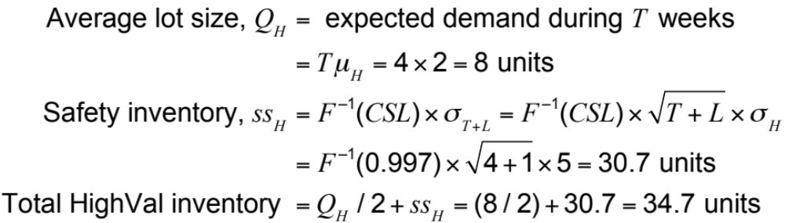
Tradeoffs When
Aggregating Inventory
HighMed inventory costs (current scenario, HighVal)
All 24 territories, HighVal inventory = 24 x 34.7 = 832.8 units

Slide 34
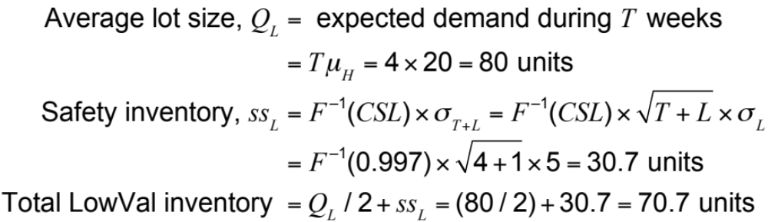
Tradeoffs When
Aggregating Inventory
HighMed inventory costs (current scenario, LowVal)
All 24 territories, LowVal inventory = 24 x 70.7 = 1696.8 units

Slide 35
Tradeoffs When
Aggregating Inventory
Annual inventory
holding cost
for HighMed = (average HighVal inventory x $200
+ average LowVal inventory x $30) x 0.25
= (832.8 x $200 + 169.8 x $30) x 0.25
= $54,366 ($54,395 without rounding)

Slide 36
Tradeoffs When
Aggregating Inventory
HighMed transportation cost (current scenario)
Average weight of each replenishment order
= 0.1Q_{H} + 0.04Q_{L} = 0.1 x 8 + 0.04 x 80 = 4 pounds
Shipping cost per replenishment order
= $0.66 + 0.26 x 4 = $1.70
Annual transportation cost = $1.70 x 13 x 24 = $530
HighMed total cost (current scenario)
Annual inventory and transportation cost at HighMed
= inventory cost + transportation cost
= $54,366 + $530 = $54,896

Slide 37
Tradeoffs When
Aggregating Inventory
 | Current Scenario | Option A | Option B
Number of stocking locations | 24 | 24 | 1.2 units
Reorder interval | 4 weeks | 1 week | 1 week
HighVal cycle inventory | 96 units | 24 units | 24 units
HighVal safety inventory | 737.3 units | 466.3 units | 95.2 units
HighVal inventory | 833.3 units | 490.3 units | 119.2 units
LowVal cycle inventory | 960 units | 240 units | 240 units
LowVal safety inventory | 737.3 units | 466.3 units | 95.2 units
LowVal inventory | 1,697.3 units | 706.3 units | 335.2 units
Annual inventory cost | $54,395 | $29,813 | $8,473
Shipment type | Replenishment | Replenishment | Customer order
Shipment size | 8 HighVal + 80 LowVal | 2 HighVal + 20 LowVal | 1 HighVal + 10 LowVal
Shipment weight | 4 lbs. | 1 lb. | 0.5 lb.
Annual transport cost | $530 | $1,148 | $13,464
Total annual cost | $54,926 | $30,961 | $22,938
Table 14-6

Slide 38
Tradeoffs When
Aggregating Inventory
Average weight of each customer order
= 0.1 x 0.5 + 0.04 x 5 = 0.25 pounds
Shipping cost per customer order
= $5.53 + 0.53 x 0.25 = $5.66
Number of customer orders per territory per week = 4
Total customer orders per year = 4 x 24 x 52 = 4
Annual transportation cost = 4,992 x $5.66 = $28,255
Total annual cost = inventory cost + transportation cost
= $8,474 + $28,255 = $36,729

Slide 39
Tradeoffs When
Aggregating Inventory
 | Aggregate | Disaggregate
Transport cost | Low | High
Demand uncertainty | High | Low
Holding cost | High | Low
Customer order size | Large | Small
Table 14-7

Slide 40
Trade-off Between Transportation Cost and Responsiveness
Steel shipments LTL = $100 + 0.01x
 | Monday | Tuesday | Wednesday | Thursday | Friday | Saturday | Sunday
Week 1 | 19,970 | 17,470 | 11,316 | 26,192 | 20,263 | 8,381 | 25,377
Week 2 | 39,171 | 2,158 | 20,633 | 23,370 | 24,100 | 19,603 | 18,442
Table 14-8

Slide 41
Trade-off Between Transportation Cost and Responsiveness
Table 14-9
 |  | Two-Day Response |  | Three-Day Response |  | Four-Day Response
Day | Demand | Quantity Shipped | Cost ($) | Quantity Shipped | Cost ($) | Quantity Shipped | Cost ($)
1 | 19,970 | 19,970 | 299.70 | 0 |  | 0
2 | 17,470 | 17,470 | 274.70 | 37,440 | 474.40 | 0
3 | 11,316 | 11,316 | 213.16 | 0 |  | 48,756 | 586.56
4 | 26,192 | 26,192 | 361.92 | 37,508 | 475.08 | 0
5 | 20,263 | 20,263 | 302.63 | 0 |  | 0
6 | 8,381 | 8,381 | 183.81 | 28,644 | 386.44 | 54,836 | 648.36
7 | 25,377 | 25,377 | 353.77 | 0 |  | 0
8 | 39,171 | 39,171 | 491.71 | 64,548 | 745.48 | 0
9 | 2,158 | 2,158 | 121.58 | 0 |  | 66,706 | 767.06
10 | 20,633 | 20,633 | 306.33 | 22,791 | 327.91 | 0
11 | 23,370 | 23,370 | 333.70 | 0 |  | 0
12 | 24,100 | 24,100 | 341.00 | 47,70 | 574.70 | 68,103 | 781.03
13 | 19,603 | 19,603 | 296.03 | 0 |  | 0
14 | 18,442 | 18,442 | 284.42 | 38,045 | 480.45 | 38,045 | 480.45
 |  |  | $4,164.46 |  | 3,464.46 |  | 3,264.46

Slide 42
Tailored Transportation
The use of different transportation networks and modes based on customer and product characteristics
Factors affecting tailoring
  Customer density and distance
  Customer size
  Product demand and value

Slide 43
Tailored Transportation
 | Short Distance | Medium Distance | Long Distance
High density | Private fleet with milk runs | Cross-dock with milk runs | Cross-dock with milk runs
Medium density | Third-party milk runs | LTL carrier | LTL or package carrier
Low density | Third-party milk runs or LTL carrier | LTL or package carrier | Package carrier
Table 14-10

Slide 44
Tailored Transportation
Product Type | High Value | Low Value
High demand | Disaggregate cycle inventory. Aggregate safety inventory. Inexpensive mode of transportation for replenishing cycle inventory and fast mode when using safety inventory. | Disaggregate all inventories and use inexpensive mode of transportation for replenishment.
Low demand | Aggregate all inventories. If needed, use fast mode of transportation for filling customer orders. | Aggregate only safety inventory. Use inexpensive mode of transportation for replenishing cycle inventory.
Table 14-11

Slide 45
Role of IT in Transportation
The complexity of transportation decisions demands use of IT systems
IT software can assist in:
  Identification of optimal routes by minimizing costs subject to delivery constraints
  Optimal fleet utilization
  GPS applications

Slide 46
Risk Management in Transportation
Three main risks to be considered in transportation are
  Risk that the shipment is delayed
  Risk of disruptions
  Risk of hazardous material
Risk mitigation strategies
  Decrease the probability of disruptions
  Alternative routings
  In case of hazardous materials the use of modified containers, low-risk transportation models, modification of physical and chemical properties can prove to be effective

Slide 47
Making Transportation
Decisions in Practice
Align transportation strategy with competitive strategy
Consider both in-house and outsourced transportation
Use technology to improve transportation performance
Design flexibility into the transportation network

Slide 48
Summary of Learning Objectives
Understand the role of transportation in a supply chain
Evaluate the strengths and weaknesses of different modes of transportation
Discuss the role of infrastructure and policies in transportation
Identify the relative strengths and weaknesses of various transportation network design options
Identify trade-offs that shippers need to consider when designing a transportation network

Slide 49

All rights reserved. No part of this publication may be reproduced, stored in a retrieval system, or transmitted, in any form or by any means, electronic, mechanical, photocopying, recording, or otherwise, without the prior written permission of the publisher.
Printed in the United States of America.

