Slide 1
Information Technology in a Supply Chain
17

Slide 2
Learning Objectives
Understand the importance of information and information technology in a supply chain
Know at a high level how each supply chain driver uses information
Understand the major applications of supply chain information technology and the processes that they enable

Slide 3
Role of IT in a Supply Chain
Information provides the foundation on which supply chain processes execute transactions and managers make decisions
Hardware, software, and people throughout a supply chain that gather, analyze, and execute upon information
  Information must be accurate
  Information must be accessible in a timely manner
  Information must be of the right kind
  Information must be shared

Slide 4
Role of IT in a Supply Chain
Information is used when making decisions about
  Facility
  Inventory
  Transportation
  Sourcing
  Pricing and revenue management

Slide 5
The Supply Chain IT Framework
Provides access and reporting of supply chain transaction data
Advanced systems layer a level of analytics that uses transaction data to proactively improve supply chain performance
Enterprise software forms the foundation of a supply chain IT system

Slide 6
The Supply Chain
Macro Processes
Customer Relationship Management (CRM)
Internal Supply Chain Management (ISCM)
Supplier Relationship Management (SRM)
Rest on Transaction Management Foundation (TMF), basic enterprise resource planning (ERP) systems
When enterprise performance is closely linked to supply chain performance, firms must focus on macro processes

Slide 7
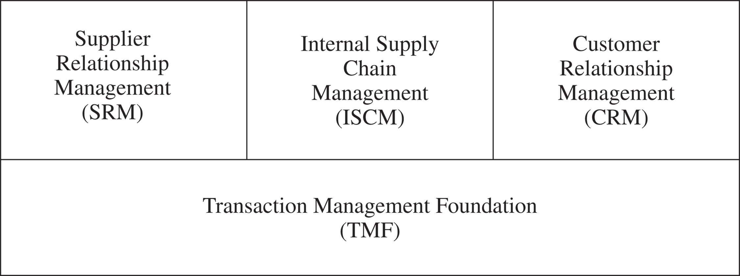
The Supply Chain
Macro Processes
Figure 17-1

Slide 8
Customer Relationship Management
The processes that take place between an enterprise and its customers downstream in the supply chain
Marketing
Sell
Order management
Call/service center

Slide 9
Internal Supply Chain Management
Strategic Planning
Demand Planning
Supply Planning
Fulfillment
Field Service
There must be strong integration between the ISCM and CRM macro processes

Slide 10
Supplier Relationship Management
Design Collaboration
Source
Negotiate
Buy
Supply Collaboration
There is a natural fit between ISCM and SRM processes

Slide 11
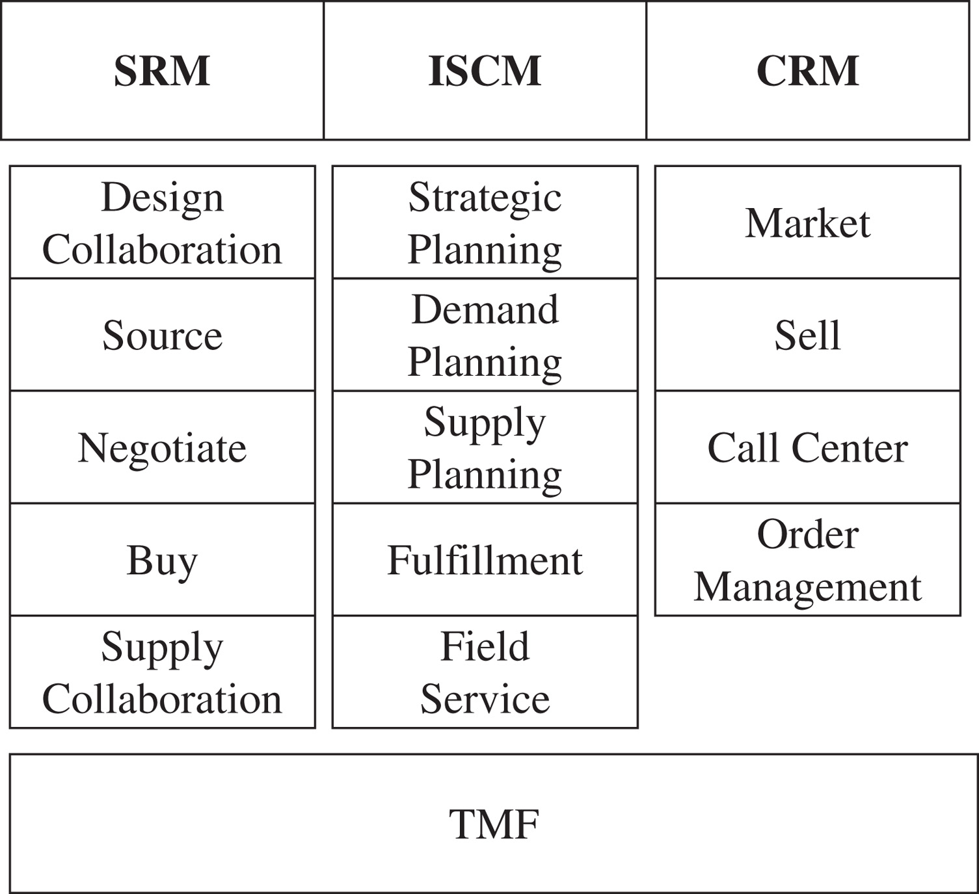
Supplier Relationship Management
Figure 17-2

Slide 12
The Transaction Management Foundation
Early ERP systems focused on transaction management and process automation
Current focus on improving decision making in the three macro processes

Slide 13
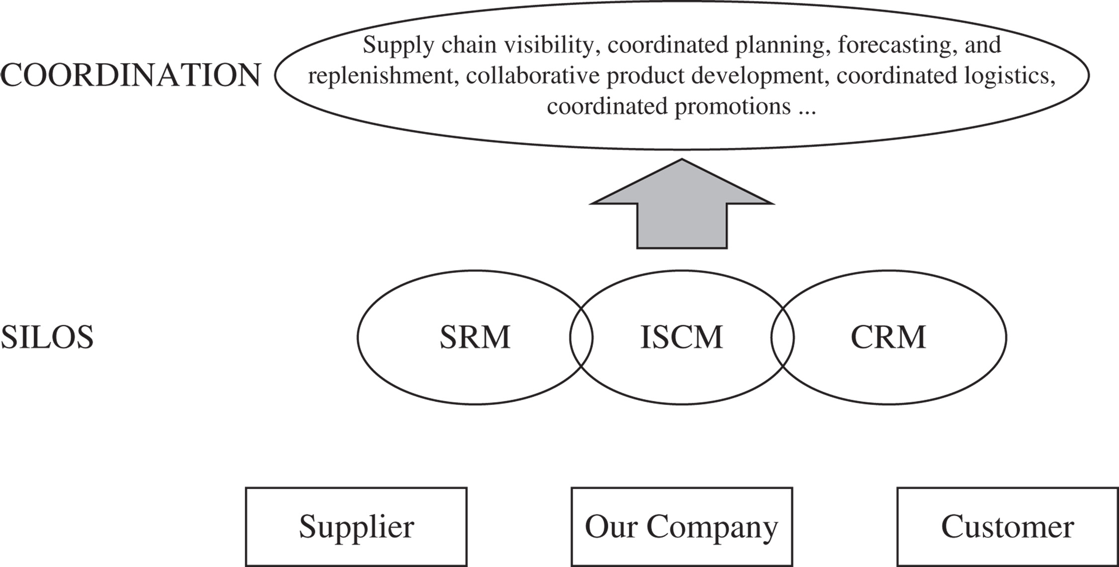
The Transaction Management Foundation
Figure 17-3

Slide 14
The Future of IT in the Supply Chain
The three SCM macro processes will continue to drive the evolution of enterprise software
Three important trends
  The growth in software as a service (SaaS)
  Increased availability of real-time data
  Increased use of mobile technology

Slide 15
Risk Management in IT
Installing new systems
  Revised business processes
  Integration
Problems can shut down the business
  Software glitches
  Power outages
  Viruses

Slide 16
Risk Management in IT
Mitigating strategies
  Install new IT systems in an incremental fashion
  Run duplicate systems to make sure the new system is performing well
  Implement only the level of complexity that is needed

Slide 17
Supply Chain IT in Practice
Select an IT system that addresses the company’s key success factors
Take incremental steps and measure value
Align the level of sophistication with the need for sophistication
Use IT systems to support decision making, not to make decisions
Think about the future

Slide 18
Summary of Learning Objectives
Understand the importance of information and information technology in a supply chain
Know at a high level how each supply chain driver uses information
Understand the major applications of supply chain information technology and the processes that they enable

Slide 19
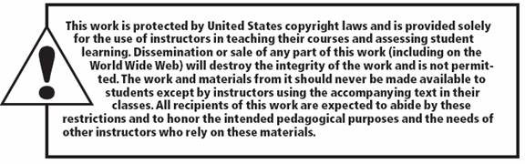
All rights reserved. No part of this publication may be reproduced, stored in a retrieval system, or transmitted, in any form or by any means, electronic, mechanical, photocopying, recording, or otherwise, without the prior written permission of the publisher.
Printed in the United States of America.

