Slide 1
Network Models
CH 06

Slide 2
DEFINITION OF NETWORK

Slide 3
definition
A network consists of a set of nodes linked by arcs (or brances).

Slide 4
Example
Design of an offshore natural-gas pipeline network connecting well heads in the Gulf of Mexico to an inshore delivery point. The objective of the model is to minimize the cost of constructing the pipeline.
Determination of the shortest route between two cities in an existing network of roads.
Determination of the maximum capacity (in tons per year) of a coal slurry pipeline network joining coal mines in Wyoming with power plants in Houston. (Slurry pipelines transport coal by pumping water through specially designed pipes.)
Determination of the time schedule (start and completion dates) for the activities of a construction project.
Determination of the minimum-cost flow schedule from oil fields to refineries through a pipeline network.

Slide 5
Network optimization algorithms
There are variety of network optimization algorithm, and this chapter present 4 of these:
Minimal spanning tree (situation 1)
Shortest-route algorithm (situation 2)
Maximal-flow algorithm (situation 3)
Critical path (CPM) algorithm (situation 4)

Slide 6
a. Minimal spanning tree algorithm
The minimal spanning tree algorithm deals with linking the nodes of a network, directly or indirectly, usning the shortest total length of connecting branches.

Slide 7
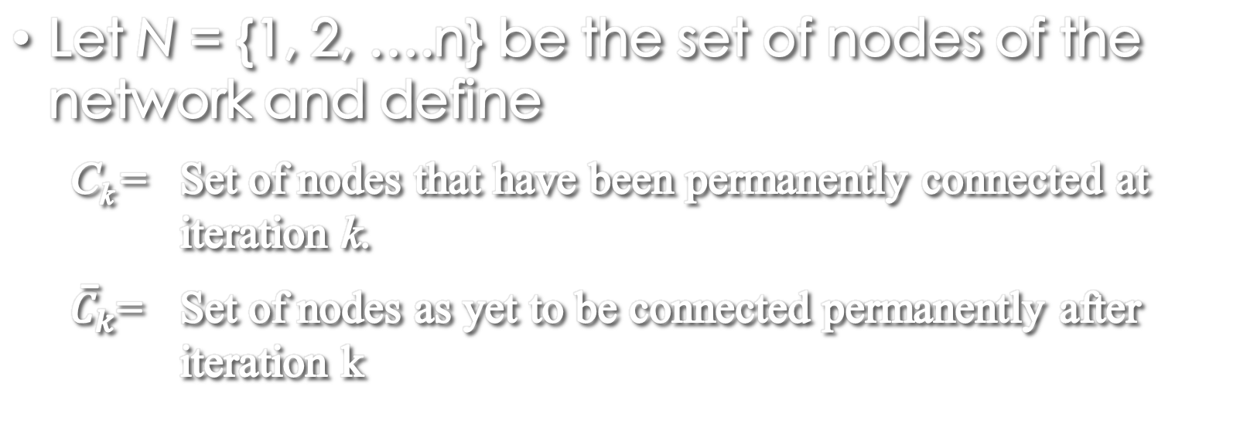
The step of the procedure
Let N = {1, 2, ….n} be the set of nodes of the network and define
  C_{k} = Set of nodes that have been permanently connected at iteration k.
  ${\overline{C}}_{k}$= Set of nodes as yet to be connected permanently after iteration k

Slide 8
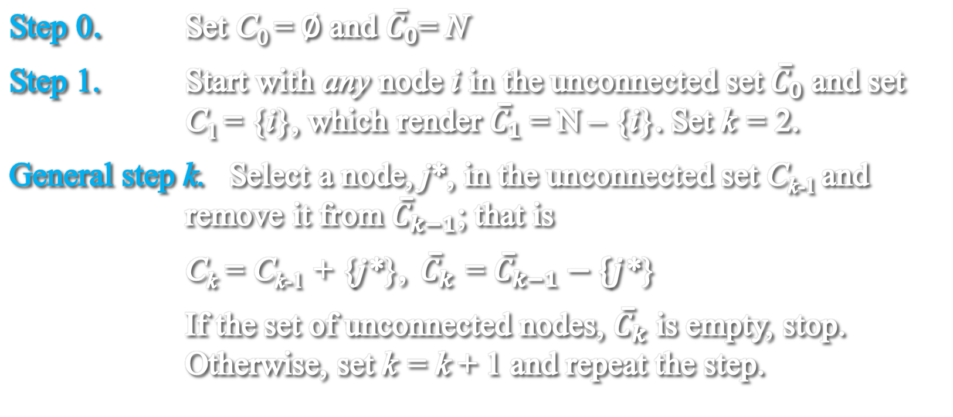
The step of the procedure
Step 0. Set C₀ = $∅$ and ${\overline{C}}_{0}$= N
Step 1. Start with any node i in the unconnected set ${\overline{C}}_{0}$ and set C₁ = {i}, which render ${\overline{C}}_{1}$ = N – {i}. Set k = 2.
General step k. Select a node, j*, in the unconnected set C_{k-1} and remove it from ${\overline{C}}_{k−1}$; that is
C_{k} = C_{k-1} + {j*}, ${\overline{C}}_{k}$ = ${\overline{C}}_{k−1}−\{j$*}
If the set of unconnected nodes, ${\overline{C}}_{k}$ is empty, stop. Otherwise, set k = k + 1 and repeat the step.

Slide 9
example
5
3
2
Midwest TV Cable Company is in the process of providing cable service to five new housing development areas. Figure 6.6 depicts possible TV linkages among the five areas. The cable miles are shown on each arc. Determine the most economical cable network.
6
1
4
9
1
3
10
6
5
5
8
7
4
3

Slide 10


$${\overline{C}}_{1}$$
$${\overline{C}}_{2}$$
5
5
3
2
2
C₂
6
1
1
4
9
C₁
9
1
3
1
3
5
6
5
6
7
7
4
4
Iteration 1
Iteration 2

Slide 13
b. shortest-route problem
The shortest-route problem determines the shortest route between a source and destination in a transportation network.
Other situations can be representated by the same model, as illustrated by the following example.

Slide 14
example
RentCar is developing a replacement policy for its car fleet for a 4-year planning horizon. At the start of each year, a decision is made as to whether a car should be kept in operation or replaced. A car must be in service a minimum of 1 year and a maximum of 3 years. The following table provides the replacement cost as a function of the year a car is acquired and the number of years in operations.
Equipment Acquired at start of year | Replacement cost ($) for given years in operation
 | 1 | 2 | 3
1 | 4000 | 5400 | 9800
2 | 4300 | 6200 | 8700
3 | 4800 | 7100 | -
4 | 4900 | - | -

Slide 15
The problem can be formulated as a network in which nodes 1 to 5 represent the start of years 1 to 5. Arcs from node 1 (year 1) can reach only nodes 2, 3, and 4 because a car must be in operations between 1 and 3 years. The arcs from the other nodes can be interpreted similarly. The length of each are equals the repolacement cost. The solution of the problem is equivalent to finding the shortest route between node 1 and 5.
9800
5400
7100
1
2
3
4
5
4000
4300
4800
4900
6200
8700

Slide 16
Example reliable route
IQ Smart drives daily to work. Having just completed a course in network analysis, Smart is able to determine the shortest route to work. Unfortunately, the selected route is heavily patrolled by police, and with all the fines paid for speeding, the shortest route may not be the best choice. Smart has thus decided to choose a route that maximizes the probability of not being stopped by police.
The network in figure 6.11 shows the possible routes between home and work, and the associated probabilities of not being stopped on each segment. The probability of not being stopped on a route is the p;roduct of the probabilities associated with its segments. The probability of not being stopped on a route is the product of the probabilities associated with its segments. For example, the probability of not receiving a fine on the route 1-3-5-7 is .9 x .3 x .25 = .0675. Smart’s objective is to select the route that maximizes the probability of not being fined.

Slide 17
.8
.35
Figure 6.11
2
4
6
.5
.2
.6
.4
7
1
.1
.9
.25
3
.3
5
The problem can be formulated as a shortest-route model by using a logarithmic transformation that converts the product probability into the sum of the logarithms of probabilities, that is, if p_{1k} = p₁ x p₂ x … x p_{k} is the probability of not being stopped, then log p_{1k} = log p₁ + log p₂ + … + log p_{k}
Mathematially, the maximization of log p_{1k} is equivalent to the minimization of – log p_{1k}. Because log p_{ik} ≤ 0, the maximization of log p_{ik} is equivalent to the minimization of – log p_{ik} . Using this transformation, the individual probabilities p_{j} in Figurre 6.11 are replaced with –log p_{ik} for all j in the network, thus yielding the shortest-route network in Figure 6.12

Slide 18
.09691
.45593
Figure 6.12
2
4
6
.30103
.69897
.22185
.39794
7
1
1.0
.04576
.60206
3
.52288
5
the shortest route in Figure 6.12 is defined by the nodes 1,3,5, and 7 with a corresponding "length" of 1.1707 (= -log P_{I7}). Thus, the maximum probability of not being stopped is P₁₇ = .0675 only, not very encouraging news for Smart!

Slide 19
Shortest-route algorithm
This time we will discusse two algorithm:
Dijkstra’s algorithm
Floyd’s algorithm

Slide 20
Dijkstra’s Algorithm
Dijkstra’s Algorithm is designed to determine the shortest routes between the source node and every other node in the network.
Let u_{i} be the shortest distance from source node 1 to node i, and define d_{ij} (≥0) fas the length of (ij). Then the algorithm defines the label for an immediately succeeding node j as
[u_{j}, i] = [u_{i} + d_{ij}, i], d_{ij} ≥ 0
The label for the starting node is [0, −], indicating that the node has no predecessor.

Slide 21
Dijkstra’s Algorithm
Node labels in Dijkstra’s algorithm are of two types: temporary and permanent. A temporary label is modified if a shorter route to a node can be found. If no better route can be found, the status of the temporary label is changed to permanent.
Step 0. Label the source node (node 1) with the permanent label [0, -]. Set i = l.
Step 1. (a) Compute the temporary labels [u_{i} + d_{ij} , i] for each node j that can be reached from node i, provided j is not permanently labeled. If node j is already labeled with [u_{j}, k] through another node k and if u_{i} + d_{ij} < u_{j}, replace [u_{j}, k] with [u_{i} + d_{ij} , i].
(b) If all the nodes have permanent labels, stop. Otherwise, select the label [u_{r}> s] having the shortest distance (= u_{r}) among all the temporary labels (break ties arbitrarily). Set i = r and repeat step i.

Slide 22
Floyd’s Algorithm
Floyd's algorithm is more general than Dijkstra's because it determines the shortest route between any two nodes in the network. The algorithm represents an n-node network as a square matrix with n rows and n columns. Entry (i, j) of the matrix gives the distance d_{ij} from node i to node j, which is finite if i is linked directly to j, and infinite otherwise.
The idea of Floyd's algorithm is straightforward. Given three nodes i, j, and k in Figure 6.19 with the connecting distances shown on the three arcs, it is shorter to reach j from i passing through k if
d_{ik} + d_{kj} < d_{ij}

Slide 23
k
d_{kj}
d_{ik}
FIGURE 6.19
i
j
d_{ij}
In this case, it is optimal to replace the direct route from i → j with the indirect route i → k → j. This triple operation exchange is applied systematically to the network using the following steps:
Step 0. Define the starting distance matrix D₀ and node sequence matrix S₀ as given below. The diagonal elements are marked with (−) to indicate that they are blocked. Set k = 1.
General step k. Define row k and column k as pivot row and pivot column. Apply the triple operation to each element dij in D_{k-1}, for all i and j. If the condition
d_{ik} + d_{kj} < d_{ij}, (i ≠ k, j ≠ k, and i ≠ j)
is satisfied, make the following changes:
Create D_{k} by replacing d_{ij} in D_{k-1} with d_{ik} + d_{kj}
Create S_{k} by replacing s_{ij} in S_{k-1} with k. Set k = k+1. If k = n+1, stop; else repeat step k.

Slide 24
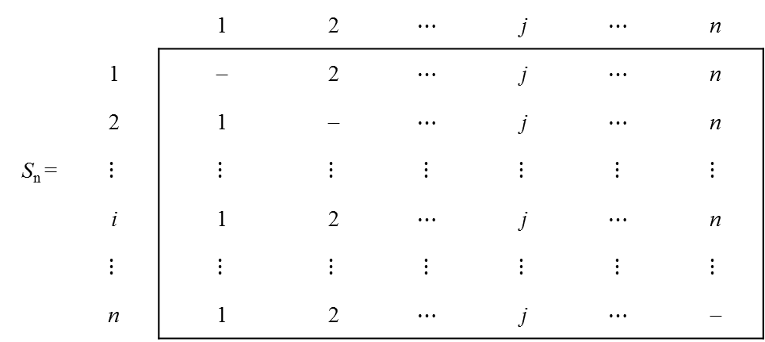
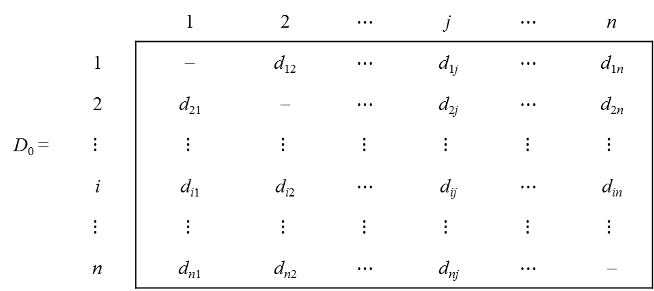
 |  | 1 | 2 | $$⋯$$ | j | $$⋯$$ | n
 | 1 | − | d₁₂ | $$⋯$$ | d_{1j} | $$⋯$$ | d_{1n}
 | 2 | d₂₁ | − | $$⋯$$ | d_{2j} | $$⋯$$ | d_{2n}
D₀ = | $$⋮$$ | $$⋮$$ | $$⋮$$ | $$⋮$$ | $$⋮$$ | $$⋮$$ | $$⋮$$
 | i | d_{i1} | d_{i2} | $$⋯$$ | d_{ij} | $$⋯$$ | d_{in}
 | $$⋮$$ | $$⋮$$ | $$⋮$$ | $$⋮$$ | $$⋮$$ | $$⋮$$ | $$⋮$$
 | n | d_{n1} | d_{n2} | $$⋯$$ | d_{nj} | $$⋯$$ | −
 |  | 1 | 2 | $$⋯$$ | j | $$⋯$$ | n
 | 1 | − | 2 | $$⋯$$ | j | $$⋯$$ | n
 | 2 | 1 | − | $$⋯$$ | j | $$⋯$$ | n
S_{n} = | $$⋮$$ | $$⋮$$ | $$⋮$$ | $$⋮$$ | $$⋮$$ | $$⋮$$ | $$⋮$$
 | i | 1 | 2 | $$⋯$$ | j | $$⋯$$ | n
 | $$⋮$$ | $$⋮$$ | $$⋮$$ | $$⋮$$ | $$⋮$$ | $$⋮$$ | $$⋮$$
 | n | 1 | 2 | $$⋯$$ | j | $$⋯$$ | −

Slide 25
Step k of the algorithm can be explained by representing d_{k-1} as shown in Figure 6.20. Here, row k and column k define the current pivot row and column. Row i represents any of the rows 1, 2, … , and k-1, and row p represents any of the rows k+1, k+2, …, and n. Similarly, column j represents any of the columns 1, 2, …, and k-1, and column q represents any of the columns k+1, k+2, …, and n. The triple operation can be applied as follows. If the sum of the elements on the pivot row and the pivot column (shown by squares) is smaller than the associated intersection element (shown by a circle), then it is optimal to replace the intersection distance by the sum of the pivot distances.
After n steps, we can determine the shortest route between nodes i and j from the matrices D_{n} and S_{n} using the following rules:
From D_{n}, d_{ij} gives the shortest distance between nodes i and j.
From S_{n}, determine the intermediate node k = s_{ij} that yields the route i→k→j. If s_{ik} = k and s_{kj} = j, stop; all the intermediate nodes of the route have been found. Otherwise, repeat the procedure between nodes i and k, and between nodes k and j.

Slide 26
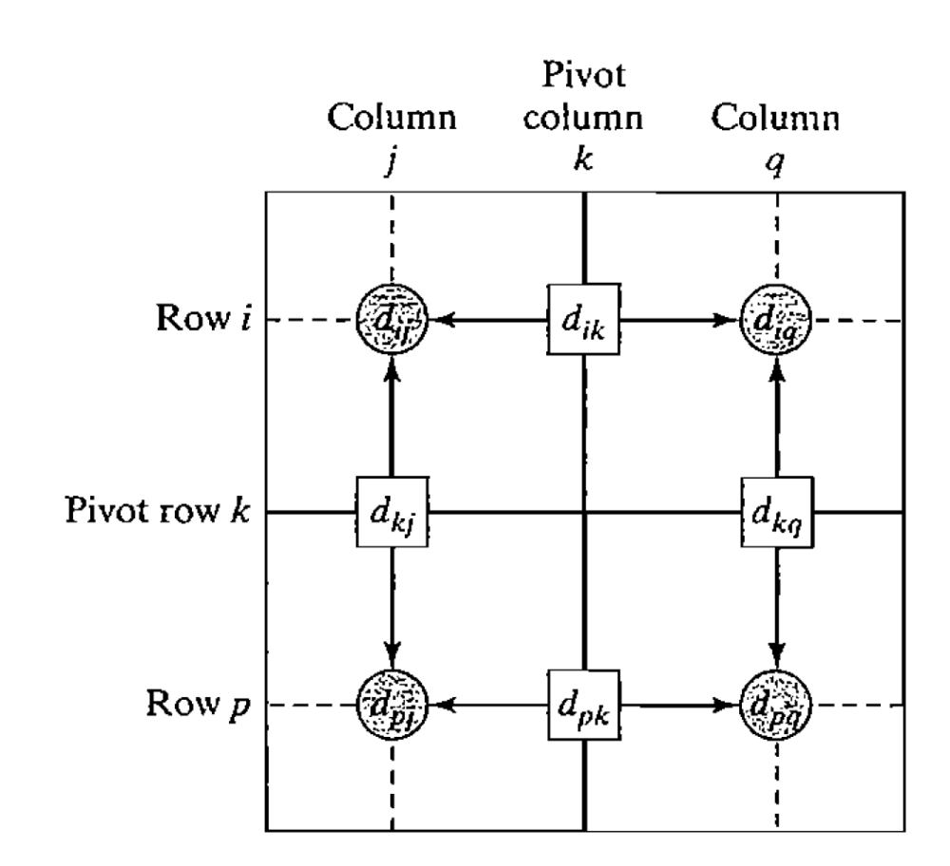
Figure 6.20

Slide 27

c. Maximal flow model
Consider a network of pipelines that transports crude oil from oil wells to refineries. Intermediate booster and pumping stations are installed at appropriate design distances to move the crude in the network. Each pipe segment has a finite maximum discharge rate of crude flow (or capacity).A pipe segment may be uni- or bidirectional, depending on its design. Figure 6.27 demonstrates a typical pipeline network. How can we determine the maximum capacity of the network between the wells and the refineries?
The solution of the proposed problem requires equipping the network with a single source and a single sink by using unidirectional infinite capacity arcs as shown by dashed arcs in Figure 6.27.
Given arc (i, j) with i < j, we use the notation (${\overline{C}}_{ij}$, (${\overline{C}}_{ji}$ ) to represent the flow capacities in the two directions i → j and j → i, respectively. To eliminate ambiguity, we place ${\overline{C}}_{ij}$ on the arc next to node i with ${\overline{C}}_{ij}$ placed next to node j, as shown in Figure 6.28.

Slide 28
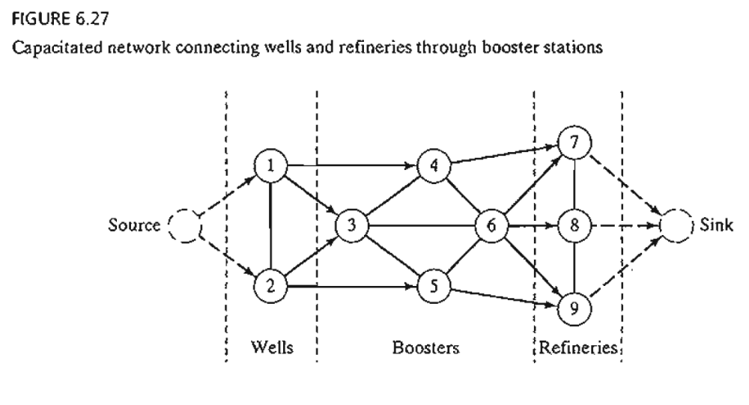
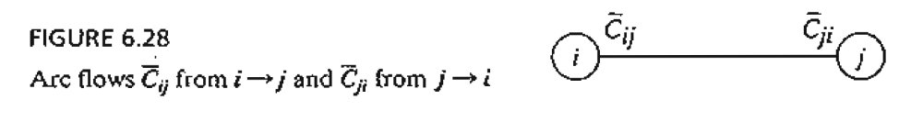

Slide 29

MAXIMAL FLOW ALGORITHM
The maximal flow algorithm is based on finding breakthrough paths with net positive flow between the source and sink nodes. Each path commits part or all of the capacities of its arcs to the total flow in the network.
Consider arc (i, j) with (initial) capacities (${\overline{C}}_{ij}$, (${\overline{C}}_{ji}$). As portions of these capacities are committed to the flow in the are, the residuals (or remaining capacities) of the arc are updated. We use the notation (c_{ij}, c_{ji}) to represent these residuals.

Slide 30
d. Cpm and pert
CPM (Critical Path Method) and PERT (Program Evaluation and Review Technique) are network-based methods designed to assist in the planning, scheduling, and control of projects. A project is defined as a collection of interrelated activities with each activity consuming time and resources. The objective of CPM and PERT is to provide analytic means for scheduling the activities. Figure 6.38 summarizes the steps of the techniques. First, we define the activities of the project, their precedence relationships, and their time requirements. Next, the precedence relationships among the activities are represented by a network. The third step involves specific computations to develop the time schedule for the project. During the actual execution of the project things may not proceed as planned, as some of the activities may be expedited or delayed. When this happens, the schedule must be revised to reflect the realities on the ground. This is the reason for including a feedback loop between the time schedule phase and the network phase, as shown in Figure 6.38

